Slide 1
A trip around the world: All continents are the same…
To embed geography knowledge of the UK and continents using geography skills

Slide 2
All continents are the same…
Do you agree?
Class vote: Yes or No

Slide 3
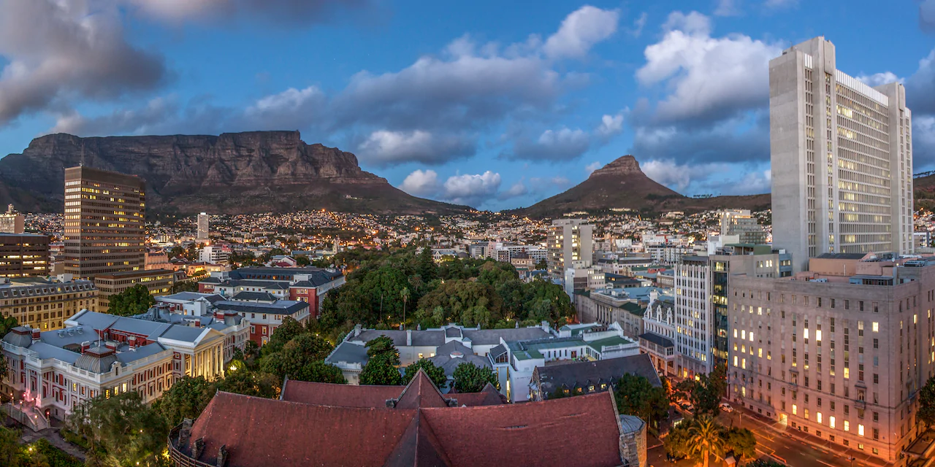
Where are we going today?
Notes:
Cape Town, South Africa

Slide 4
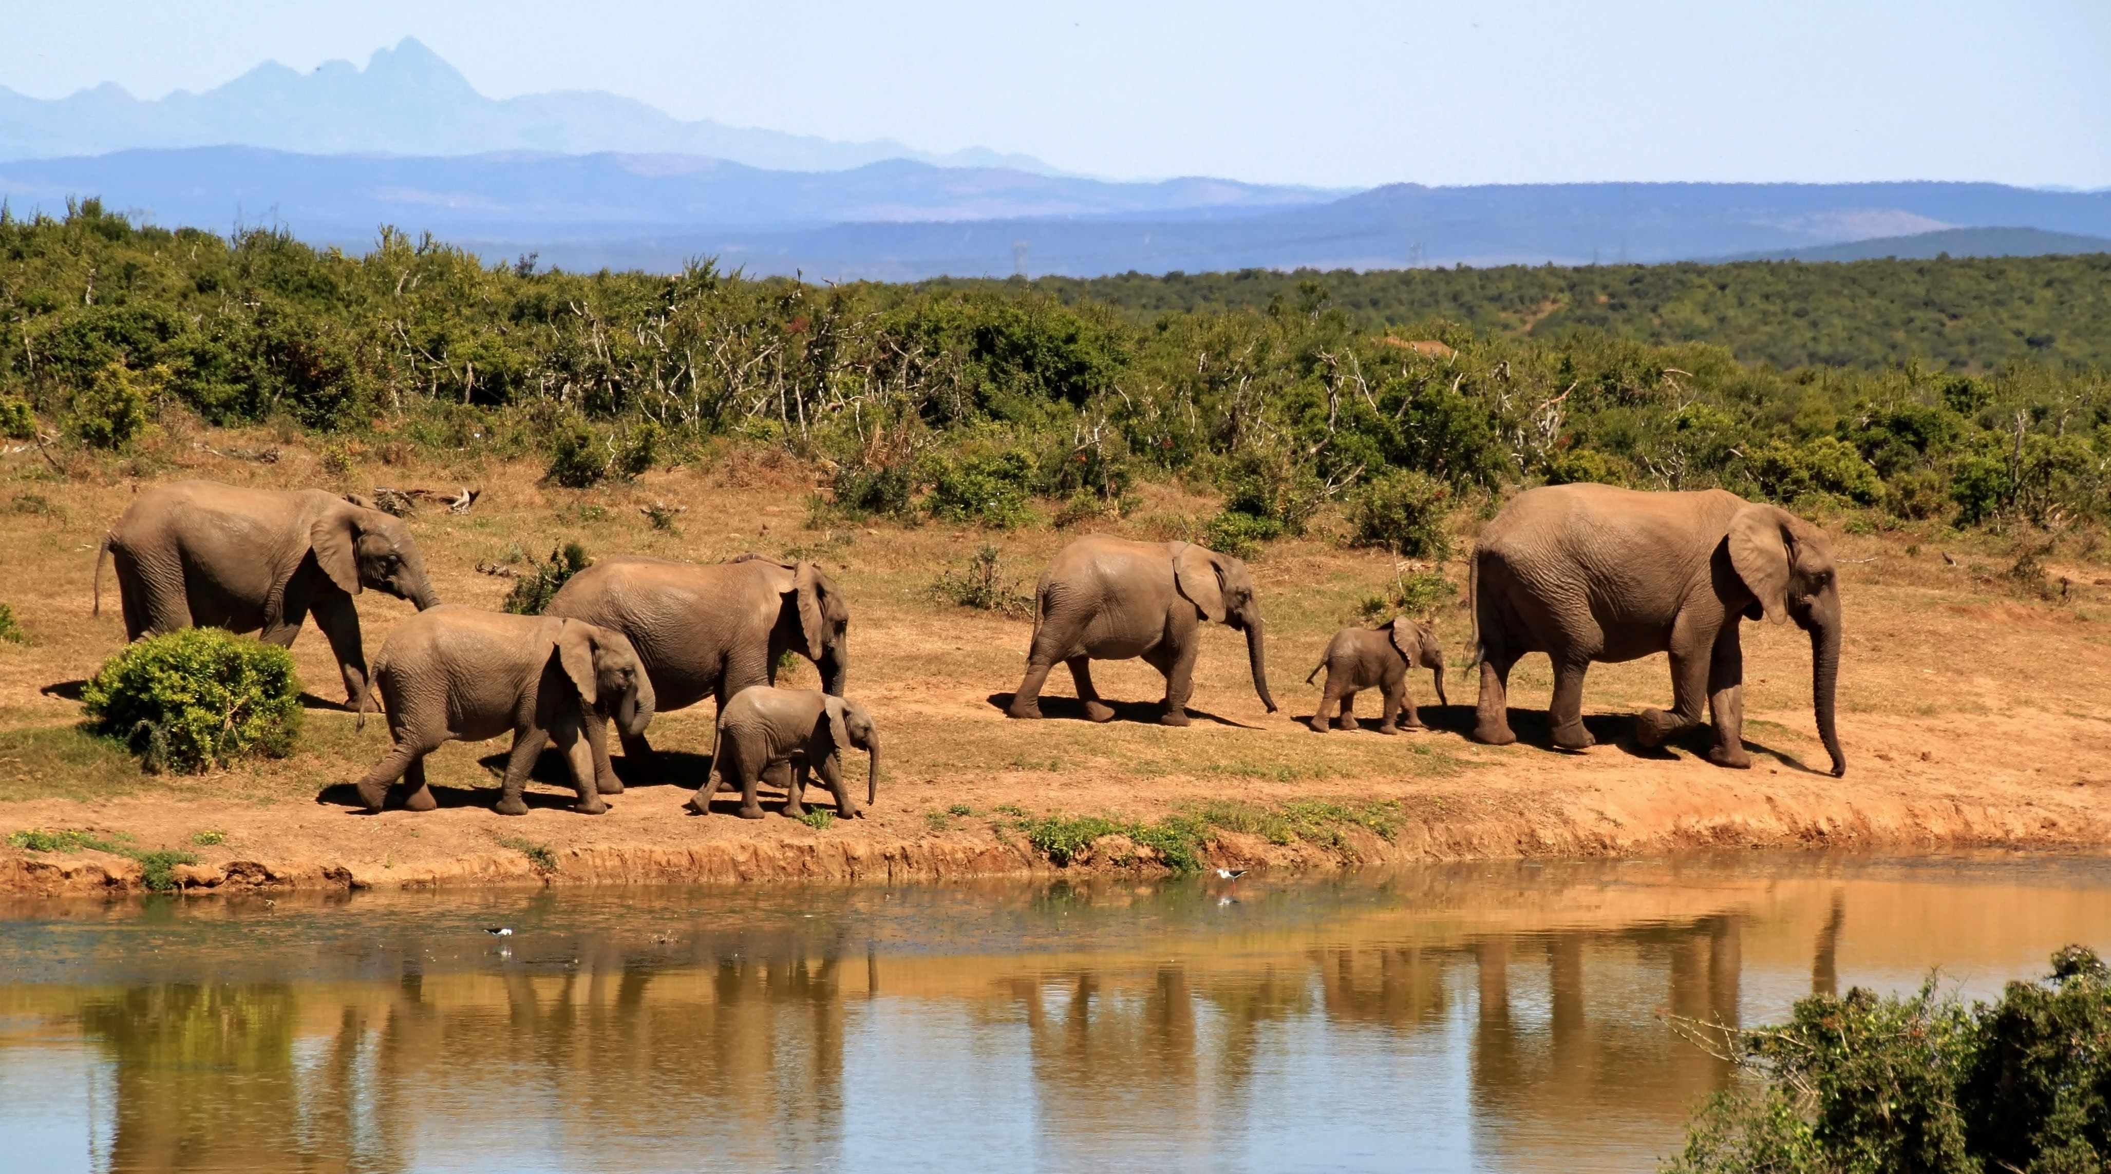
Where are we going today?

Slide 5
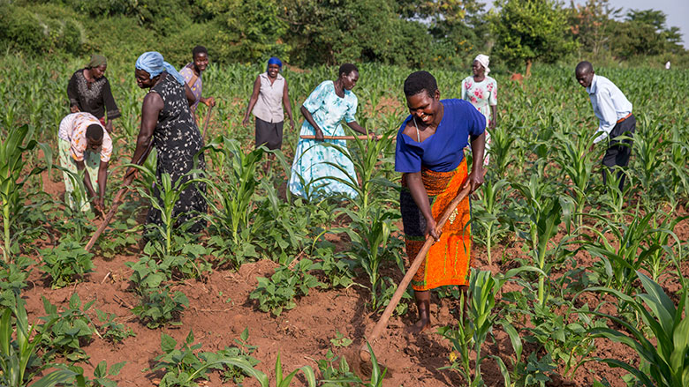
Where are we going today?

Slide 6
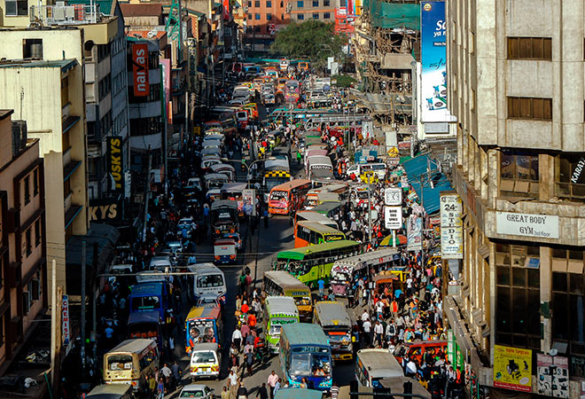
Where are we going today?
Notes:
Nairobi, Kenya

Slide 7
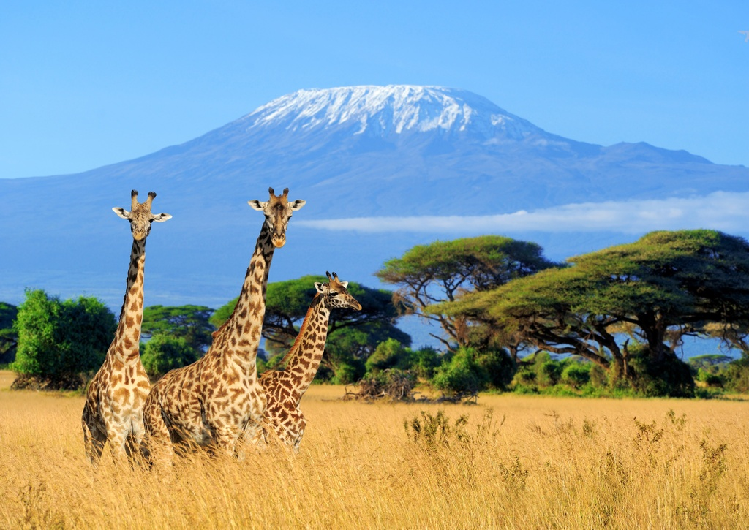
Where are we going today?
Notes:
Nairobi, Kenya

Slide 8
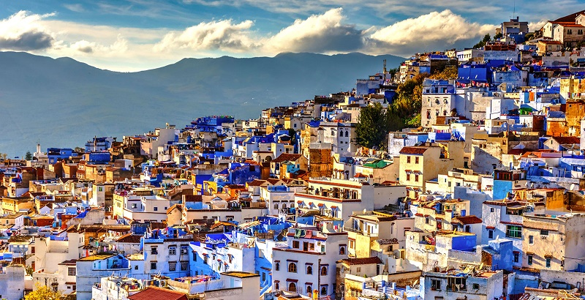
Where are we going today?
Notes:
Nairobi, Kenya

Slide 9
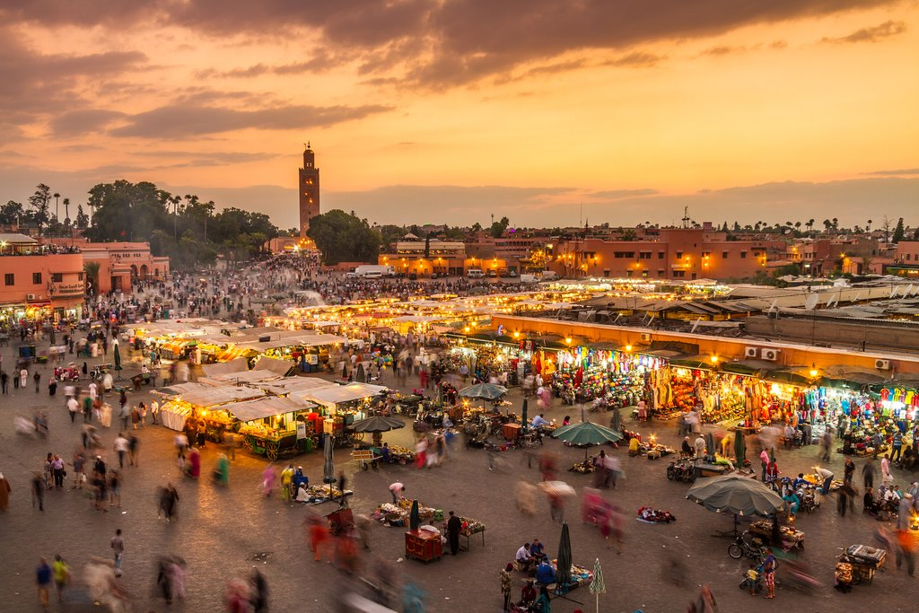
Where are we going today?
Notes:
Nairobi, Kenya

Slide 10
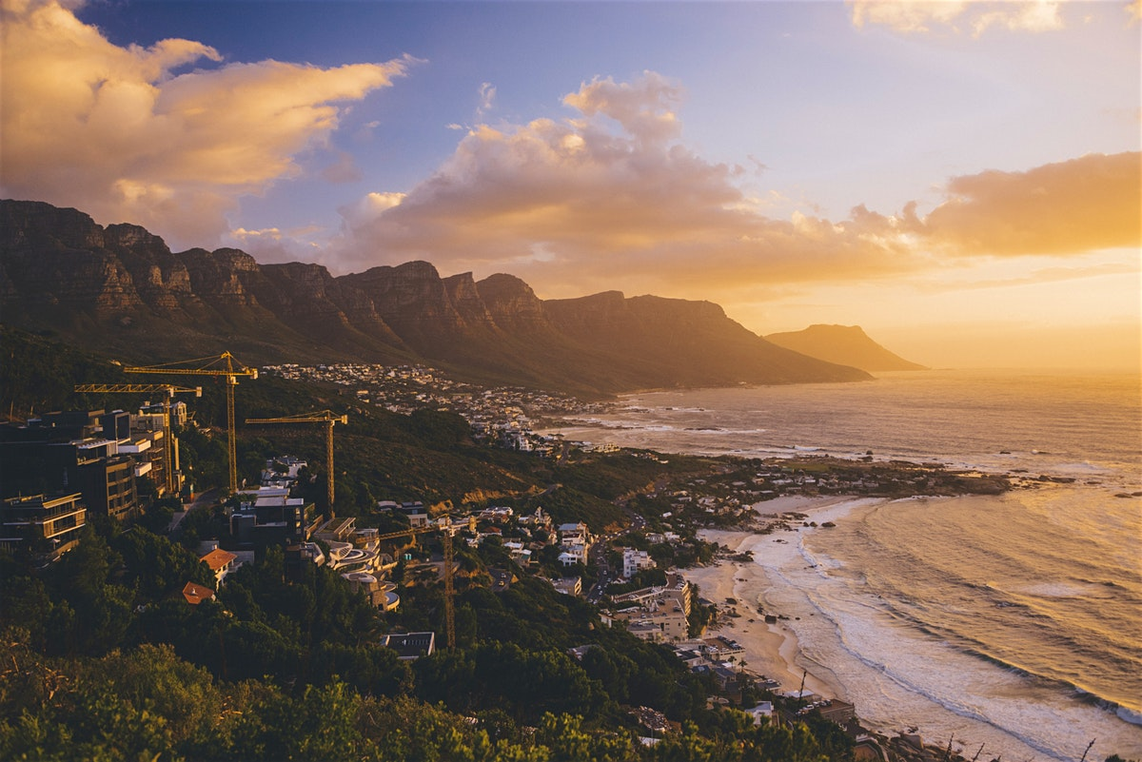
Where are we going today?

Slide 11
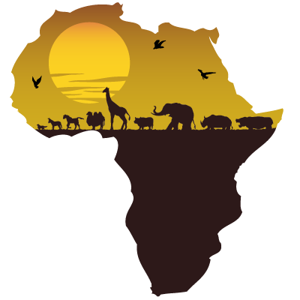
Where are we going today?

Slide 12
Introducing Africa…
https://www.youtube.com/watch?v=Fuc8thqoe1o
Africa is a continent
There are 54 countries in Africa
There are lots of different climates in Africa – including hot deserts and tropical rainforests
The longest river in the world is in Africa – River Nile
The most developed country within Africa is South Africa

Slide 13
Where is Africa?
Blank A3 map of the world continents
Label the continent of Africa and the surrounding oceans
Describe the location of Africa from the UK using the eight point compass directions, continents and oceans.
Extension – which continents, seas and countries would you cross on your way to Africa

Slide 14
What are the major countries in Africa?
Find the following countries on the A4 Africa map; South Africa, Egypt, Kenya, Madagascar, Morocco.
Label the countries on your Africa map
Choose one country and describe where it is to your partner using continent and compass directions.
Describe a journey between all of the countries - you choose where you start.

Slide 15
What is Africa like?
Use the maps to find out about the human and physical patterns of Africa.
Which maps are physical? What does physical mean?
Which maps are human? What does human mean?
Look at the maps using the following TIP
T – Title – what does it say?
I – Information – what does the key show?
P – Pattern – what is the pattern of the map
Physical
Settlement

Slide 16
What is Africa like?
Divide the continent into 3 bands – north, central and south.
Look at the maps using the following TIP
T – Title – what does it say?
I – Information – what does the key show?
P – Pattern – what is the pattern of the map

Slide 17
What is Africa like?
Divide the continent into 3 bands – north, central and south.
Which band is hot desert?
Which band is mixed climates?
Which band is tropical rainforest?
Using a key, accurately locate these on your base map of Africa.

Slide 18
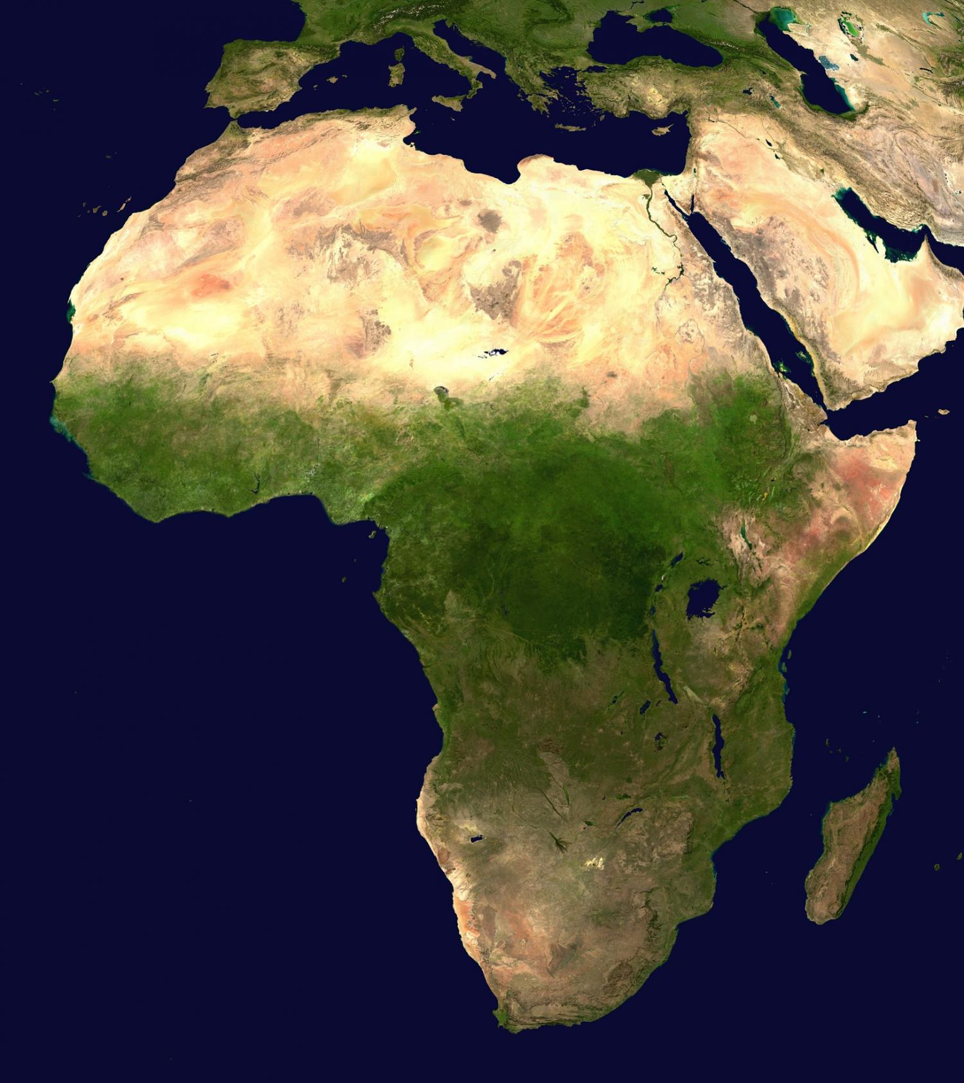

Slide 19
What is Africa like?
Using a key, accurately locate densely populated areas in Africa.
Challenge: Is there a link between the physical environment and where people live? Why do you think this might be?

Slide 20
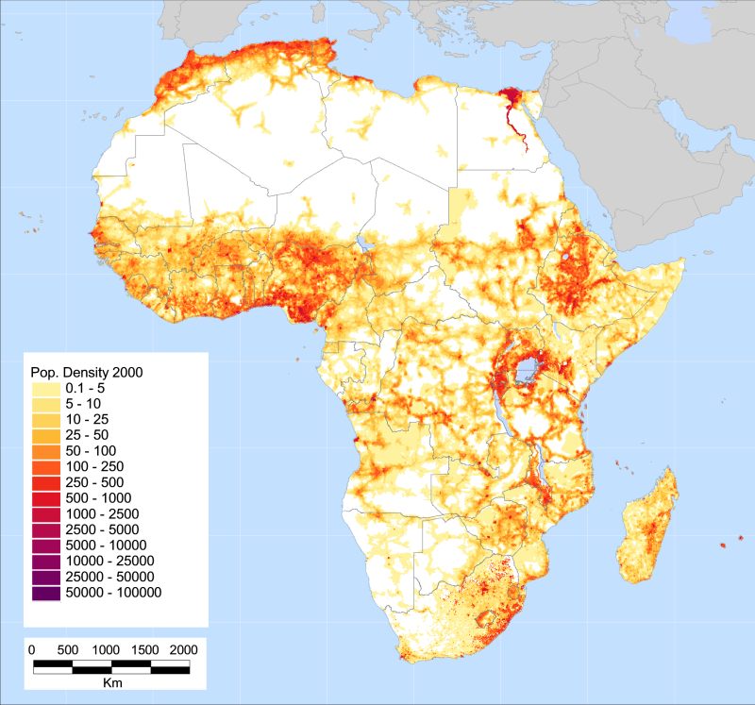

Slide 21
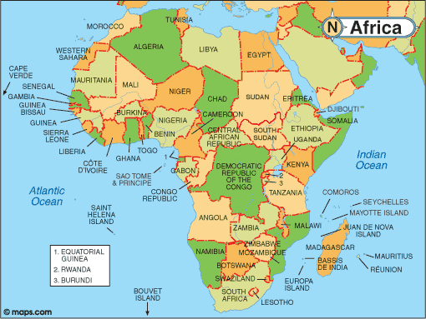

Slide 22
A trip around the world: All continents are the same…
Do you still agree?
Class vote: Yes or No
What evidence have you found this lesson to back up your opinion?

Slide 23
Stretch and Challenge Quiz: True or False (use an Atlas or the additional maps of Africa)
1. Africa is the second largest of the Earth’s seven continents.
2. There are 15 different countries in the continent of Africa.
3. Egypt is a large country in the northwest of Africa.
4. The Equator (0 degrees) and the Greenwich Meridian
(0 degrees) both pass through the continent of Africa.
5. The Sahara Desert stretches right across the northern half of Africa.
6.The River Nile flows from the mountains of Ethiopia southwards to the Mediterranean Sea.

Slide 24
Stretch and Challenge Quiz– ANSWERS
1. Africa is the second largest of the Earth’s seven continents.TRUE
2. There are 15 different countries in the continent of Africa. FALSE
3. Egypt is a large country in the northwest of Africa. FALSE
4. The Equator (0 degrees) and the Greenwich Meridian
(0 degrees) both pass through the continent of Africa. TRUE
5. The Sahara Desert stretches right across the northern half of
Africa. TRUE
6.. The River Nile flows from the mountains of Ethiopia southwards to
the Mediterranean Sea. FALSE

Slide 25
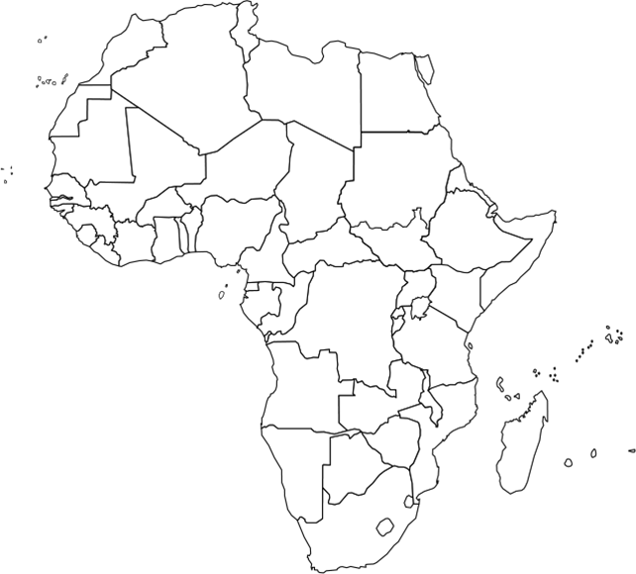
Africa

Slide 26
Key vocabulary
Continents – Europe, Asia, Oceania, Africa, South America, North America (and Antarctica)
Oceans – Arctic, Atlantic, Indian, Pacific, Southern
Directional vocabulary – south, south west, west, north west, north, north east, east, south east,
Positional vocabulary – equator, northern hemisphere, southern hemisphere, Tropic of Cancer, Tropic of Capricorn, Arctic Circle, Antarctic Circle, latitude, longitude, Greenwich Meridian

Slide 27
Work completed by the end of the lesson
Spoken
Describe the location of the continent and a country
Describe a journey to the continent and between countries
Discuss the patterns found on the human and physical maps
Discussion as to whether ‘All continents are the same’
Recorded
Blank A3 world map with continent and ocean labels
Blank A4 map of continent with the countries and seas labelled
Blank A4 map of continent with annotations showing the main human and physical features

