Slide 1
A trip around the world: All continents are the same…
To embed geography knowledge of the UK and continents using geography skills

Slide 2
All continents are the same…
Do you agree?
Class vote: Yes or No

Slide 3
Where is Oceania?

Slide 4
Why is Oceania not just Australia?
There are 14 countries that are in Oceania – how many can you name?

Slide 5
Australia
Fuji
Kiribati
Marshall Islands
Micronesia
Nauru
New Zealand
Palau
Paupa New Guinea
Samoa
Solomon Islands
Tonga
Tuvalu
Vanvatu

Slide 6
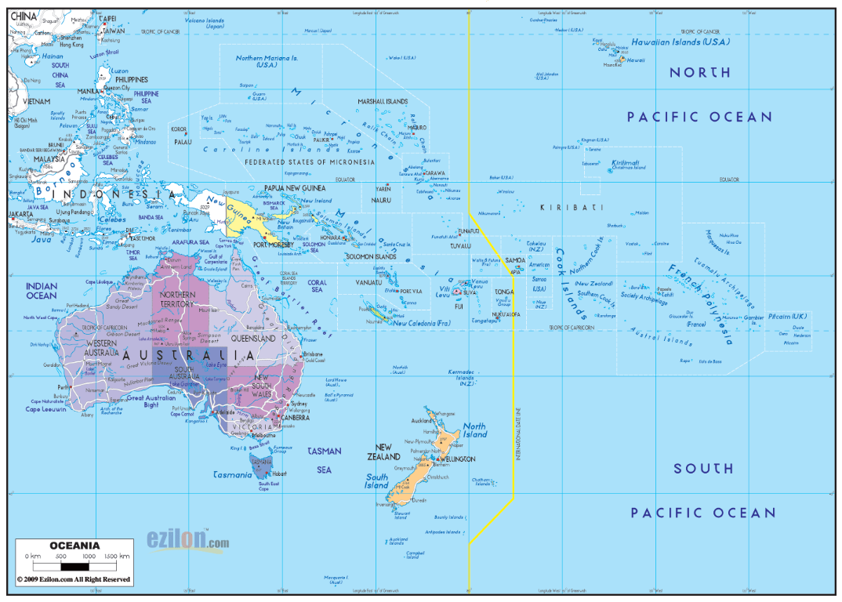

Slide 7
Oracy moment / Karaoke time
https://www.youtube.com/watch?v=ul4io_C-T1Y
To help oracy / pronunciation of countries

Slide 8
Where is Oceania?
Blank A3 map of the world continents
Label Oceania and the surrounding oceans
Describe the location of Oceania from the UK using the eight point compass directions, continents and oceans.
Extension – which continents, seas and countries would you cross on your way to Oceania

Slide 9
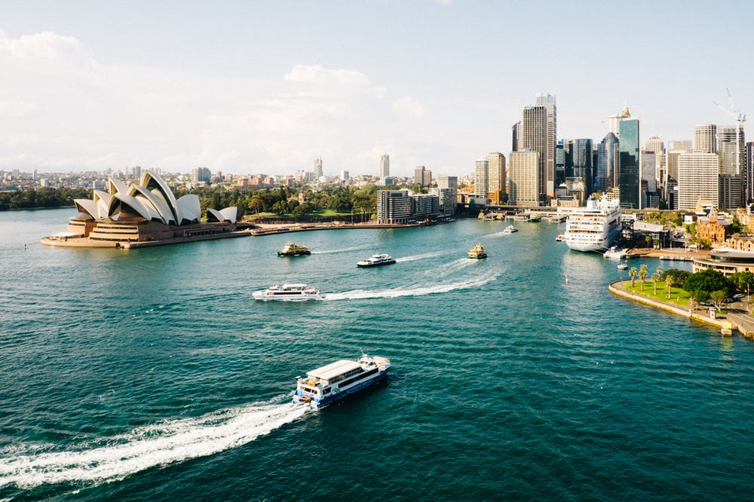
Sydney Harbour

Slide 10
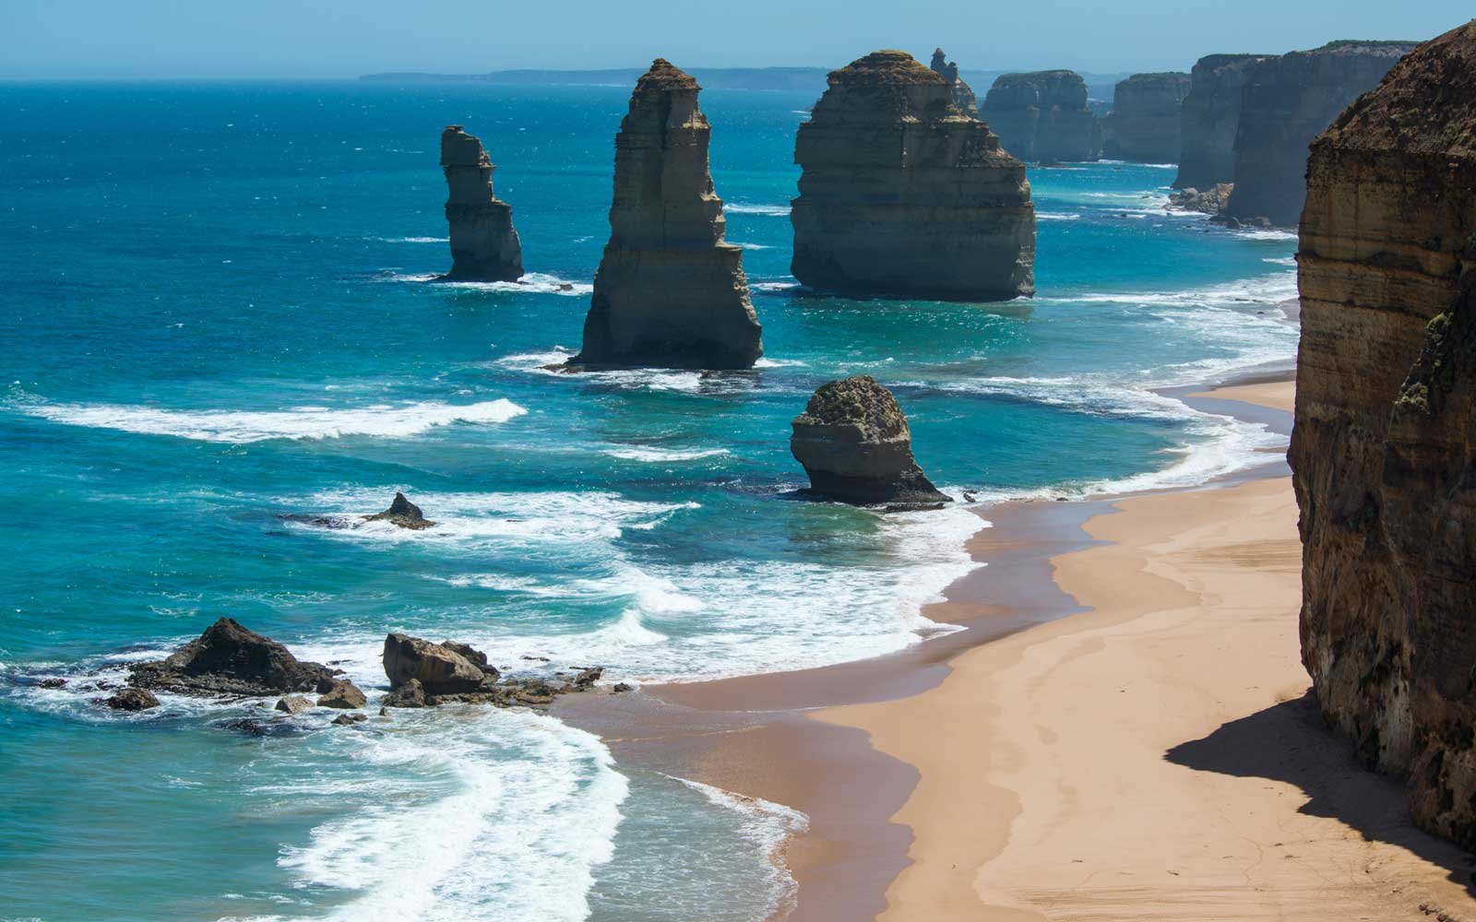
Great Ocean Road, Victoria

Slide 11
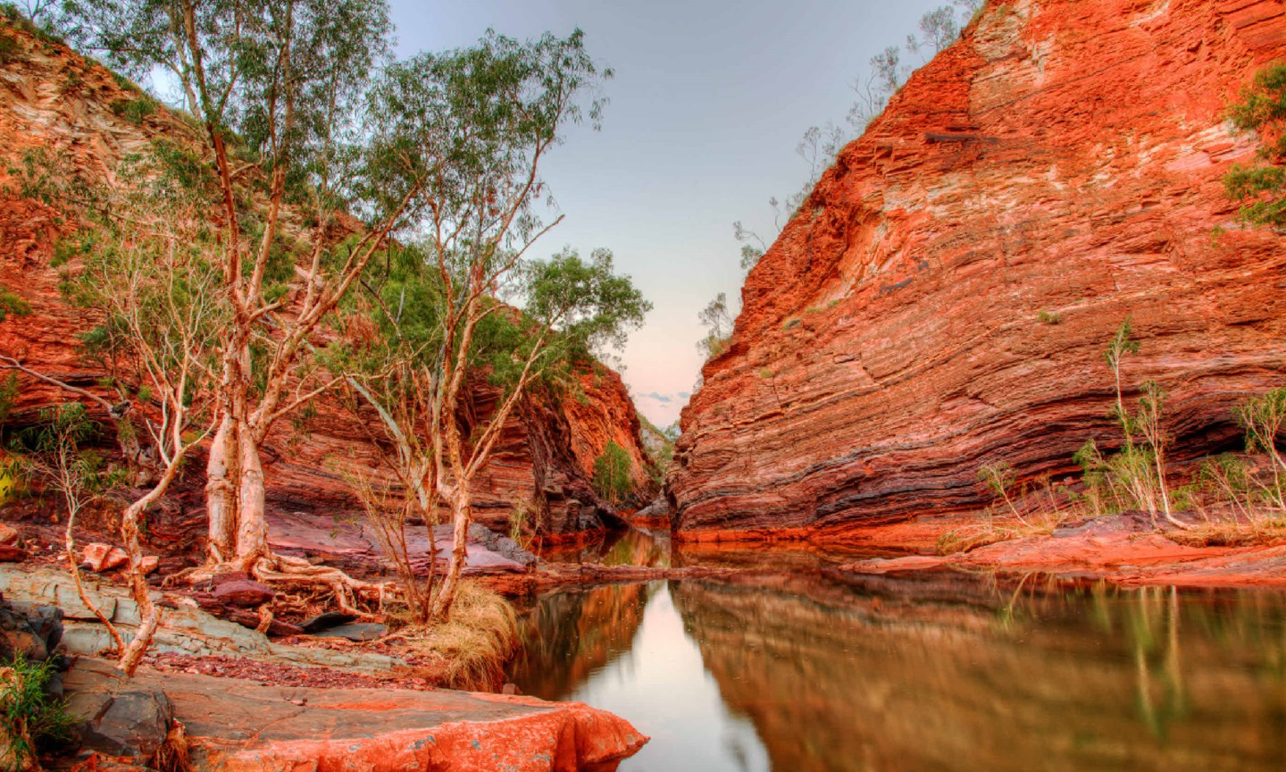
Hamersley Gorge, Karijini National Park

Slide 12
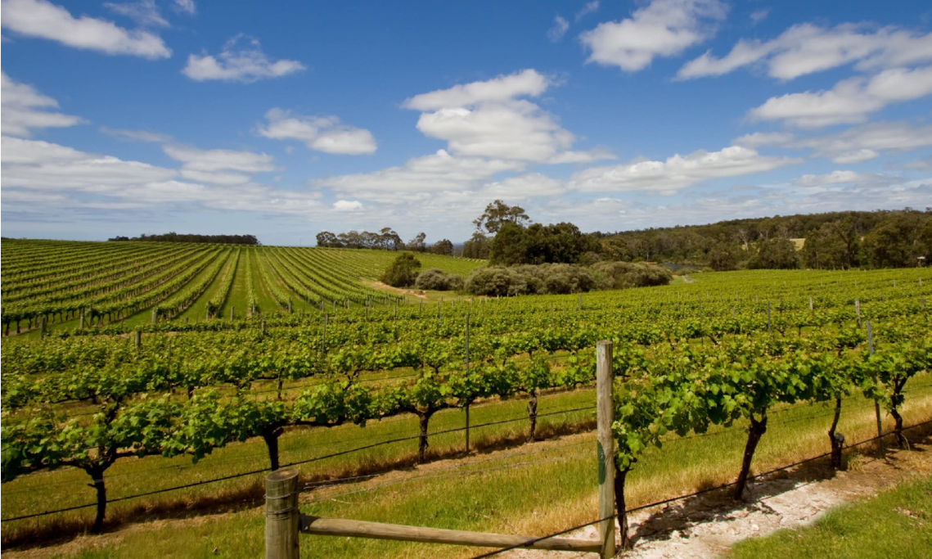
Margaret River Vineyard

Slide 13
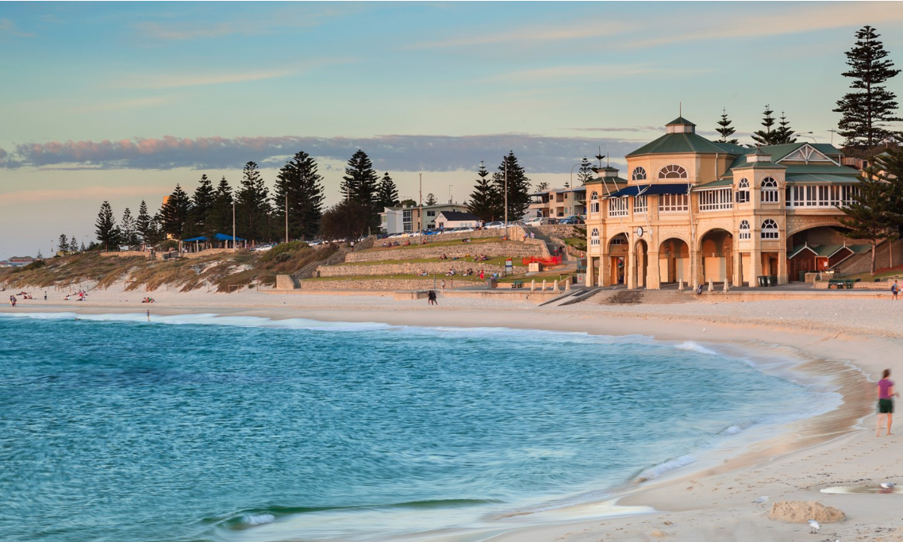
Cottesloe Beach, Perth

Slide 14
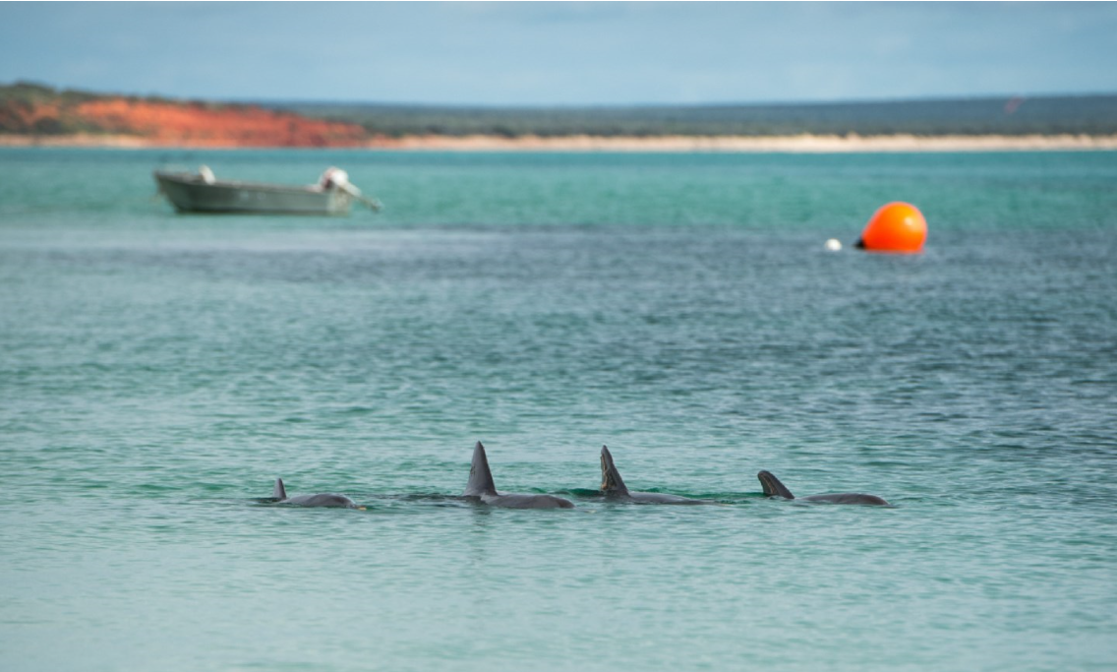
Dolphin’s visting Monkey Mia Bay, Western Australia

Slide 15
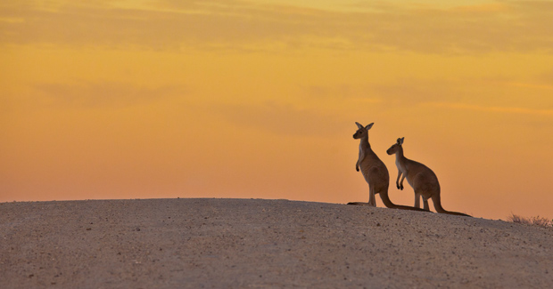
Kangaroo's in Canberra

Slide 16
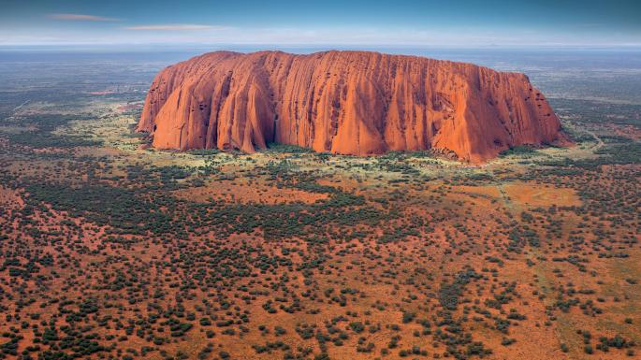
Uluru

Slide 17
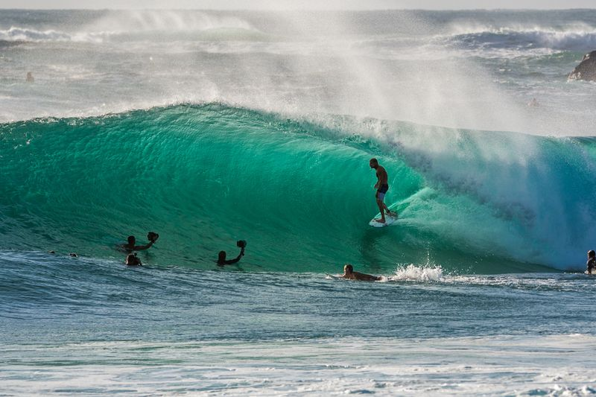
Duranbah, Gold Coast

Slide 18
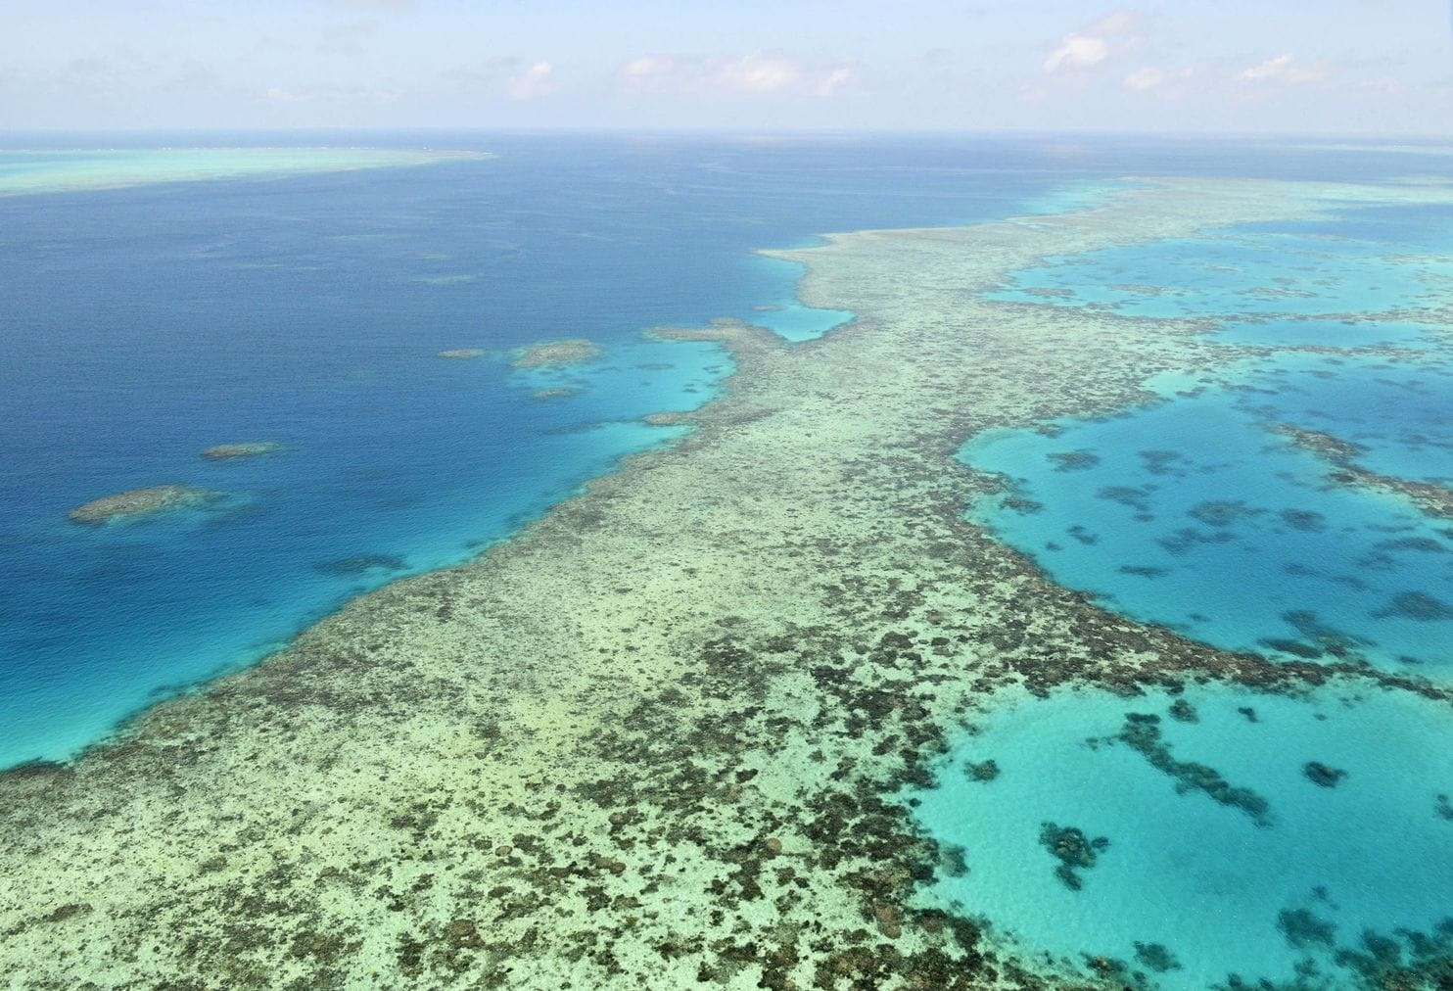
Great Barrier Reef, East Coast

Slide 19
What are the major countries in Oceania?
Find the following countries on the A4 Oceania map: Australia, New Zealand, Papua New Guinea, Vanuatu.
Label the 4 countries on your Oceania map
Choose one country and describe where it is to your partner using continent and compass directions.
Describe a journey between all of the countries - you choose where you start.

Slide 21
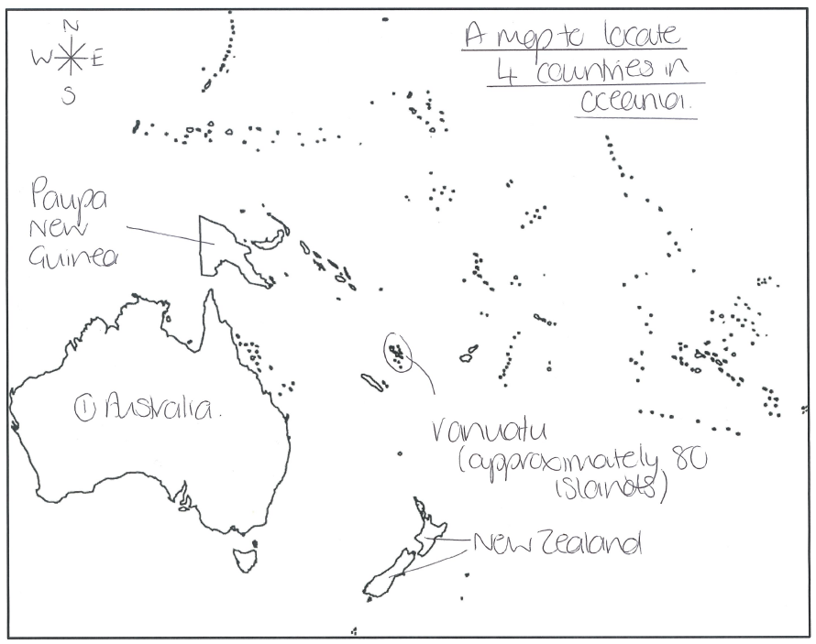

Slide 22
What is Australia like?
Use the maps to find out about the human and physical patterns of Australia.
Which maps are physical? What does physical mean?
Which maps are human? What does human mean?
Look at the maps using the following TIP
T – Title – what does it say?
I – Information – what does the key show?
P – Pattern – what is the pattern of the map
Physical, rainfall, temperature
Population density

Slide 24
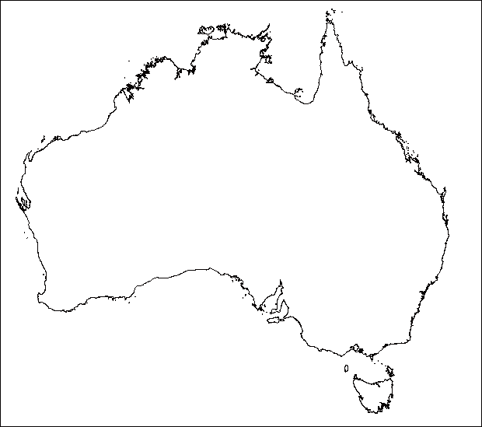

Slide 25
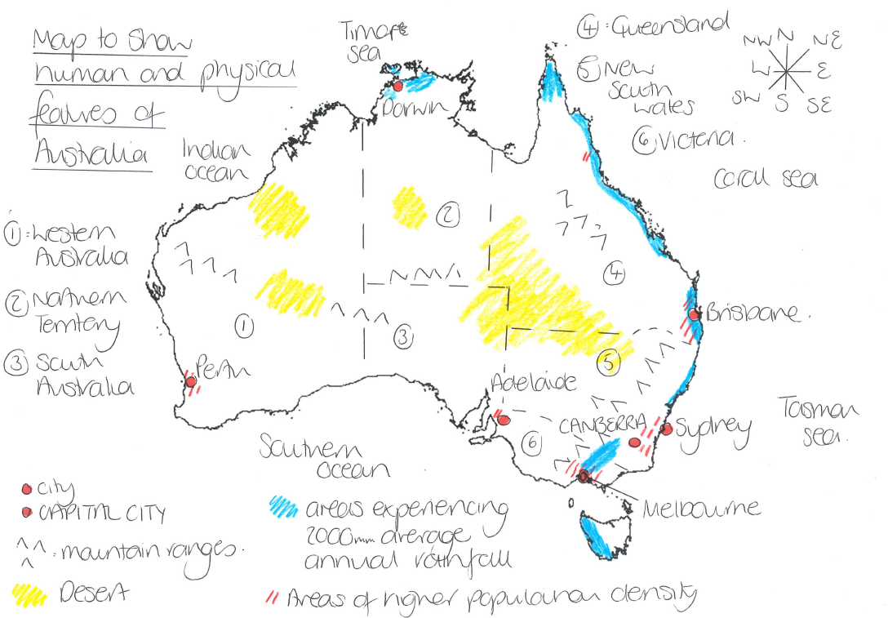

Slide 26
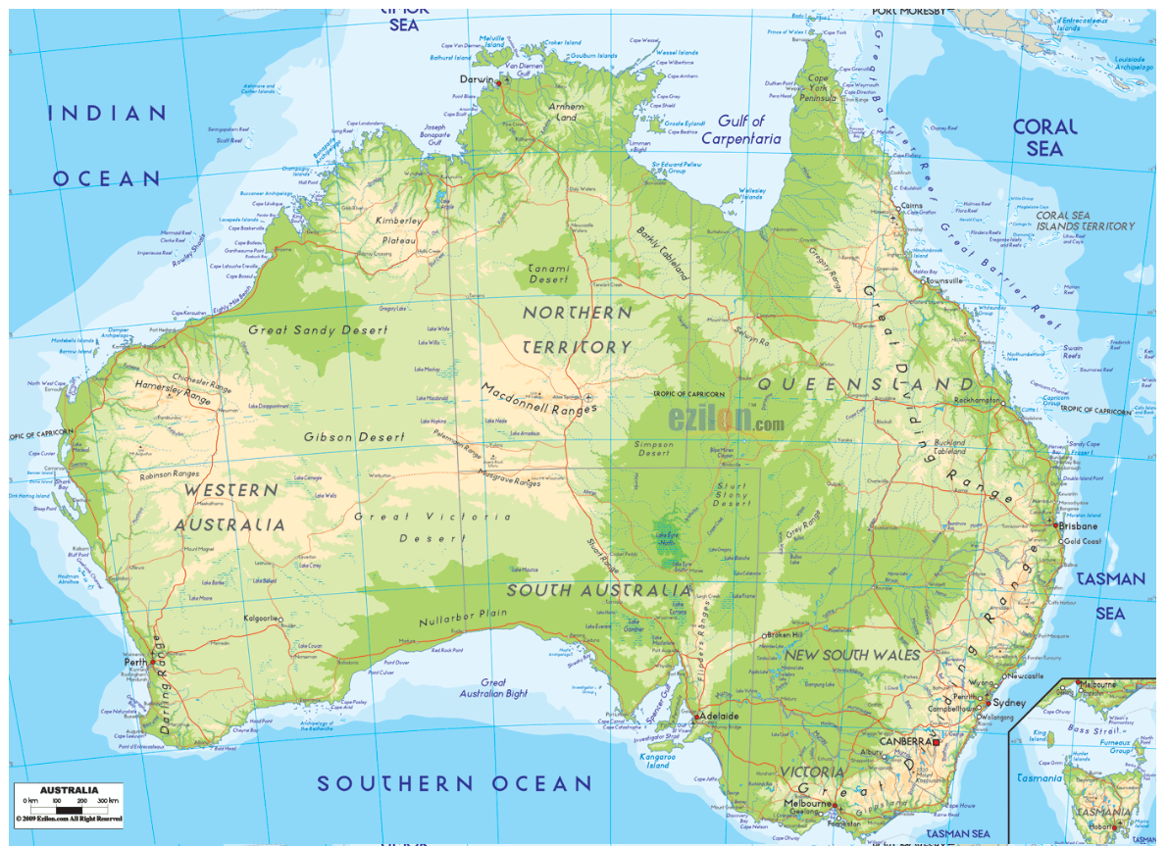
Physical map of Australia

Slide 27
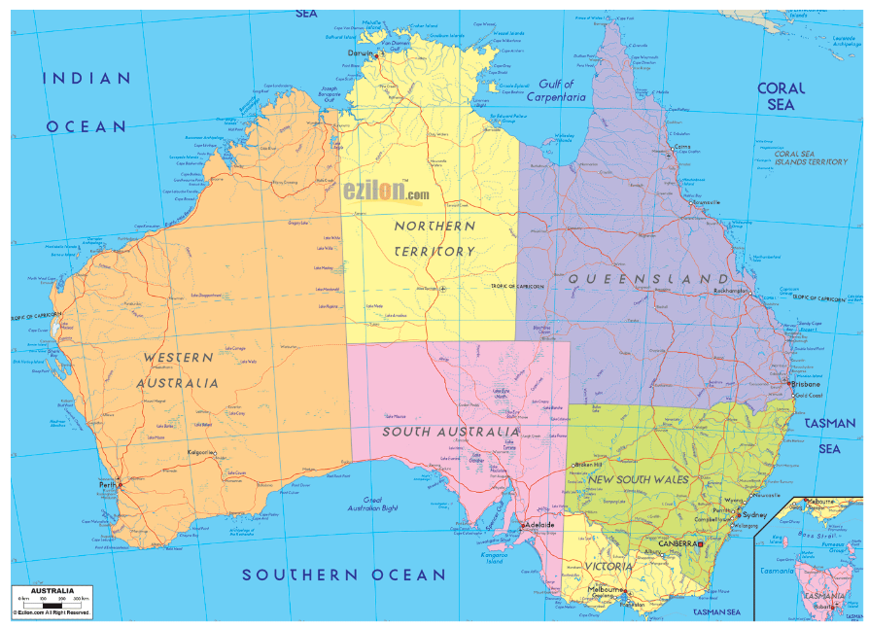
Human map of Australia

Slide 28
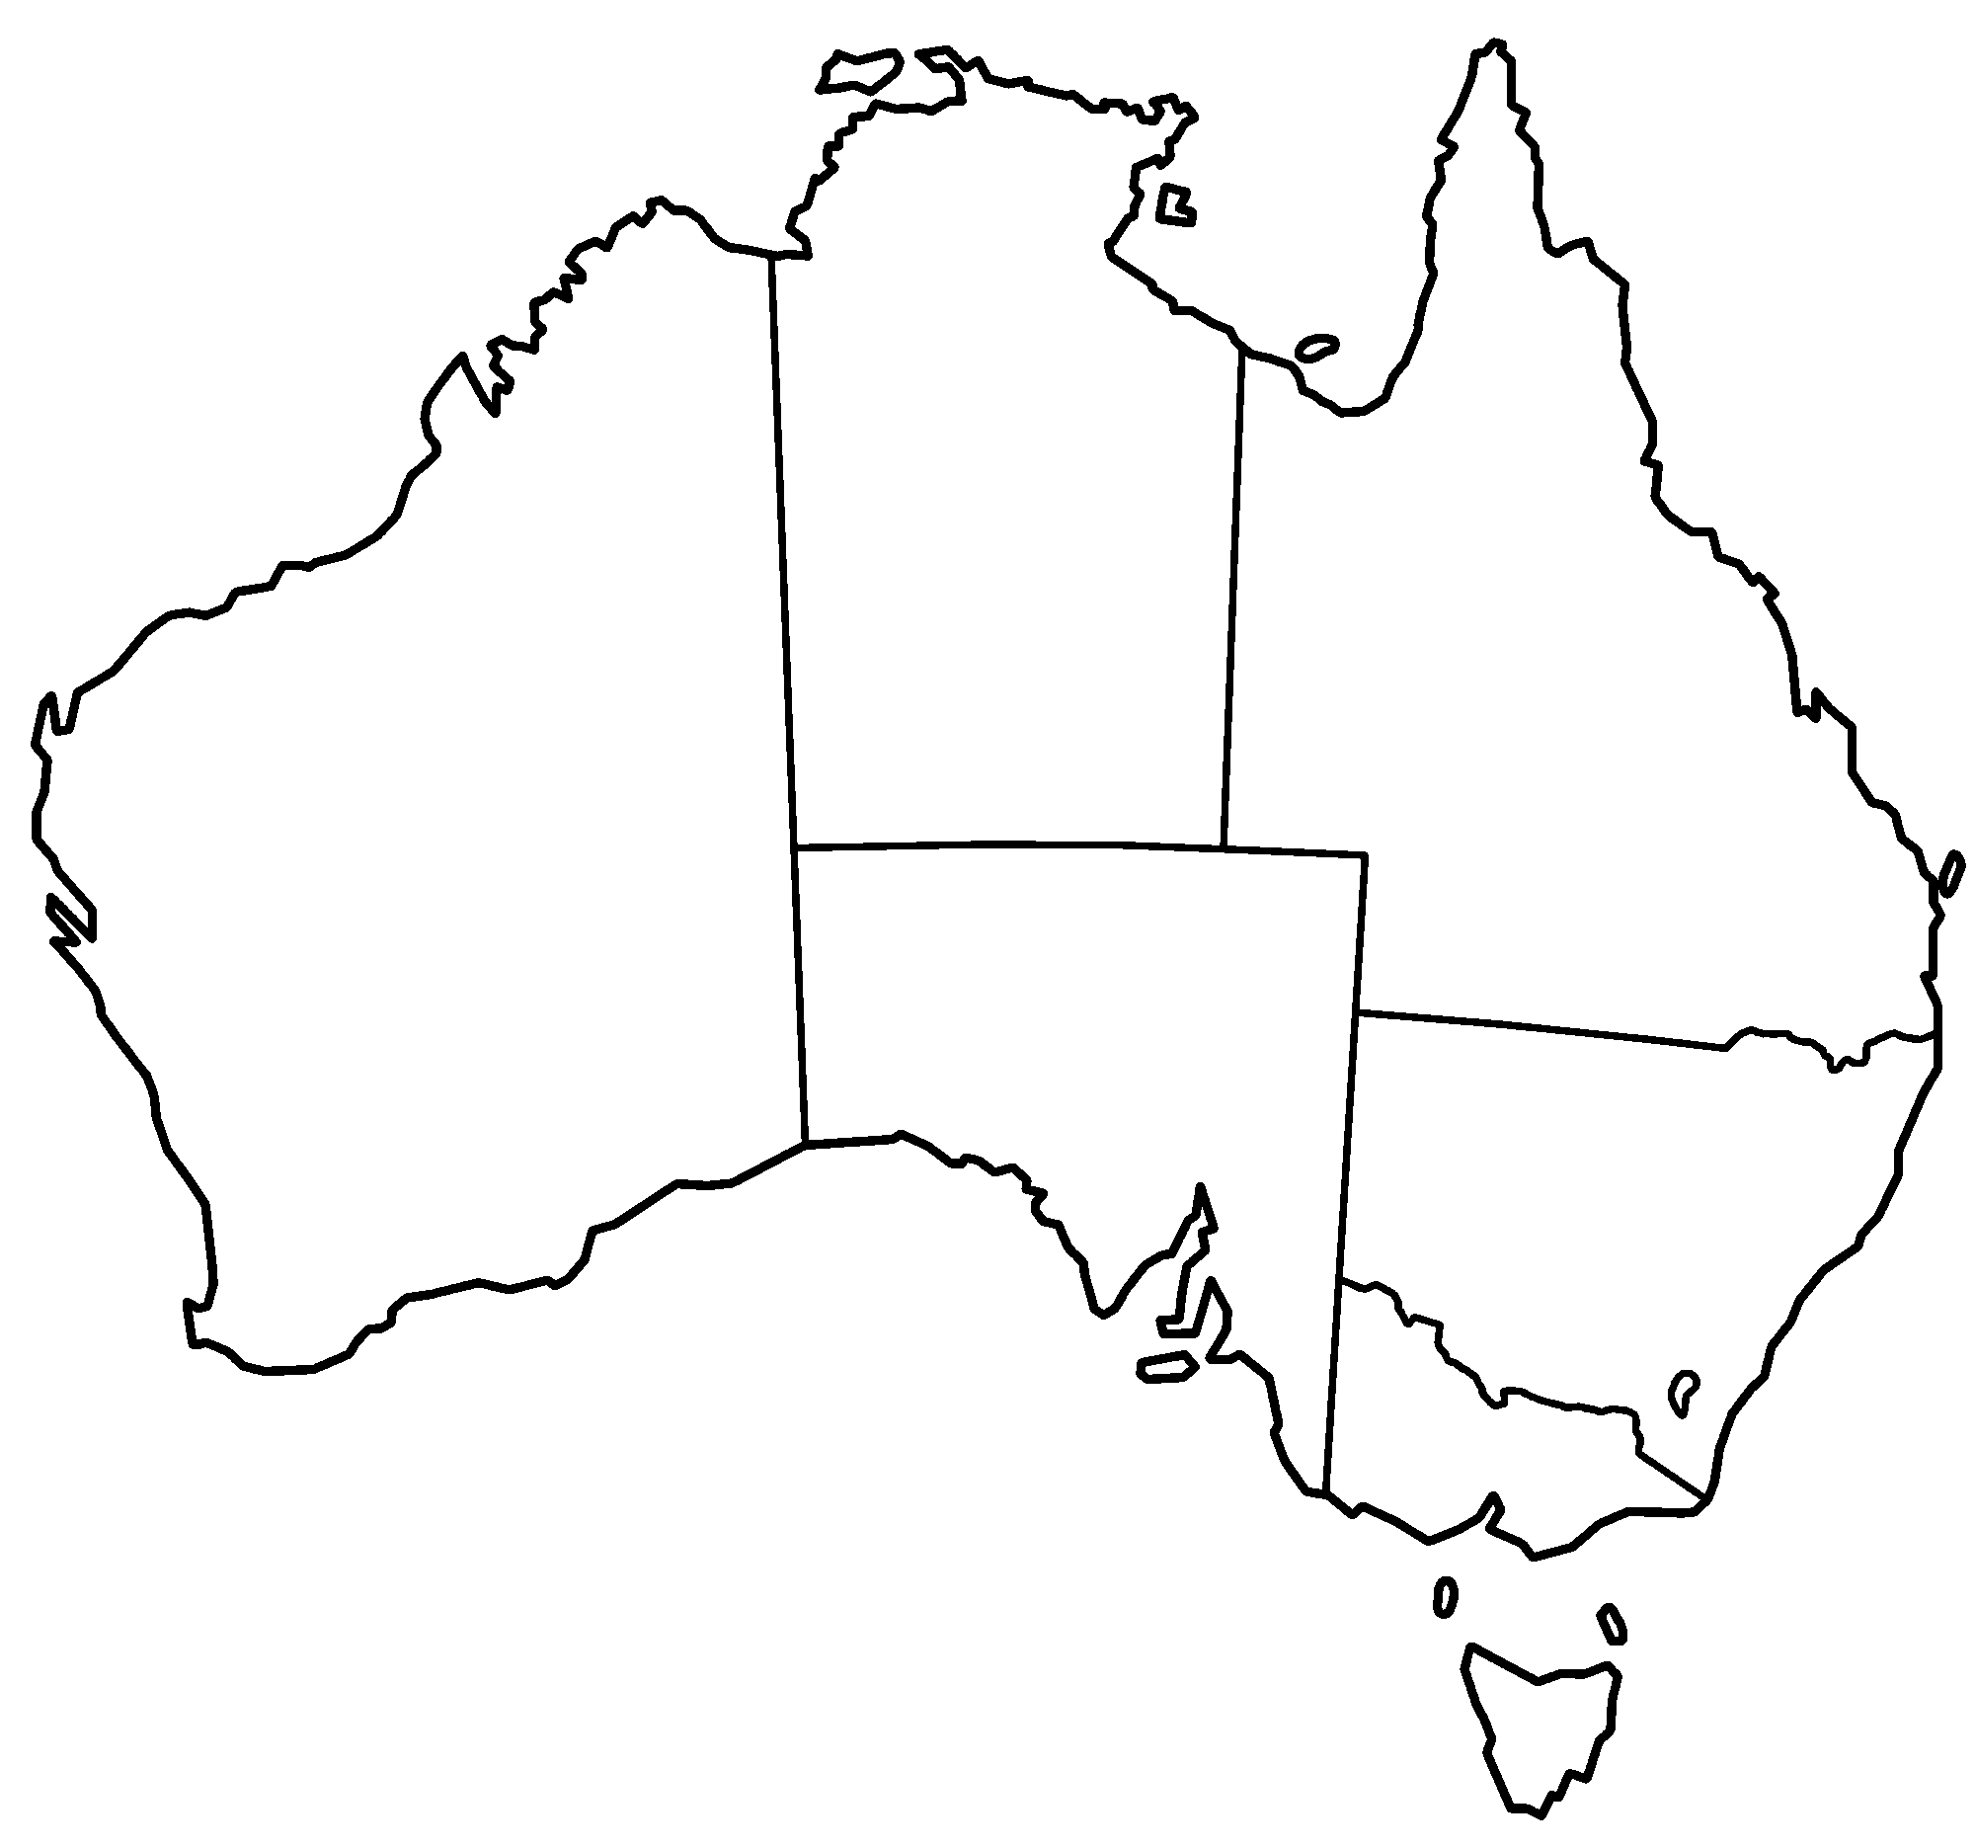

Slide 29
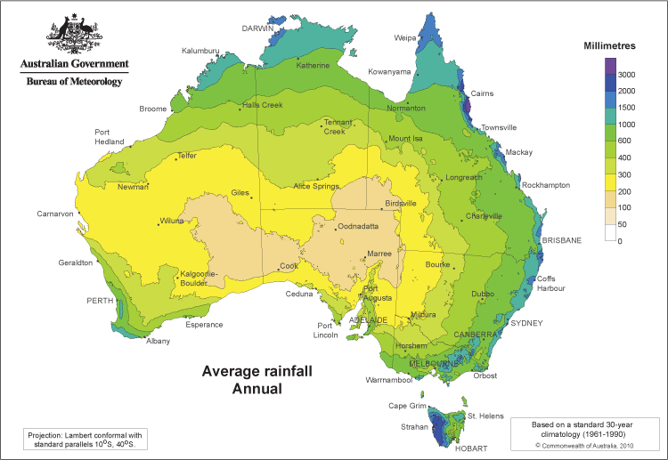
Average annual rainfall Australia

Slide 30
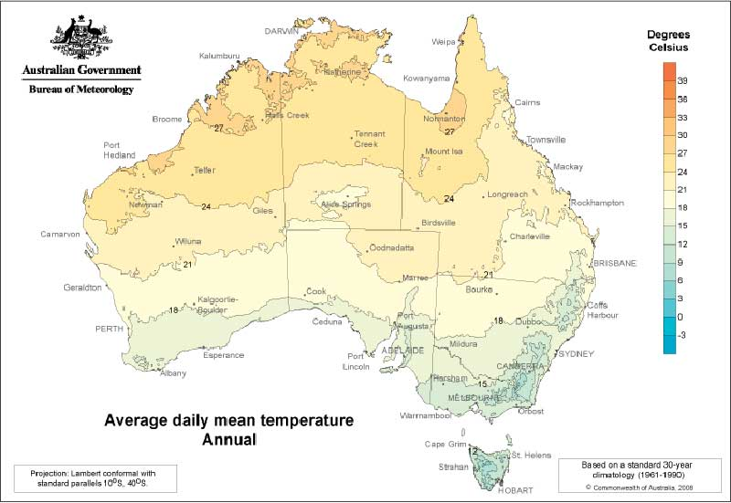
Average daily mean temperature (Annual) Australia

Slide 31
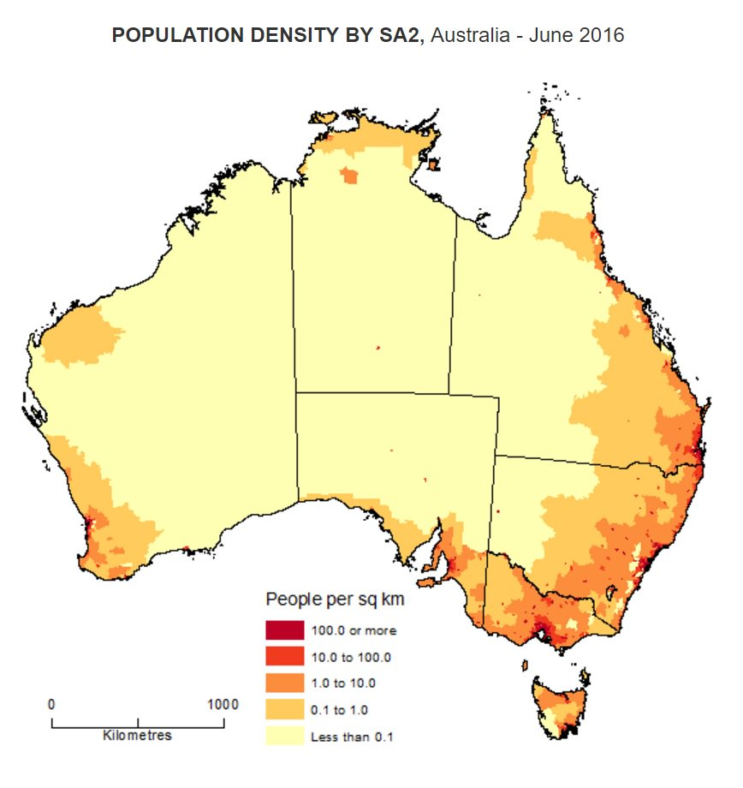
Population Density Australia

Slide 32
Key vocabulary
Continents – Europe, Asia, Oceania, Africa, South America, North America (and Antarctica)
Oceans – Arctic, Atlantic, Indian, Pacific, Southern
Directional vocabulary – south, south west, west, north west, north, north east, east, south east,
Positional vocabulary – equator, northern hemisphere, southern hemisphere, Tropic of Cancer, Tropic of Capricorn, Arctic Circle, Antarctic Circle, latitude, longitude, Greenwich Meridian

Slide 33
Work completed by the end of the lesson
Spoken
Describe the location of the continent and a country
Describe a journey to the continent and between countries
Discuss the patterns found on the human and physical maps
Discussion as to whether ‘All continents are the same’
Recorded
Blank A3 world map with continent and ocean labels
Blank A4 map of continent with the countries and seas labelled
Blank A4 map of continent with annotations showing the main human and physical features

Slide 34
Maps for other countries…

Slide 35
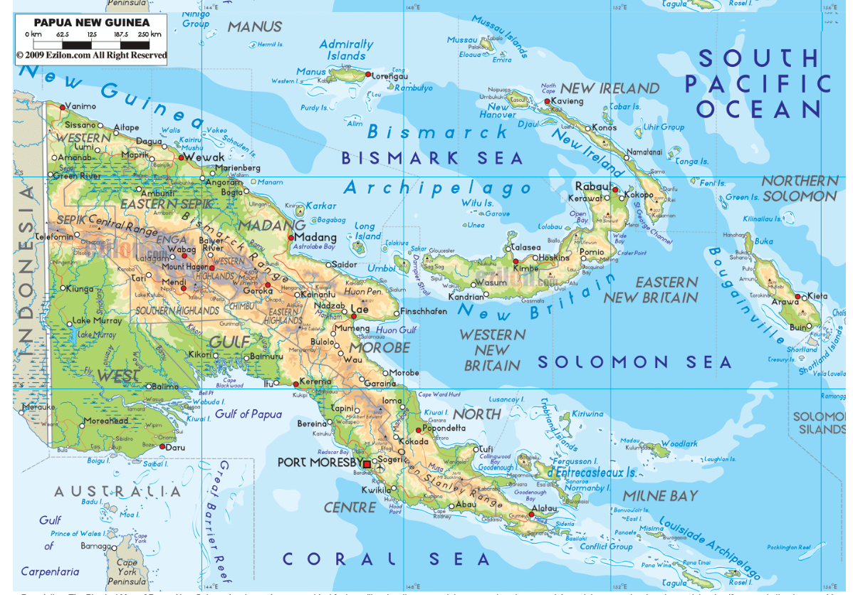
Physical map of Papua New Guinea

Slide 36
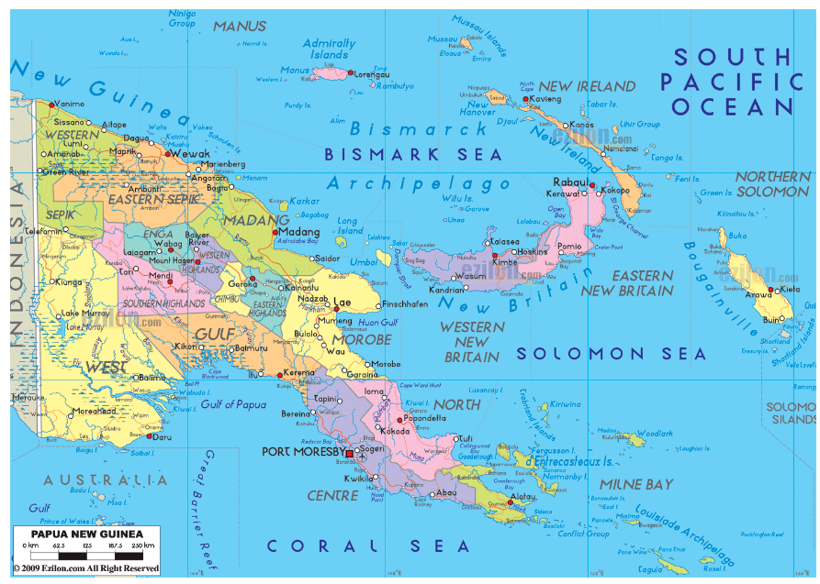
Human map of Papua New Guinea

Slide 37
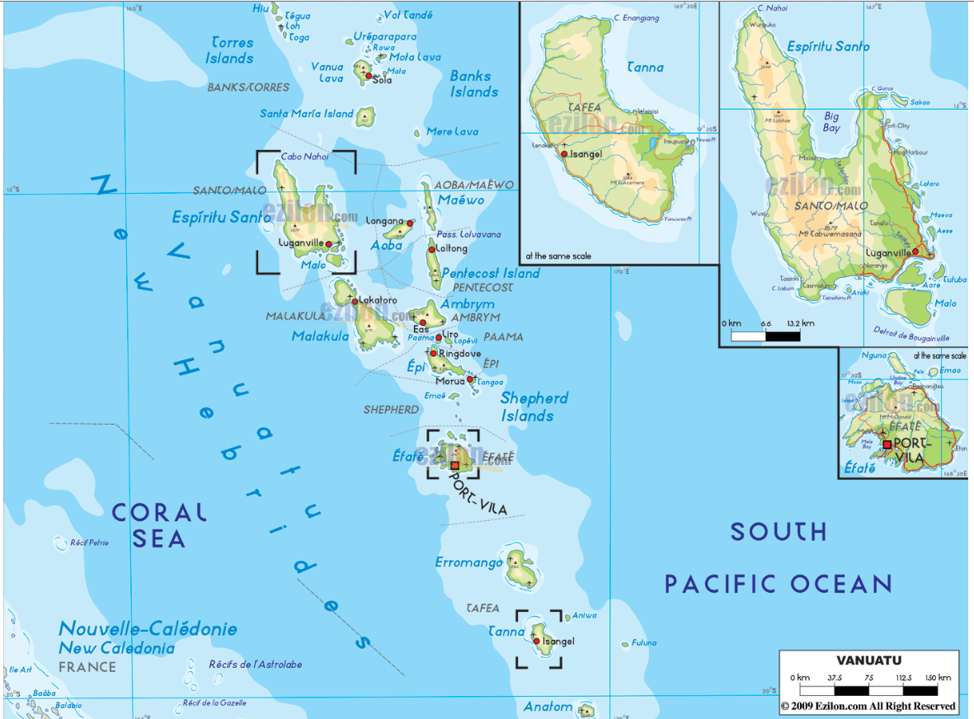
Physical map of Vanuatu

Slide 38
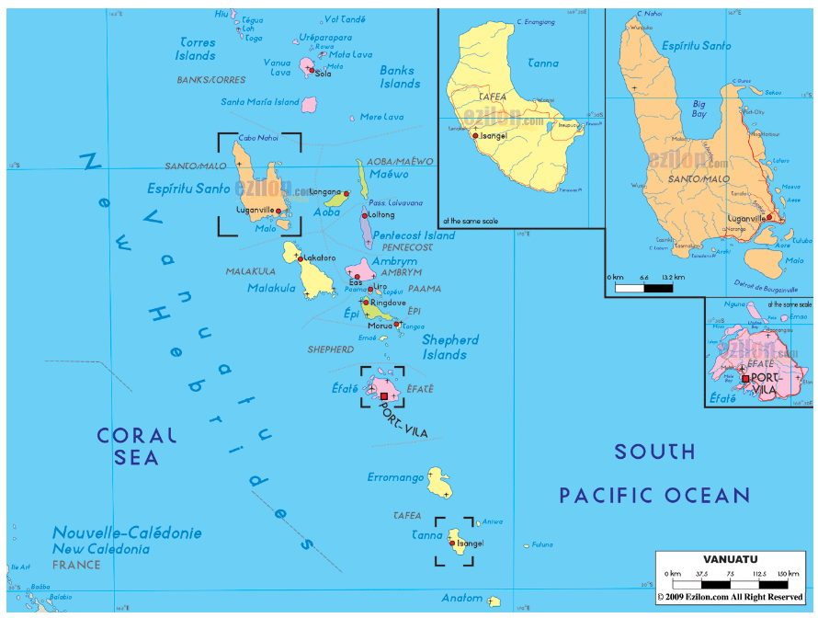
Human map of Vanuatu

Slide 39
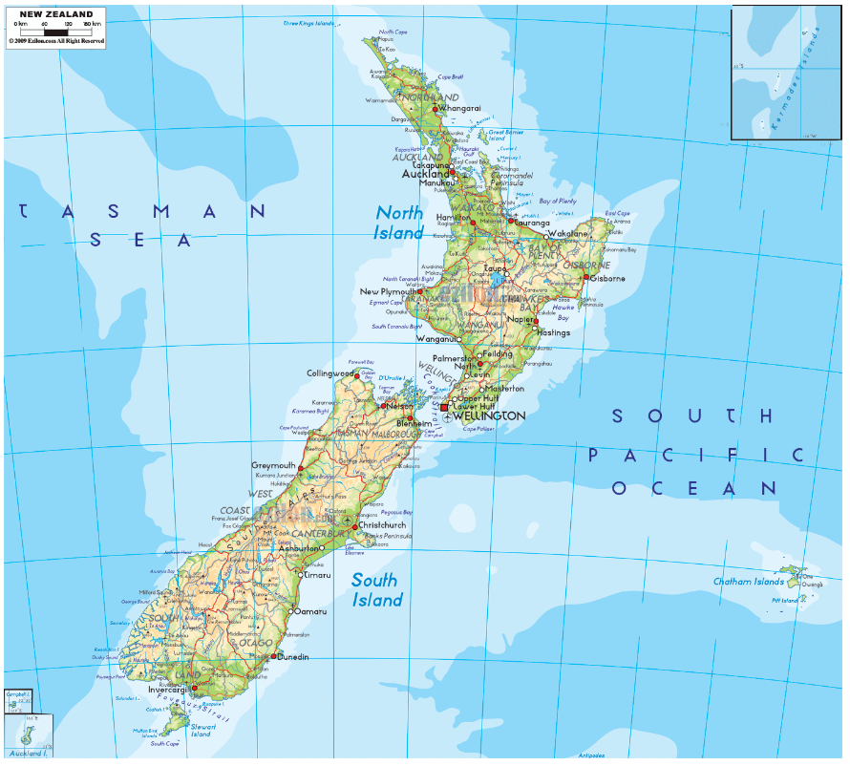
Physical map of New Zealand

Slide 40
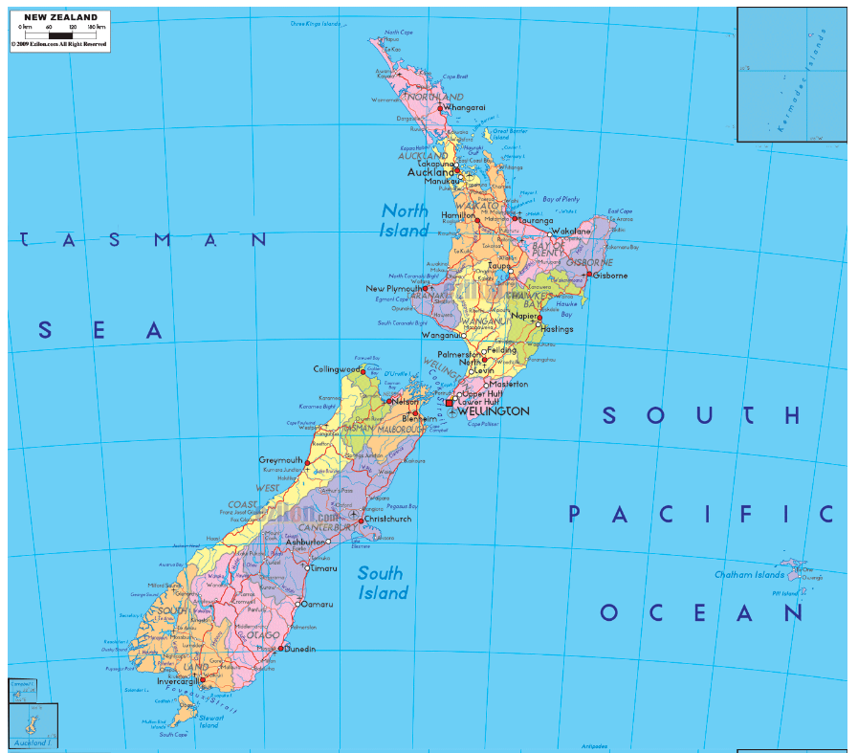
Human map of New Zealand

