Slide 1
A trip around South America: All of South America is the same…
To embed geography knowledge of South America using geography skills

Slide 2
All of South America is the same
Do you agree?
Class vote: Yes or No

Slide 3
What does South America actually look like?
https://www.youtube.com/watch?v=PH2Zf4LiiAk

Slide 4
Where is South America?
Blank A3 map of the world continents
Label the continent of South America and the surrounding oceans
Describe the location of South America from the UK using the eight point compass directions, continents and oceans.
Extension – which continents, seas and countries would you cross on your way to South America

Slide 5
What are the major countries in South America?
Find the following countries on the A4 South America map: Brazil, Argentina, Chile, Colombia.
Label the 4 countries on your South America map
Choose one country and describe where it is in South America using the eight point compass directions.
Describe a journey between all of the countries - you choose where you start.

Slide 6
What is South America like?
Maps show us information about places and their human and physical features.
Which maps are physical? What does physical mean?
Which maps are human? What does human mean?
Look at the maps using the following TIP
T – Title – what does it say?
I – Information – what does the key show?
P – Pattern – what is the pattern of the map
Physical – mountains, rivers,
Settlement – cities, population density

Slide 7
What is South America like?
Look at the maps using the following TIP
T – Title – what does it say?
I – Information – what does the key show?
P – Pattern – what is the pattern of the map
Identify the main human and physical features in each half using the maps
Annotate your map with symbols and a key to show your findings

Slide 8
All of South America is the same
Do you still agree?
Class vote: Yes or No
What evidence have you found this lesson to back up your opinion?

Slide 9
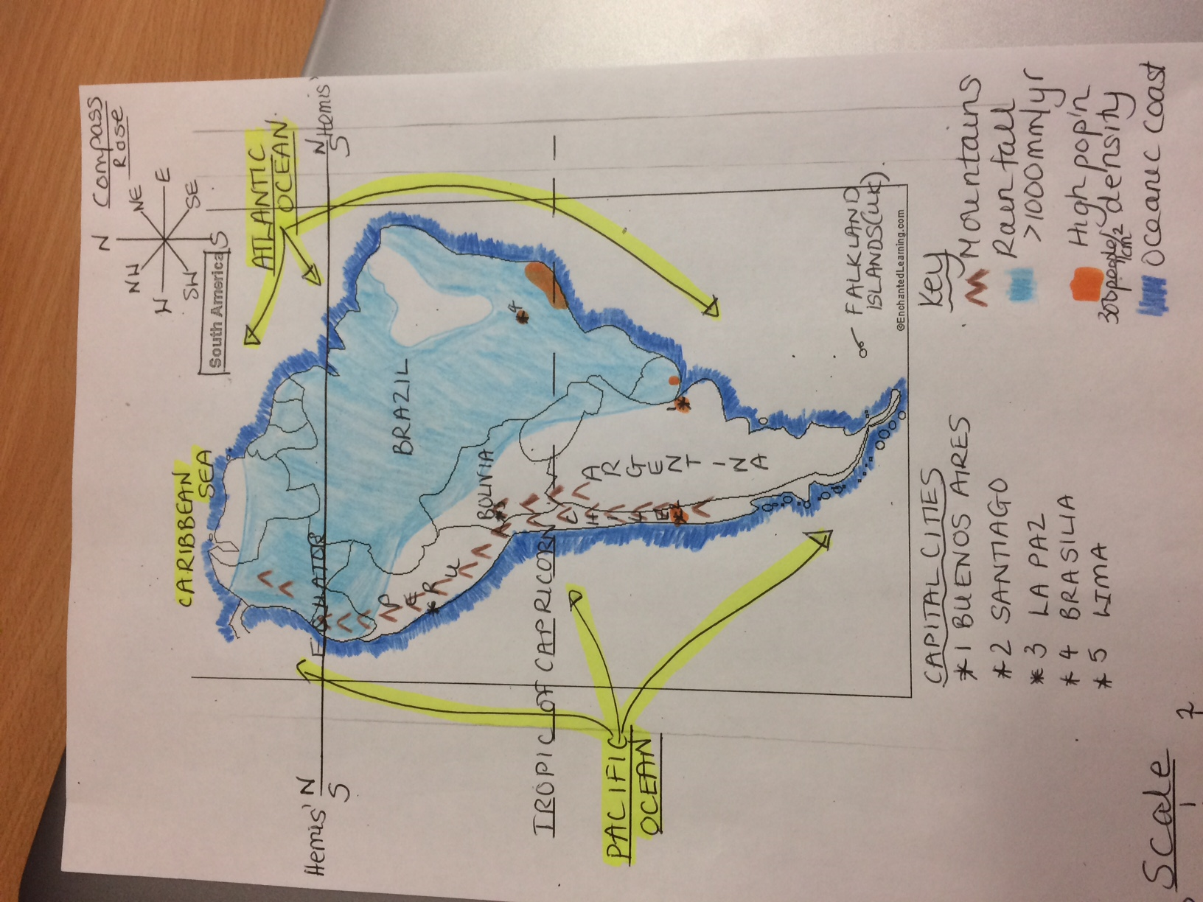
WAGOLL – South America

Slide 10
Key vocabulary
Continents – Europe, Asia, Oceania, Africa, South America, North America (and Antarctica)
Oceans – Arctic, Atlantic, Indian, Pacific, Southern
Directional vocabulary – south, south west, west, north west, north, north east, east, south east,
Positional vocabulary – equator, northern hemisphere, southern hemisphere, Tropic of Cancer, Tropic of Capricorn, Arctic Circle, Antarctic Circle, latitude, longitude, Greenwich Meridian

Slide 11
Work completed by the end of the lesson
Spoken
Describe the location of South America
Describe a journey to the continent and between countries
Discuss the patterns found on the human and physical maps
Discussion as to whether ‘All continents are the same’
Recorded
Blank A3 world map with continent and ocean labels
Blank A4 map of continent with the countries and seas labelled
Blank A4 map of continent with annotations showing the main human and physical features

Slide 12
Blank South America Map

Slide 13
South America Political Map

Slide 14
South America Relief Map

Slide 15
Precipitation Map of South America

Slide 16
Population Density Map of South America

