Slide 1
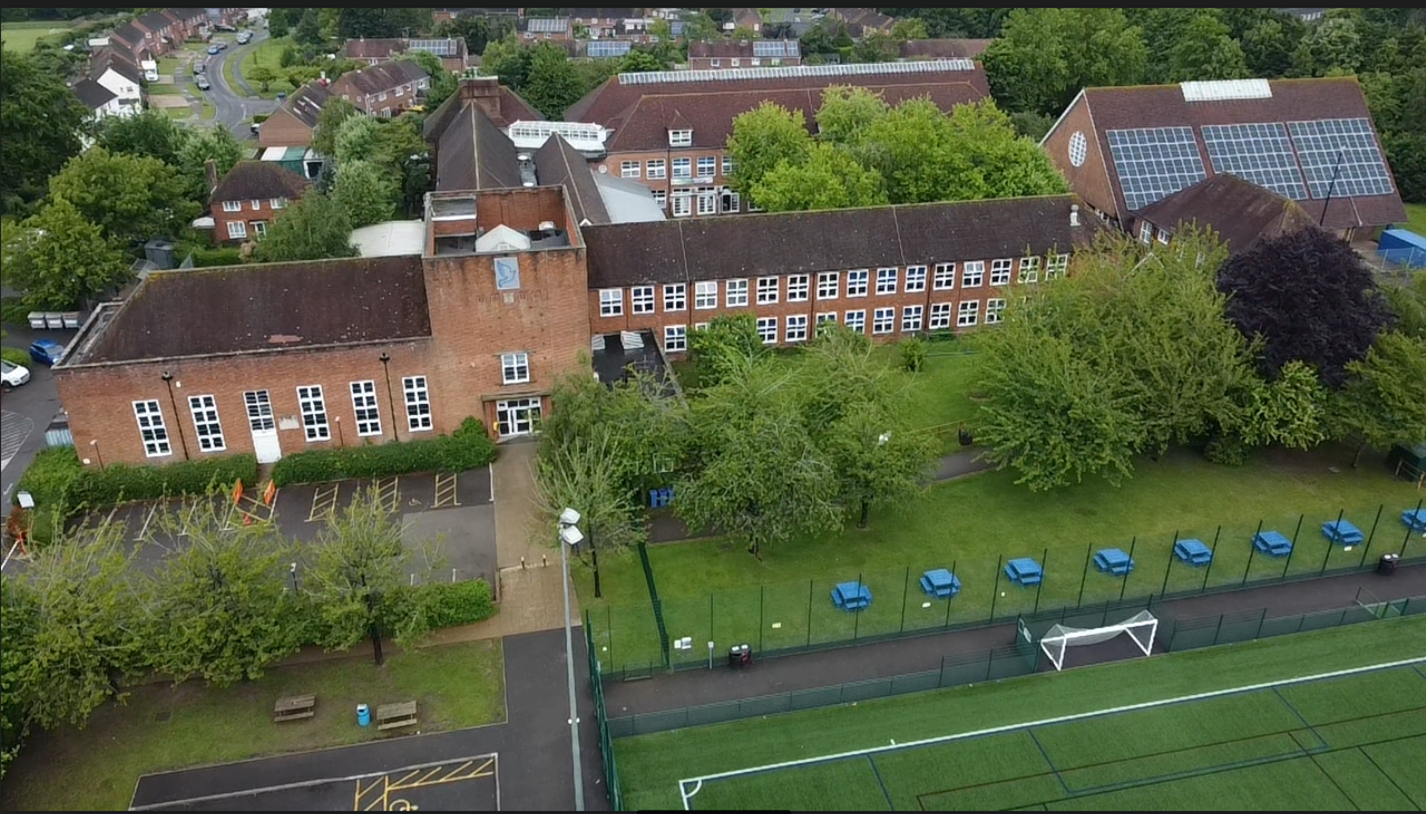
Making Geographical Decisions♥
Ideas for supporting students confidence and ability to make and justify geographical decisions
Kelly Daish – The Vyne Community School
@K_M_Campbell

Slide 2
Making Geographical Decisions♥
Challenges
Heavily resourced.
Requires high-level literacy skills.
Read large bodies of text.
Understand and extract appropriate information from maps, datasets, graphs etc.
Making connections and think holistically.
Select appropriate information to support decision.
Empathy.
Making a decision!

Slide 3
1. Optionality
Ideas
Where should a wind farm be constructed?
Where should new housing be built?
Which part of the town should be protected from flooding?

Slide 4
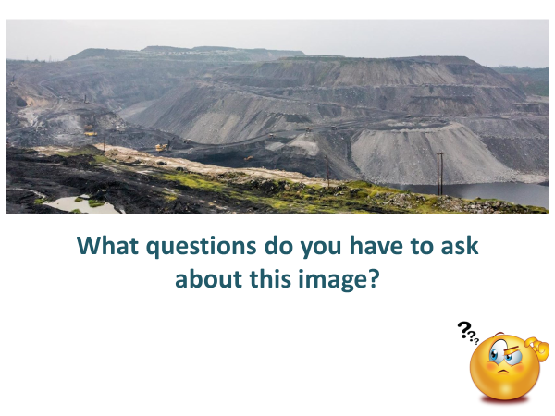
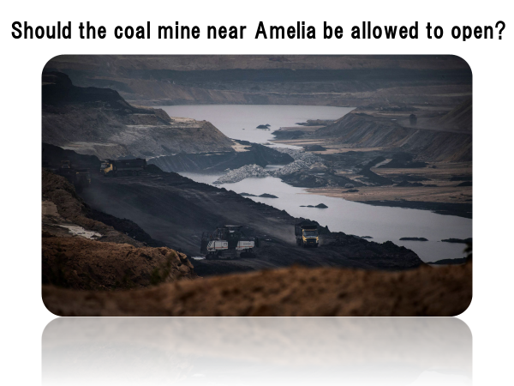
2. Yes/No
Ideas
Should deforestation be allowed to take place?
Should tourism be banned in location X?
Should people attend annual volcano awareness training?

Slide 5
3. To what extent
The economic benefits of palm oil production are worth the environmental damage caused.
Do you agree?
I totally agree because…
I partially agree because…
I disagree slightly because…
I totally disagree because…

Slide 6
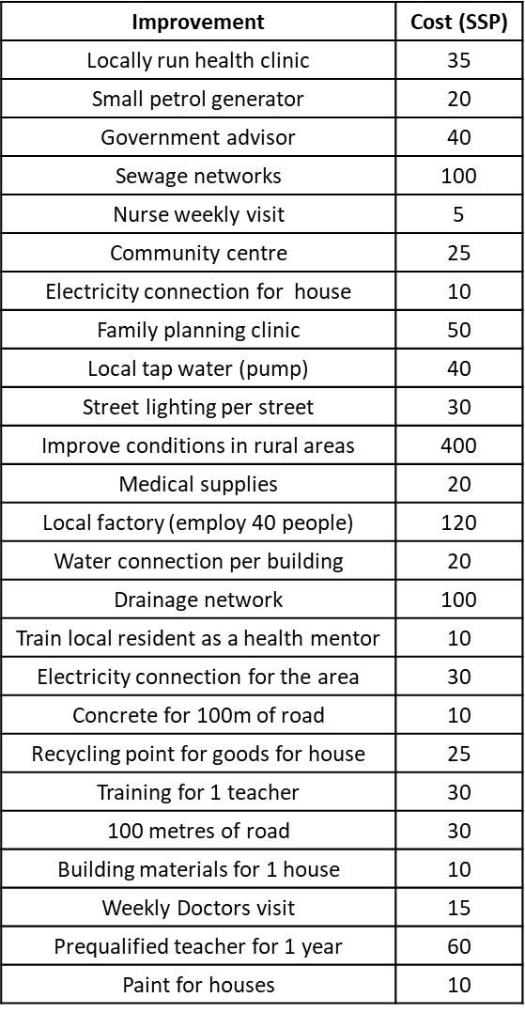
4. Shopping List

Slide 7
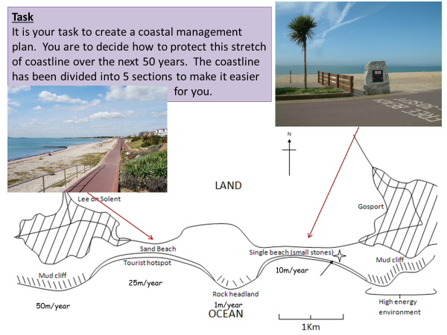
5. Open Proposal

Slide 8
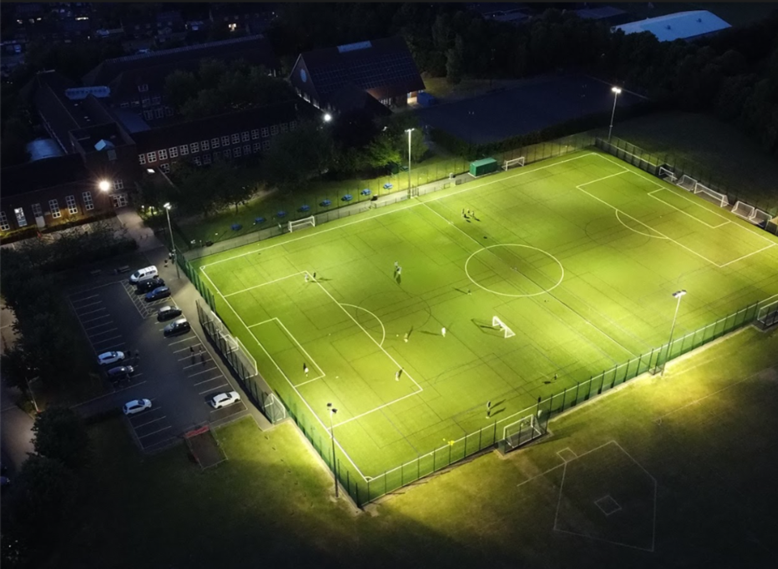
Making Geographical Decisions♥
Ideas for supporting students confidence and ability to make and justify geographical decisions
Kelly Daish – The Vyne Community School
@K_M_Campbell

