Slide 1
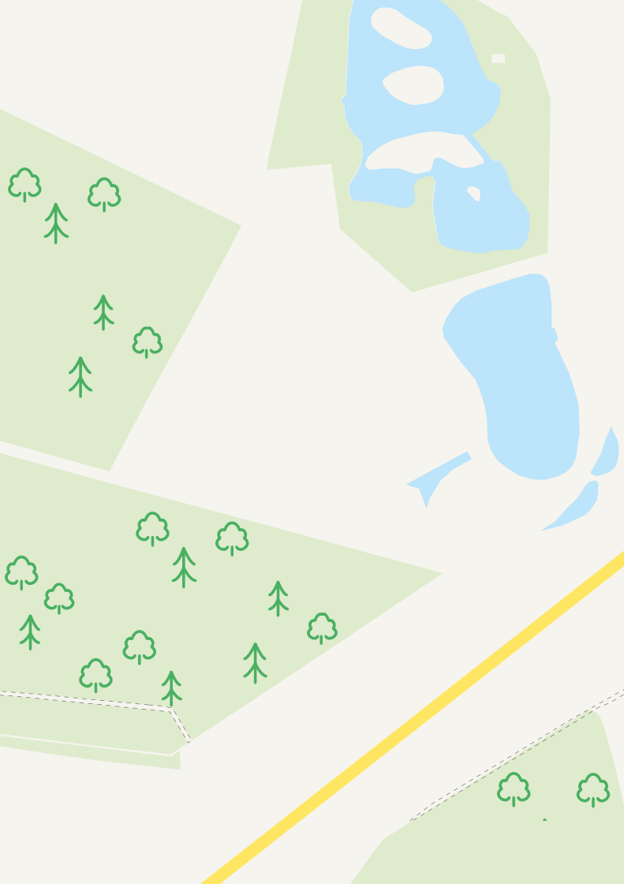
Using data tables in GIS

Slide 2
To Create a data table you will need:
GIS software
A Smartphone or tablet
Microsoft Excel
Location, decibel, temperature etc apps, to collect data around any site
Or use secondary data from another website

Slide 3
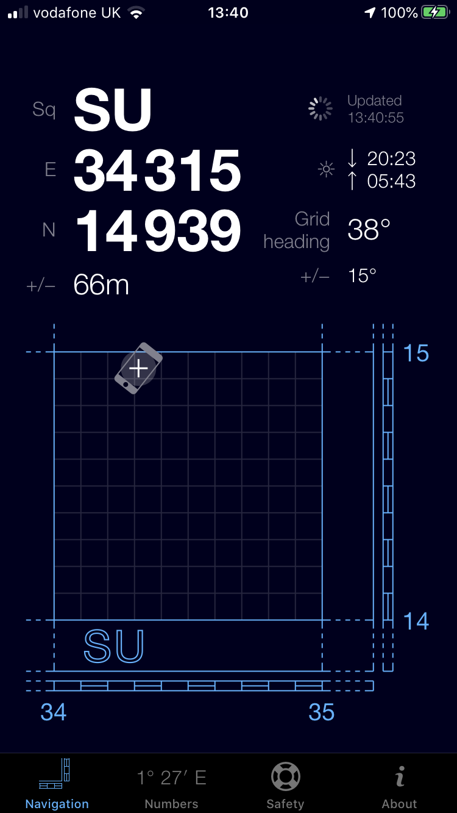
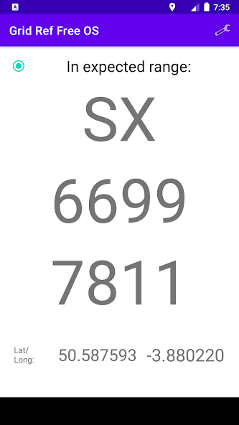
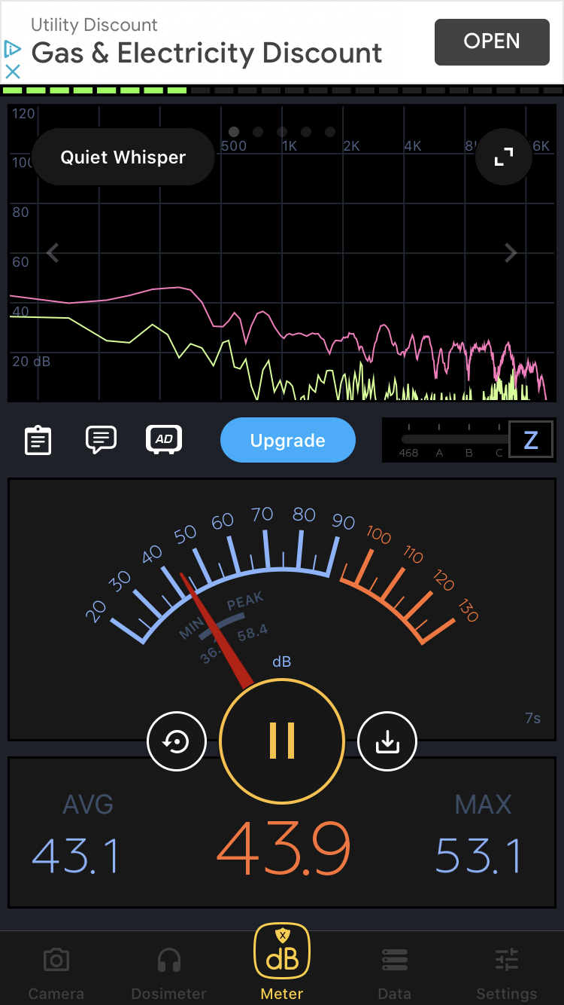
Gridpoint GB
Grid Reference OS
Decibel Meter

Slide 4
Each pupil can record their location using Gridpoint GB or Grid Reference OS
Add the decibel level, or information at any location
By taking a screen shot of each one, they record both pieces of data
Can be done individually or as a group, collate the data together in a spreadsheet and upload it into your GIS software
Curriculum: Fieldwork, Using GIS and collecting data and presenting data

Slide 5
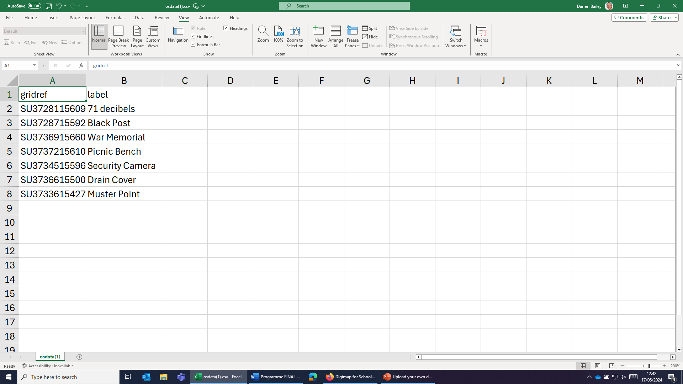

Slide 6
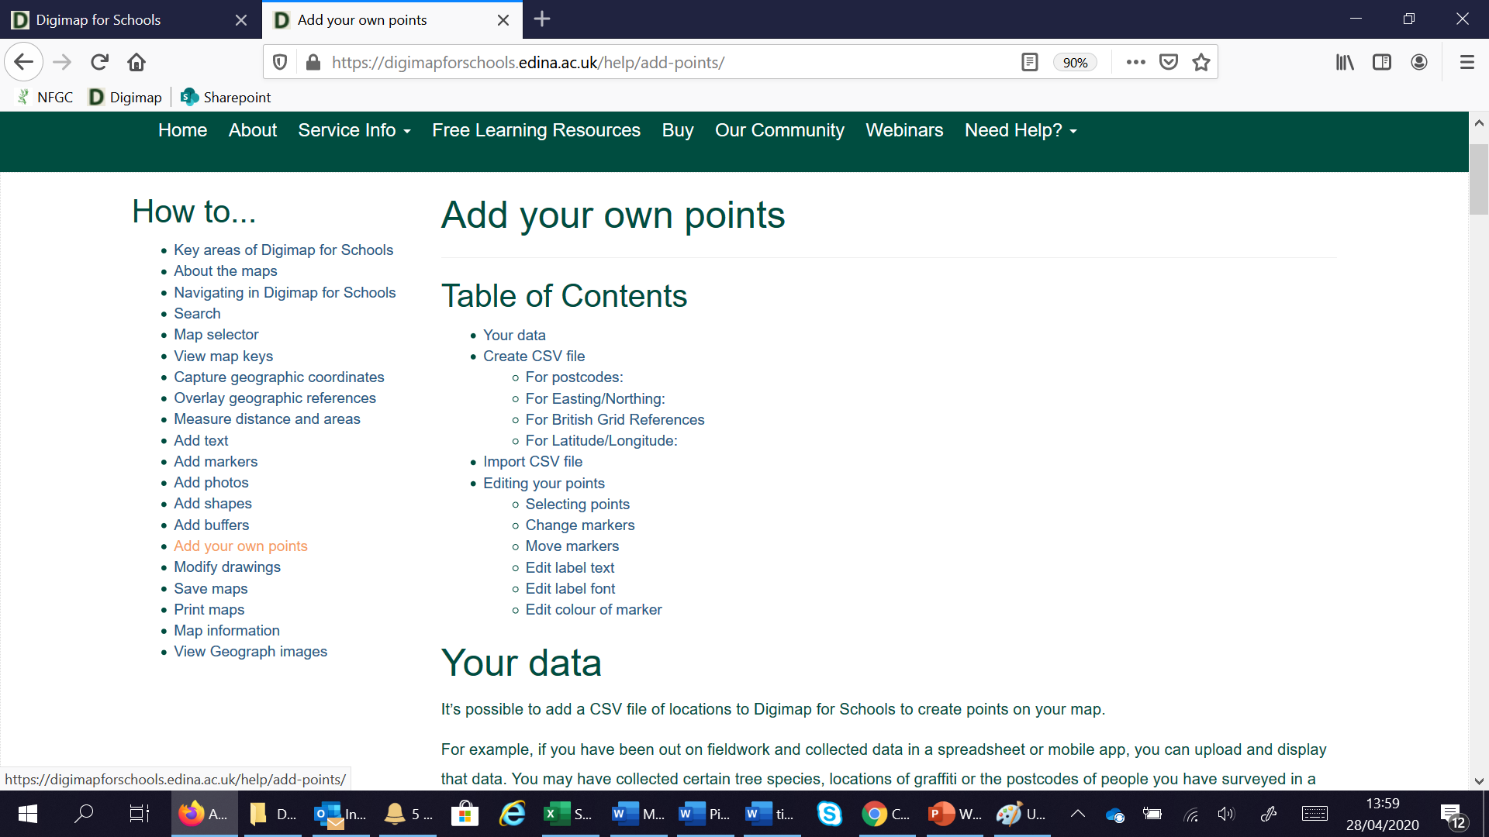
IMPORTANT INFORMATION!
Format of location field– Click the ? for the help files
Your spreadsheet must be saved as .CSV file

Slide 7
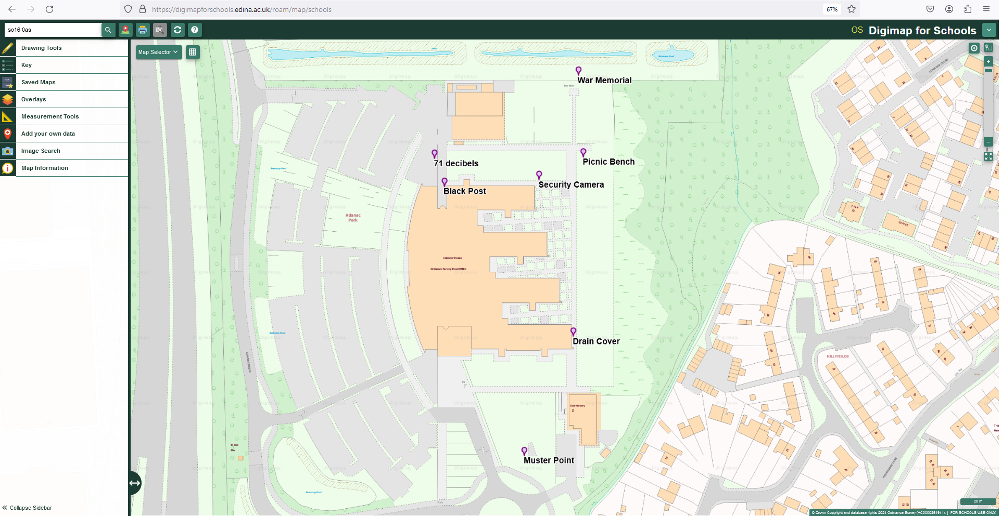

Slide 8
Other things you could record (could be around the school site);
Temperature
Wind Speed
Rain fall
Sound
Groin Drops
Bio diversity

