Slide 1
GCSE Geography Changes to exams in 2022: update
Stacey Hill – Head of Curriculum, Geography
Notes:
Good afternoon everyone, thanks very much for joining me today. My name is Stacey I’m the Head of Curriculum for Geography at AQA and I’m just going to take this time today to talk through everything we know in relation to question paper changes fo this summer’s exams.

Slide 2
Changes to exams in 2022: update
Confirm exam changes for 2022 exams
Advanced information for A-Level Geography
Feedback from you
Supporting resources
Notes:
I’ll quickly go through the changes to Paper 3 and just make sure everyone is happy with the expectations for that exam. I’ll then go through the optionality arrangements for Paper 2 and confirm all of the detail that we communicated back in December, please feel free to ask any questions about that if you’d like anything made clearer. I’ll then give you the opportunity to give us some feedback on how you’re approaching exams this summer, because we’d really like to hear about the decisions you’re making. Finally I’ll go through some really useful resources and CPD that you can access after this meeting.

Slide 3
Confirmed GCSE Changes set out by Ofqual
Mitigations for exams were carried forward from 2021, meaning that for 2022:
Fieldwork is not required
Paper 3 will not contain questions relating to students own fieldwork experience
Introducing optionality into 2022 exam series means
Students will have choice of topics in Paper 2
Notes:
Just to begin with it’s important just to remind ourselves about the carried forward changes to assessment from exam cancellations from 2020 that apply to fieldwork which I’ll go through again in a minute.
Ontop of that, the newly introduced optionality arrangements for Paper 2 give you some choice of topic areas to teach.

Slide 4
Confirmed GCSE Changes set out by Ofqual – Paper 3
Question 5 will be removed from Section B in 8035/3 Paper 3: Geographical applications. These are questions relating to students' own fieldwork experience (familiar fieldwork).
Unfamiliar fieldwork questions remain at the beginning of Section B (Question 4) totalling 16 marks
The total number of marks available for the 8035/3 paper will reduce from 76 to 56 marks (a removal of 20 marks).
The total time allocation for the 8035/3 paper will reduce from 1 hour 15 minutes to 1 hour
The pre-release material linked to the Issue Evaluation will be released on 22nd March 2022 on e-AQA/Centre services. Hard copies will also arrive to centres and must be kept secure until this date.
Notes:
The implications for the paper as a whole are a reduction of marks from 76 to 56 and to reflect this reduction in marks the assessment time will reduce from 1 hour 15 minutes to 1 hour.
Lastly, although this doesn’t represent a change to the exam, it’s worth mentioning because lots of teachers have been in touch to ask, that the pre-release material that links to the issue valuation in Paper 3 will be released as normal 12 weeks prior to the exam, which this year falls on 22nd March. It’ll go onto the secure website and hard copies will be sent to centres to remain secure until that date.

Slide 5
Further GCSE Changes set out by Ofqual – Paper 2
Ofqual announced in the most recent consultation outcomes that Paper 2: challenges in the human environment will have optionality in 2022.
Students will answer all questions in Section A: Urban issues and challenges and will answer EITHER Section B: Changing economic world OR Section C: Resource management.
If students choose to answer Section C the normal rubric will apply, where students must answer question 3 and one of questions 4, 5 or 6 (food, water or energy).
Notes:
If we move on to discuss the Paper 2 changes now, you’ll know that during the Autumn term Ofqual announced, following a further consultation that GCSE Geography exams would have optionality introduced to try and reduce the amount of content to be taught in light of the disruptions. The proposal put forward by AQA that was accepted was to introduce optionality into the Paper 2 exam. The reason we chose this was, after asking the questions to several of our centres, these were the two units that teachers tend to leave for teaching until year 11, and so we felt this was the best option to try and capture most centres. So this means that this summer, students will all answer questions on Urban, and then they will get a choice between changing economic world and resources.
Just to clarify as we’ve had this question as well, if you choose to teach resources, the normal rubric still applies, so your students will answer question 3 and then they’ll choose food, water or energy.

Slide 6
Further GCSE Changes set out by Ofqual – Paper 2
The total time allocation for Paper 2 will be reduced from 1 hour 30 minutes to 1 hour 15 minutes.
A total of 5 marks will be introduced to Section C. These marks could appear anywhere in Section C.
In Section B, the 9-mark question will be replaced with a 6-mark question. To keep the total of 30 marks, 3 marks will be introduced elsewhere in Section B.
The total marks for Paper 2 will be reduced from 88 marks to 63 marks (a removal of 25 marks).
Sections B and C will now have equal weighting worth 30 marks each.
The highest tariff question in both Section B and C will be 6 marks.
There are 3 spelling, punctuation and grammar (SPaG) marks that will appear in the 9-mark question at the end of Section A.
Notes:
So what does this mean, these are the details of what we’ve done to amend the exam paper in order to try and balance the two optional units

Slide 7
Further GCSE Changes set out by Ofqual
The total marks for the overall qualification will be reduced from 252 to 207.
Marks will be scaled up to maintain the usual weightings for each exam (Paper 1 and 2 - 35%, Paper 3 - 30%).
Sample papers to demonstrate the new structure can be found in assessment resources
The Assessment Objective weightings for 2022 will differ slightly to those outlined in the specification
AO1 in the usual series – 15% AO1 in Summer 2022* – 15%
AO2 in the usual series – 25% AO2 in Summer 2022* – 27%
AO3 in the usual series – 35% AO3 in Summer 2022* – 31%
AO4 in the usual series – 25% AO4 in Summer 2022* – 27%
*these percentages are based on the reduced total mark for the 2022 exam series.

Slide 8
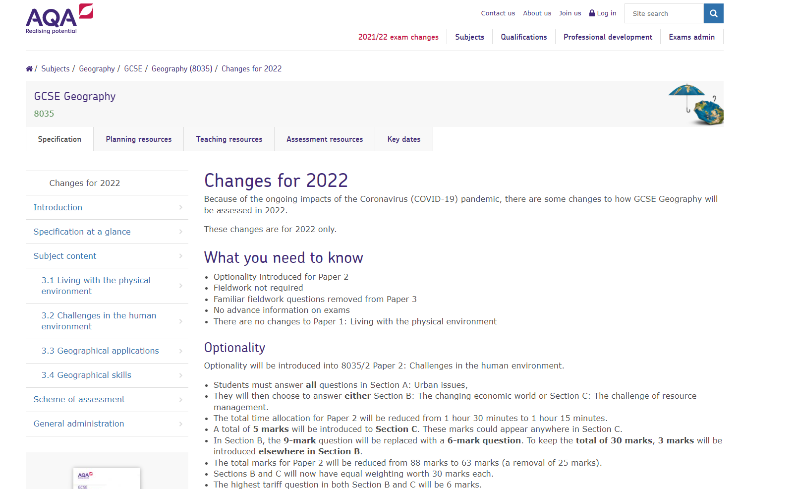
Where can I stay updated on this information?
AQA | GCSE | Geography | Changes for 2022

Slide 9
AS & A-Level Geography in 2022
Advance information
To help students revise, exam boards will provide advance information about the focus of exams for all subjects at GCSE, AS and A-level – with the exception of:
GCSE English Literature
GCSE History
GCSE Geography
GCSE and A-level Art and Design
Ofqual and the DfE have decided that exam boards will publish advance information by 7 February 2022
Notes:
What we don’t know yet – exactly what this will look like for our subject, e.g we don’t know if it will be all papers / units etc and exactly what form the AI will take.

Slide 10
Resources to support your teaching
Getting to grips with command words

Slide 11
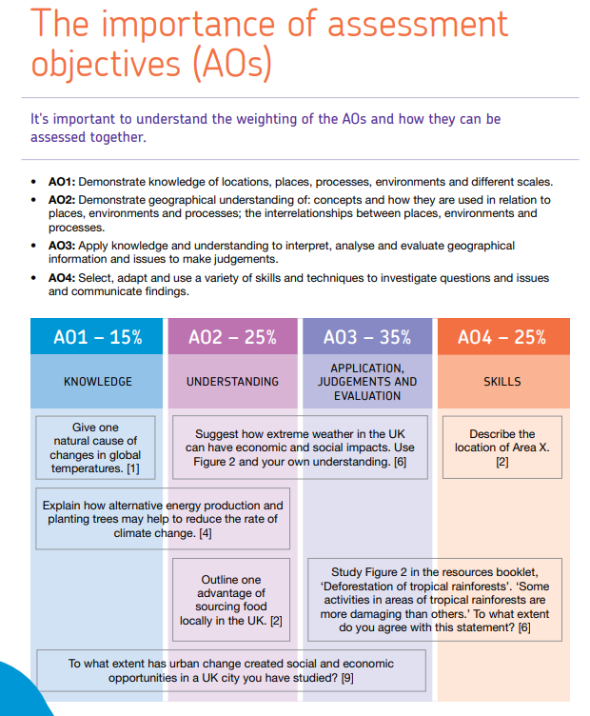
Resources to support your teaching
Contains helpful breakdowns of different commands and the questions where they are typical used
Examples of past questions for each command
Some exemplar material linked to each command to demonstrate good/poor responses
Tips to help students to respond (useful for the evaluative commands)
Starts by linking question types to the assessment objectives

Slide 12
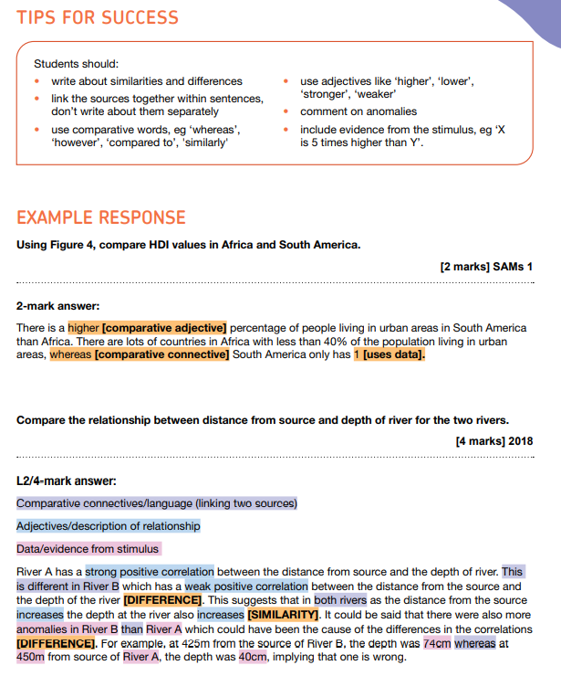
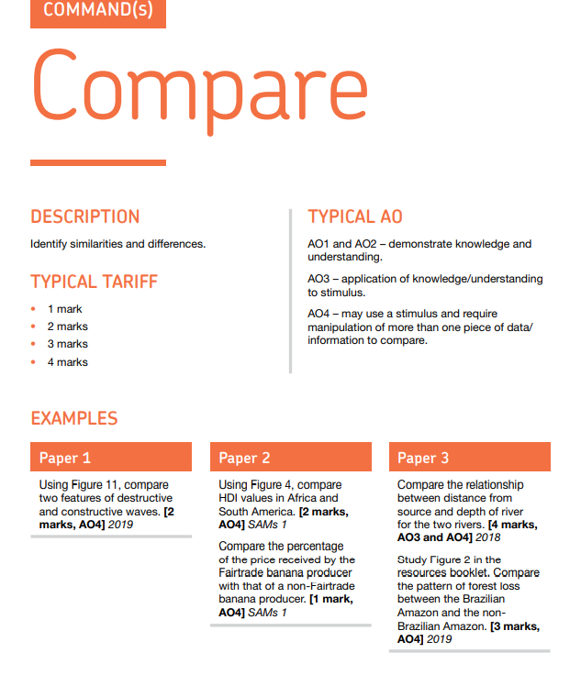
Resources to support your teaching

Slide 13
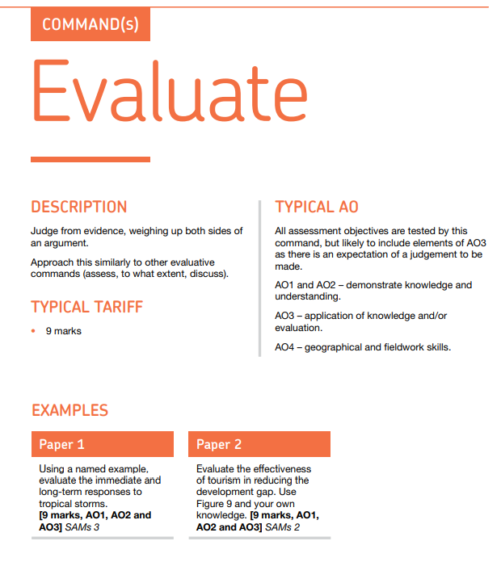
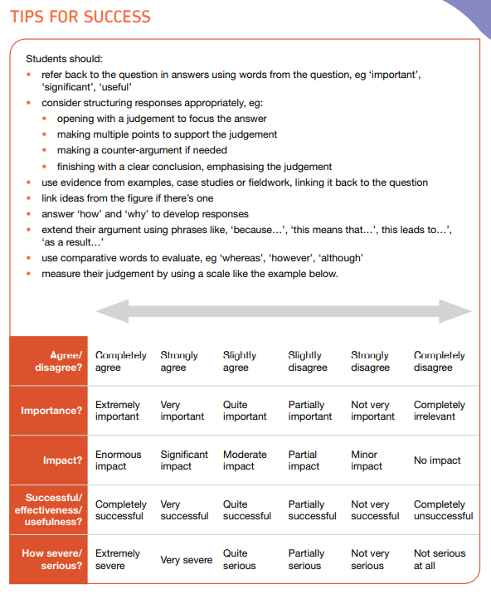
Resources to support your teaching

Slide 14
Resources to support your teaching
Useful tool when beginning to introduce exam questions to students at the start of KS4 (or when you begin exam style questioning)
Begin with more basic commands and demonstrate progression of difficulty
If your students have an awareness of the AOs (or similar) this resource links the AOs to the commands for you
As a revision tool, this can help students to identify their areas of improvement and they can focus on those
For you, this can help you to write new and appropriate exam questions for your students

Slide 15
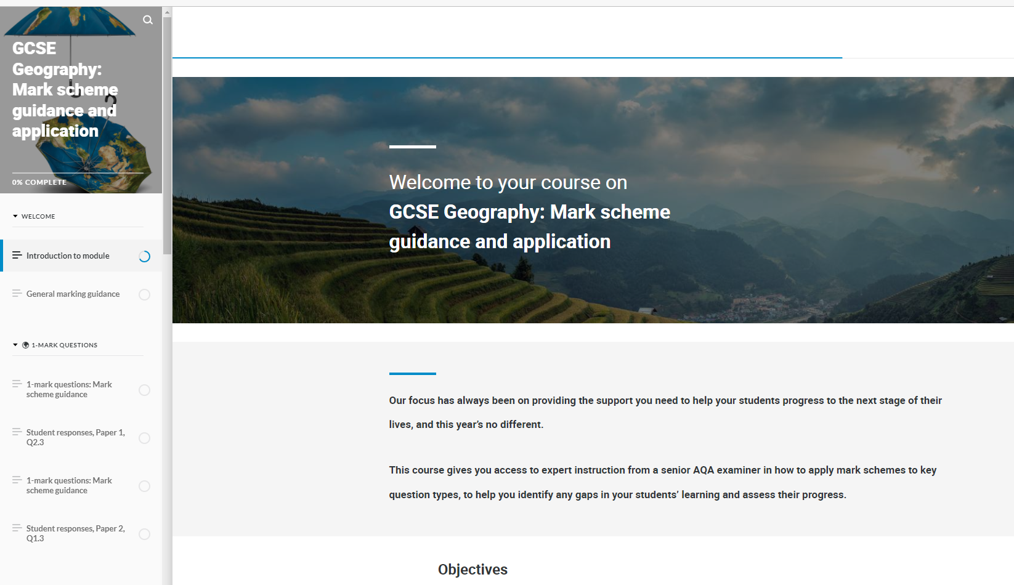
Support with marking
Teachers are telling us that they are concerned about the standard of marking within their departments after so many years without marking standardised assessments.
GCSE Geography: Mark scheme guidance and application - Introduction to module | Rise 360 (articulate.com)

Slide 16
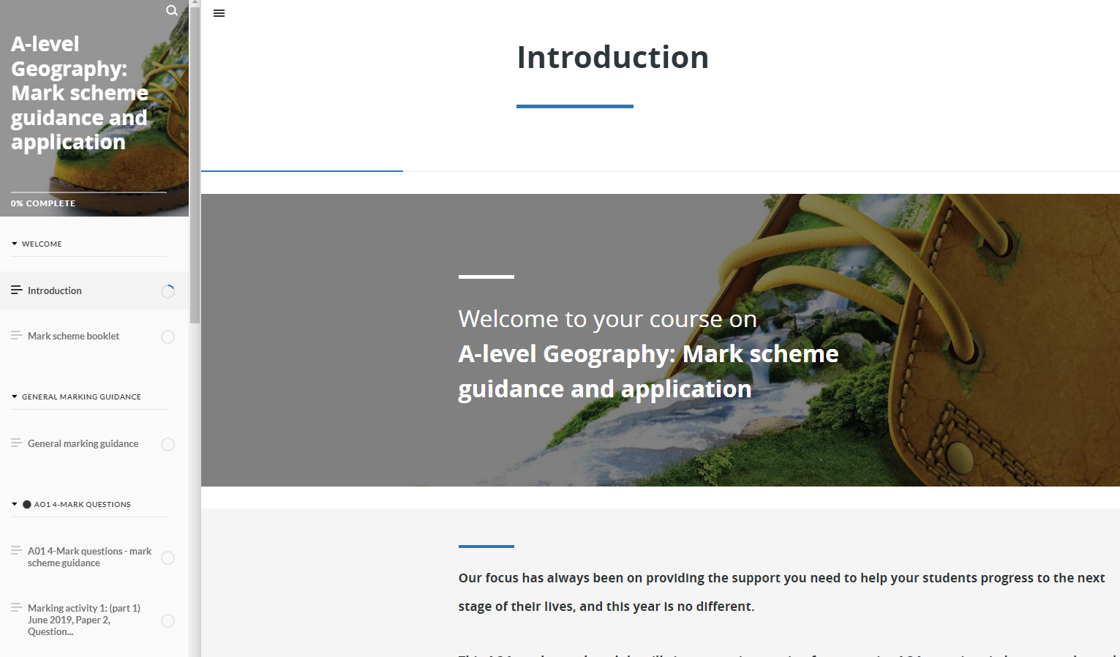
Support with marking
The same resource is available for those of you delivering A-Level Geography as well.
A-level Geography: Mark scheme guidance and application - Overview | Rise 360 (articulate.com)

Slide 17
Further free CPD coming up
GCSE Geography: Support student exam preparation
7th 9th March 2022
GCSE Geography: Virtual communities - Spring 2022
8th 9th 14th 15th March 2022 (these are regional so you can meet and network with other, local Geography teachers)

Slide 18
Unfamiliar Fieldwork
Mark breakdown and AO allocations
Fieldwork enquiry sequence
Example questions & answers
Strategies for revision

Slide 19
Impact of changes on assessment - fieldwork
Question 4 in Section B of 8035/3 Paper 3: Geographical applications will remain part of the assessment. These are questions set in an unfamiliar fieldwork context.
‘Unfamiliar fieldwork’ questions make up 16 marks of Section B (12 marks of AO4 and 4 marks of AO3), and this will remain the same for 2022.
This means that these questions largely assess Geographical Skills (AO4), with some application (AO3).
This highlights the importance of the Geographical Skills checklist -found in section 3.4.2 of the specification Graphical skills
Understanding the fieldwork enquiry process (3.3.2 Section B: Fieldwork) means that you can see which strands can be examined and where AO4/AO3 is likely to be tested. This is something that you'll also see reflected in the SAMs and past papers.
Max 4 mark tariff in Q4.
Notes:
So back to fieldwork, lets think about how the removal of marks impacts the paper and talk about some ways that you can encourage students to still engage with the remaining required content.
Essentially question 5, which are questions relating to students own fieldwork will be removed from the paper, and students will answer question 4, which are questions relating to unfamiliar fieldwork.
Unfamiliar fieldwork questions are very different to the familiar fieldwork questions and from the conversations we’ve had with teachers there’s a general consensus really that students naturally develop these fieldwork skills whilst they are out doing their own fieldwork and so specific attention to these questions hasn’t always been a focus during planning and that’s fair enough really. Now that the mandate to undertake fieldwork has been removed, and students are not necessarily getting any fieldwork experience it’s time to think a little differently about how you still allow them to access these marks. You might not know where to start with this and so hopefully by talking about it now it’ll help you to feel a bit more confident in delivering it.
The best thing to do to begin with is to take a look at the Assessment Objectives and these questions. The unfamiliar fieldwork accounts for 16 marks of the qualification and of those 16 marks, 12 of them are AO4 questions, they are skills questions set in a fieldwork context, with 4 marks allocated to AO3 which is all about application, making judgements and reaching conclusions.

Slide 20
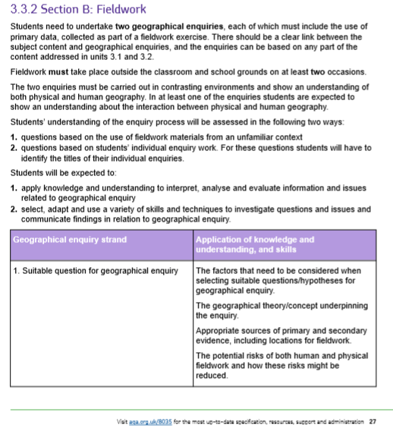
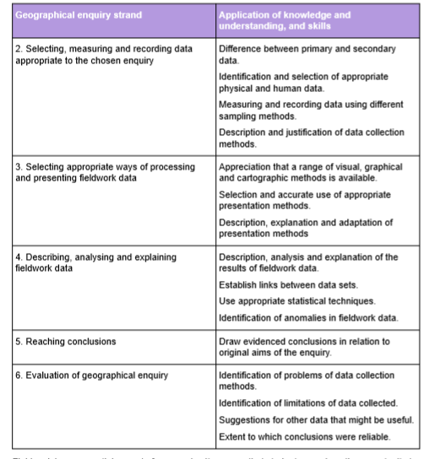
Impact of changes on assessment
Notes:
Bare that in mind as we look at the next step which is to revisit the fieldwork enquiry which is split into strands. If you haven’t looked at this for a while or haven’t seen this before at all I’d suggest spending some time becoming familiar with it, but I’m sure the majority of us, as Geographers understand the route to enquiry and the different strands that make up a fieldwork investigations. This is what our assessment writers use when the select questions for the exam, to ensure good coverage of the whole enquiry sequence.
If you think back to my previous point about the vast majority of marks here being based on skills, and you then start to look at the different strands of the enquiry, you begin to see that there are some stands here that lend themselves much better to the assessment of skills than others. [GIVE SOME EXAMPLES]

Slide 21
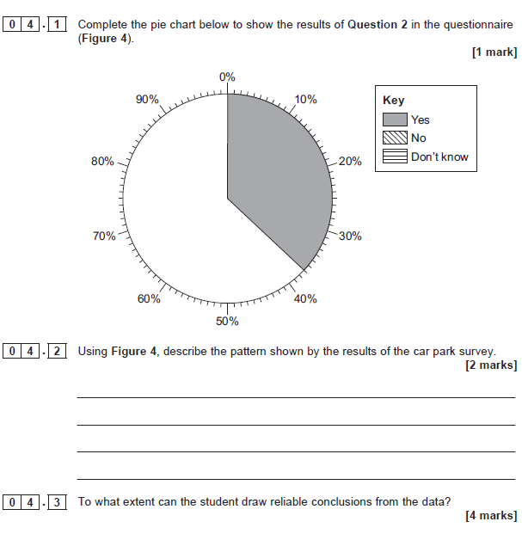
Examples of unfamiliar fieldwork questions
Notes:
You can see from this example of a question taken from the 2020 autumn series paper which is on the secure area of the website how these questions are set up – it provides a set up of part of a fieldwork enquiry and explains some context. It then follows with a series of question stems that build a level of difficulty. You can see here the skills based questions (completing the pie chart, describing patterns) and then you can see where there’s a level of judgement and conclusion expected – some of those AO3 marks attached to the higher tariff question. This is typical of the structure of these question types and you might find a couple of these scenarios make up the majority of the questions.

Slide 22
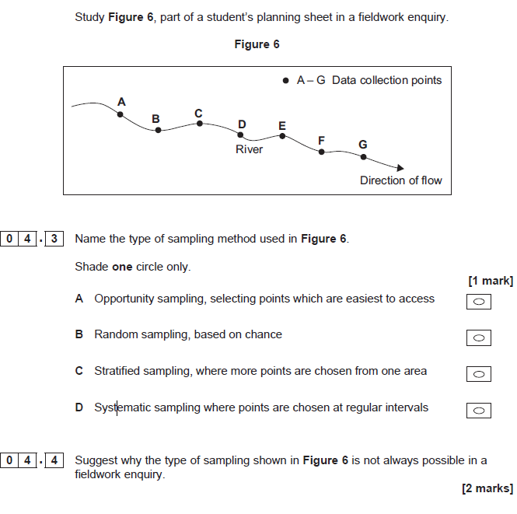
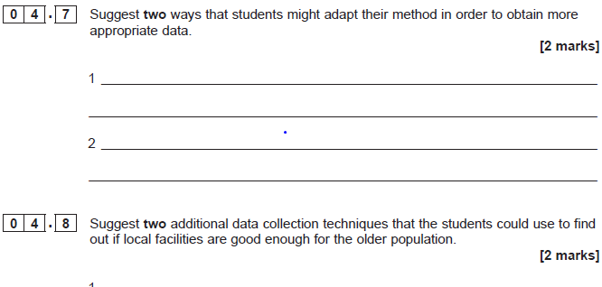
Examples of AO4 Questions
Notes:
Here is another example from an earlier series that follows a very similar structure and if we focus on the skills questions here, you can see where they come from if we cross-check it with the strands of the enquiry – the earlier strands as we mentioned before

Slide 23
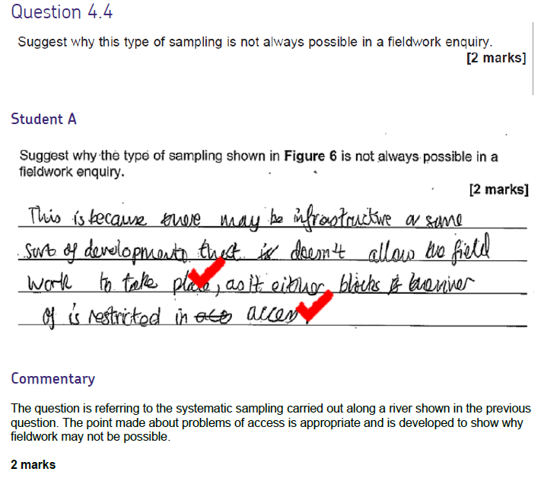
Notes:
We’re not going to spend lots of time looking at answers and marking here, I’m not a standardised examiner but I wanted to show a few examples of some responses to these questions. These resources are actually from the support that was put together by AQA last year to help with Teacher assessed grades but are actually really great resources to bank if you haven’t already downloaded them.
You can see how this student achieves 2 marks with a really simple developed point – sometimes that’s the key to doing well on these questions and not over-doing it. You can sometimes find that, in the absence of fieldwork some students do better on these types of questions, as they’re not tempted to bring in their own knowledge or incorrectly refer to their own fieldwork by default.

Slide 24
Examples of AO4 Questions
You can see here how there is some expectation of a judgement ‘assess the usefulness’ which brings in those AO3 marks, however the judgement is in relation to students knowledge of measures of central tendency (a required Geographical skill) in the context of housing quality data
Notes:
If we take a closer look at some of those questions with the AO3/AO4 mark combination you can immediately see the difference in the expectations when you take a look at the command words/phrases. ‘assess the usefulness of’ implies that a certain level of judgement is required (typical of AO3) students should be able to spot these and would approach responding to them like they would if they saw a similar command word on a 6/9 mark question elsewhere in the paper.

Slide 25
Examples of unfamiliar fieldwork questions
Notes:
If we go back to this thread of questions and look at this question here, you can see the question is ‘to what extent’ and this is the clue to your students that a judgement of some sort is required for those AO3 marks, similar to the previous question.
So one strategy you can think about when it comes to teaching and revision for this is to come up with lots of questions that allow students to do this and practice this, practice spotting the questions and understanding the difference in how they should response vs a skills question.

Slide 26
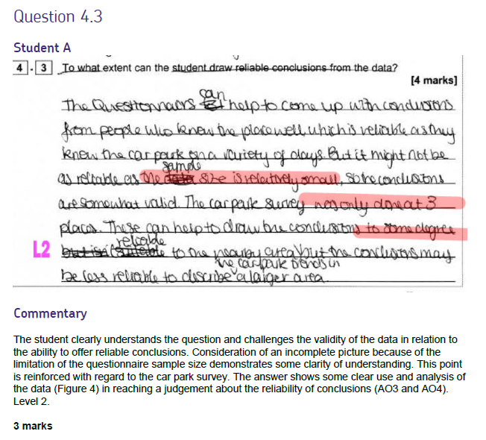
Notes:
Again here’s an example of a level 2 response (4 mark questions are the only levels marked questions on unfamiliar fieldwork, the rest are point marked). The student demonstrates an understanding of the limitations of the sample size and goes on to explain the impact that has.

Slide 27
Summary of ideas - How to engage students
It is possible to embed the geographical skills (with and without fieldwork context) and elements of the fieldwork enquiry process into ‘normal’ lessons or revision.
The key is to get students to practice and experience skills-questions in fieldwork contexts.
Remember that of the 16 marks available, 12 of them are questions testing AO4, so the expectation of how students respond to these in more in line with a skills questions you’d see in papers 1 & 2
The 4 remaining marks are AO3 questions, so there is some expectation that students are able to reach decisions, make judgements and be able to apply the knowledge and understanding they have of the fieldwork enquiry process.
Notes:
So now that you’ve spent some time looking in more detail at these questions and have a solid understanding of the assessment objectives and how that really drives the questions that we ask in conjunction with the fieldwork enquiry process, how do we then think about allowing students to become familiar and confident in giving these questions a go and picking up some marks?
Ideally with enough time and planning, you’d be aiming to make room for teaching of fieldwork skills through the content that you already teach, but where that isn’t an option, it can be something you introduce to practice during revision of taught content.
The key is to get students to practice and experience skills-questions in fieldwork contexts. You do not need to cover every possible aspect of fieldwork as students are not credited for previous knowledge of a particular fieldwork context (just aim to have some practice in the context of physical and human Geography)
The best way to be able to tackle this part of the content without going overboard is to really understand the questions and what the examiner is expecting students to do. Too often when it comes to skills questions throughout the rest of the course, students end up writing about things they know and not what they can see in front of them. The more you’re able to help students to make that connection with what is expected of them, the more likely they are to pick up some marks.
I know I’ve talked a lot about these skills marks, but there are still 4 remaining AO3 marks which you usually see split over 2 questions so the later stages of the enquiry are still important for students to be able to make judgements and draw conclusions based on their knowledge of different aspects of the enquiry. The best thing you can do here is show students some examples of questions and work through them together.

Slide 28
Summary of ideas - How to engage students
Think about:
The content that you teach - where could you find opportunities for students to consider the content they are learning/revising in a fieldwork context (rivers, coasts, urban)
Give students lots of exposure to data and different fieldwork contexts
For any environment show photographs and ask students about what geographical investigations could take place there, what types of data they could collect (an opportunity to talk about primary/secondary and qualitative/quantitative data), what sampling methods would and wouldn’t be suitable and why, what risks they might need to plan for etc.
For any geographical data discuss the presentation methods and talk about alternatives and their suitability
Notes:
Think about:
The content that you teach look for opportunities where students can consider the content they are learning/revising in a fieldwork context (rivers, coasts, urban). Looking at past paper questions can be a good place to start here, because these questions test skills, the fieldwork context can draw from any fieldwork context.
Thinking about what we’ve already said in terms of the fieldwork enquiry process and understanding where these types of questions may come from, you can focus to begin with on engaging students in the first few stages of the enquiry (as you would do when delivering fieldwork anyway). Give students lots of exposure to questions in different fieldwork contexts and data. It could be something like a fieldwork booklet that helps with revision with lots of examples of questions contained within them.
Show photographs and ask students about what geographical investigations could take place there, what types of data they could collect (an opportunity to talk about primary/secondary and qualitative/quantitative data), what sampling methods would and wouldn’t be suitable and why, what risks they might need to plan for etc.
Introduce them to some data, they will need to be able to manipulate data so giving them exposure to data sets in a fieldwork context is important. You can discuss with them the presentation methods they might use and talk about alternatives and their suitability. It wouldn’t be necessary to spend lots of time getting them to present data, though it could be useful to give them some data partially completed to practice plotting data for example as this can often appear in the exam (and it helps them with papers 1 and 2 as well). It makes sense really to use any datasets you already have from your usual fieldwork – it saves you sourcing loads more and it’s something you already know how to deliver to students, and likely will be familiar to them if it’s local

Slide 29
If you've got any questions, get in contact:
geography@aqa.org.uk

