Slide 1
Curriculum Connect AQA Geography: Outcomes of 2022 series
Stacey Hill – Head of Curriculum, Geography
Spring 2023
Version 1.1

Slide 2
Presentation Overview
Entry Data & statistics
Grading
Teacher & examiner feedback on exams
Improving student performance
Looking ahead to 2023
Further support

Slide 3
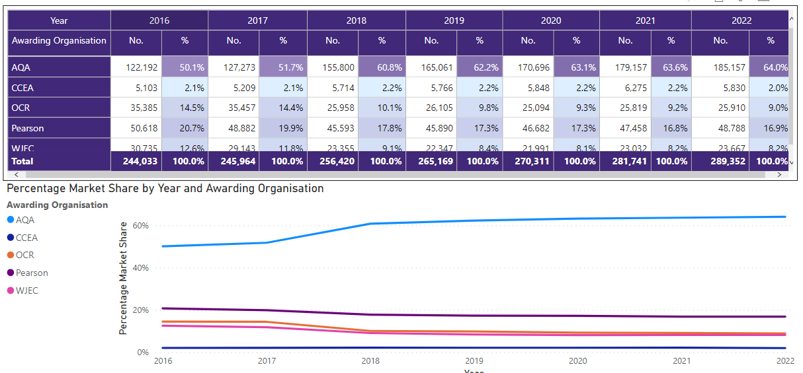
Entry data Geography (8035)
Notes:
You can find this information on the Ofqual website

Slide 4
Qualification summary - 2022
Exam adaptations:
There were no changes to Paper 1: Living with the physical environment
Students answered all questions in Section A: Urban issues, they then chose to answer either Section B: The changing economic world or Section C: The challenge of resource management.
40% approx. of students opted for Changing Economic World
60% approx. of students opted for Resource Management
Familiar fieldwork questions were removed on Paper 3: Geographical Applications and 3 marks of SPaG were moved from Section B to Section A.

Slide 5
Grade outcomes explained
Because of exam changes and reduction in marks, Papers 2 & 3 were scaled to maintain their usual weighting towards the qualification.
Because of this you might have seen student results at paper level (for unit 2 and 3) that are a bit unusual (e.g 40.56763).
It’s worth remembering that this series will need some amending in order to be used for mocks in the future (a reverse of the changes to Paper 2 and Paper 3)
Overall Subject Outcome
Grade | Mark (252) *scaled | Cumulative % (2022) | Cumulative % (2019)
9 | 193 | 7.4 | 4.6
8 | 173 | 17.3 | 12.8
7 | 154 | 29.8 | 24.4
6 | 134 | 44.5 | 38.4
5 | 114 | 59 | 52.2
4 | 94 | 71.9 | 65.2
3 | 68 | 84.8 | 81.6
2 | 42 | 93.4 | 92.5
1 | 17 | 98.4 | 98.2

Slide 6
Grade outcomes explained
Grading seems to have worked out as expected and predicted.
Ofqual stipulated that 2022 would present a standard greater than 2019 but lower than 2021.
Grade boundaries themselves were higher than in 2019, but the overall number of students achieving each grade was higher than in 2019 at all grades.
Greater student performance and demand of the exam paper are things that could have contributed to increased grade boundaries, and impact overall outcomes every year.
Overall Subject Outcome
Grade | Mark (252) *scaled | Cumulative % (2022) | Cumulative % (2019)
9 | 193 | 7.4 | 4.6
8 | 173 | 17.3 | 12.8
7 | 154 | 29.8 | 24.4
6 | 134 | 44.5 | 38.4
5 | 114 | 59 | 52.2
4 | 94 | 71.9 | 65.2
3 | 68 | 84.8 | 81.6
2 | 42 | 93.4 | 92.5
1 | 17 | 98.4 | 98.2
Notes:
The cumulative percentages of students awarded each grade are the better data to view when it comes to understanding how well students have done in any particular year. Focussing on grade boundaries alone doesn’t necessarily provide the bigger picture of how protected students are when it comes to awarding standards.
Ofqual explain that grade boundaries may not in all cases be lower in their blog Exam results 2022: 10 things to know about GCSE, AS and A level grades - The Ofqual blog point 5.
**Consider the rounding of marks at paper level when it comes to scaling

Slide 7
Feedback on exams

Slide 8
Feedback from centres on exams – GCSE (8035)
Generally comments suggested that exam papers felt more accessible this year and were positively received.
Teachers were pleased that the complexity of some questions were less of a concern this series compared to others, and students felt more able to give more questions a go, particularly for Paper 1 and Paper 3.
Unfamiliar fieldwork questions were felt to be well designed and accessible in the absence of first hand fieldwork experience.
Concerns were expressed about colour profiles on some stimulus material, and the resulting impact on students with colour vision deficiency (CVD)
Notes:
This summer, the feedback we’ve had from centres has been quite positive. On the whole, it felt as though the exams were more accessible than in previous series’. Questions themselves appeared clearer and students felt more able to try and answer most questions. This is supported by the fact that the mean marks were higher on all components compared to 2019, and links to the previous comments made in relation to changes to grade boundaries. It is really encouraging to see that the feedback from centres is increasingly more positive and we can continue to build on that for future exam papers.

Slide 9
General feedback from lead examiners
It was noted across all lead examiner reports that students seemed to generally be well prepared for the assessment, and in all cases teachers were commended for their dedication to supporting students to achieve their best in very challenging circumstances.
Despite the projected loss of learning as a result of the pandemic, student performance across the papers was of a good standard.
In some cases it was noted that there was an improvement in performance on some aspects of the assessment highlighted in 2019, which is encouraging (e.g. responding more directly to command words such as ‘to what extent’ and better application of knowledge when presented with photographs).

Slide 10
Areas for improvement
8035/1
Physical landscapes: Understanding of physical processes leading to the formation of landforms. In many cases students struggled to accurately sketch and many approached the formation in a very list-like way which limited the marks.
Notes:
The examiner reports outline in considerably more detail the areas for improvement at item level and discuss the things that students did well and less well question by question. My aim today really is to pick out one key theme from each paper and discuss how students can better engage with that content and prepare for the assessment.
For paper 1, interestingly this point related to UK physical landscapes, so consider this in the context of the two options that you select from rivers, coasts and glaciers. Students were asked to explain the formation of certain physical landforms by using both a written explanation and a diagram. Arguably quite a traditional approach to assessing this element of the content. It was clear that some students struggled to articulate the formation of these landforms beyond providing a list of statements. The idea of this being a sequence of formation which includes change over time is something that didn’t always come across and lacked accuracy (for example getting confused between different types of erosion). It’s worth students remembering and understanding that an accurate diagram requires annotation. Those annotations don’t need to repeat content in the written explanation, but should aim to show the examiner that key features of landforms are understood and identified.

Slide 11
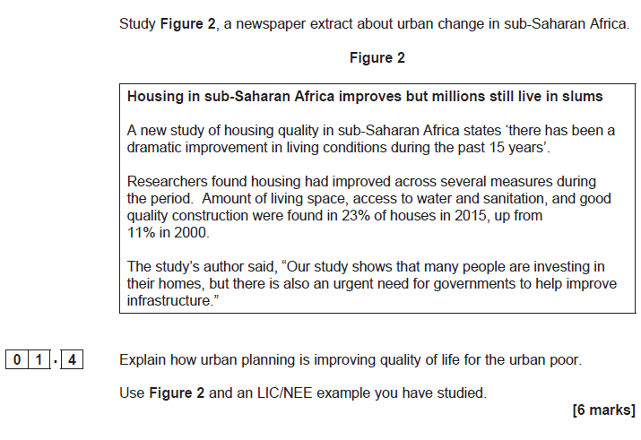
Areas for improvement
8035/2
AO2 & AO3 questions (01.4, 01.5 and 03.4) were not done as well as some other similar tariff questions. Often it’s because students don’t always grasp that there is a requirement to apply understanding related to the content in the question. This was picked up back in 2019 and still proving problematic
Notes:
When it comes to Paper 2, in a similar way we’re identifying one of the themes identified in the examiner’s report. This is something that is a real unique feature of these assessments, there are quite a number of questions that combine these assessment objective and relate to a stimulus so it’s likely a question type that is still taking some time to get used to. The questions all require some ability to interpret or analyse information, where the source a springboard to answering the question. Some may require a judgement to be made and all need some additional knowledge beyond that shown in the source, therefore responses that simply repeat information in the source are not given credit. Examples can be used to back up the answer.

Slide 12
Areas for improvement
8035/3
In contrast to Paper 1 & 2, commands were responded to less well on this paper (e.g ‘do you agree?’), perhaps because the focus is less on knowledge and understanding as evidence due to the AO3 marks.
Notes:
In terms of Paper 3, interestingly the theme we’ve picked out relates to those longer tariff questions, where the more challenging commands are written. Responding to commands that require a judgement, or commands that require students to quantify a judgement was less well done on this Paper in comparison to Paper 1 & 2. Often we can see that students respond to longer tariff questions, particularly in Section A in a way that does not always address the particular command in the question. It could be that students have practised potential questions as part of the their revision and those learned responses are their starting point in the assessment that they don’t quite manage to get away from to address the specific question in front of them.

Slide 13
Looking ahead to 2023

Slide 14
Looking towards 2023 exams
The Department for Education announced in May that exams for 2023 are expected to go ahead without any additional exam mitigations.
The intention is to return to the carefully designed and well-established pre-pandemic assessment arrangements as quickly as possible, given they are the best and fairest way of assessing what students know and can do.

Slide 15
Fieldwork – where are we right now?
We are returning to a series where the full fieldwork requirements will be expected to be met
Many teachers may not have ever planned and delivered fieldwork
Many others may feel out of practice and concerned about returning to fieldwork
Many centres struggling to provide the same type of fieldwork now compared to before (support from senior leadership, cost increases and demand for transport, growing cohorts etc.)
By the time we get to the 2023 series, ‘familiar fieldwork’ will not have appeared in an exam since 2019
We really want to raise the profile of fieldwork as a means to provide a well-rounded Geography education, without piling on more pressure to teachers
We are aware that this is a real challenge facing Geography teachers at this moment in time

Slide 16
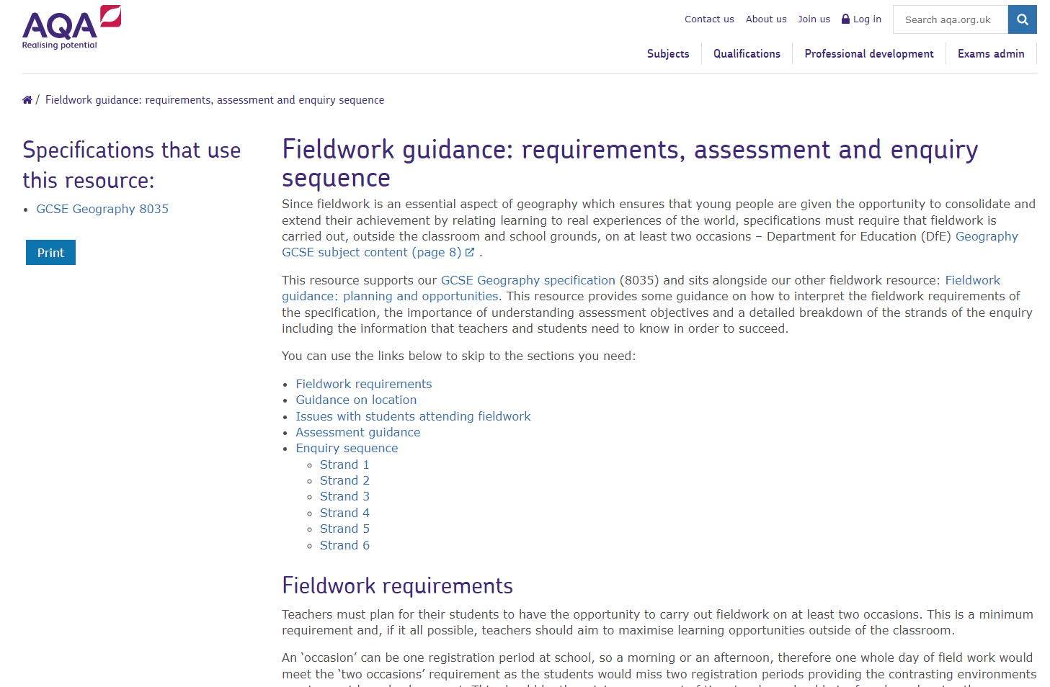
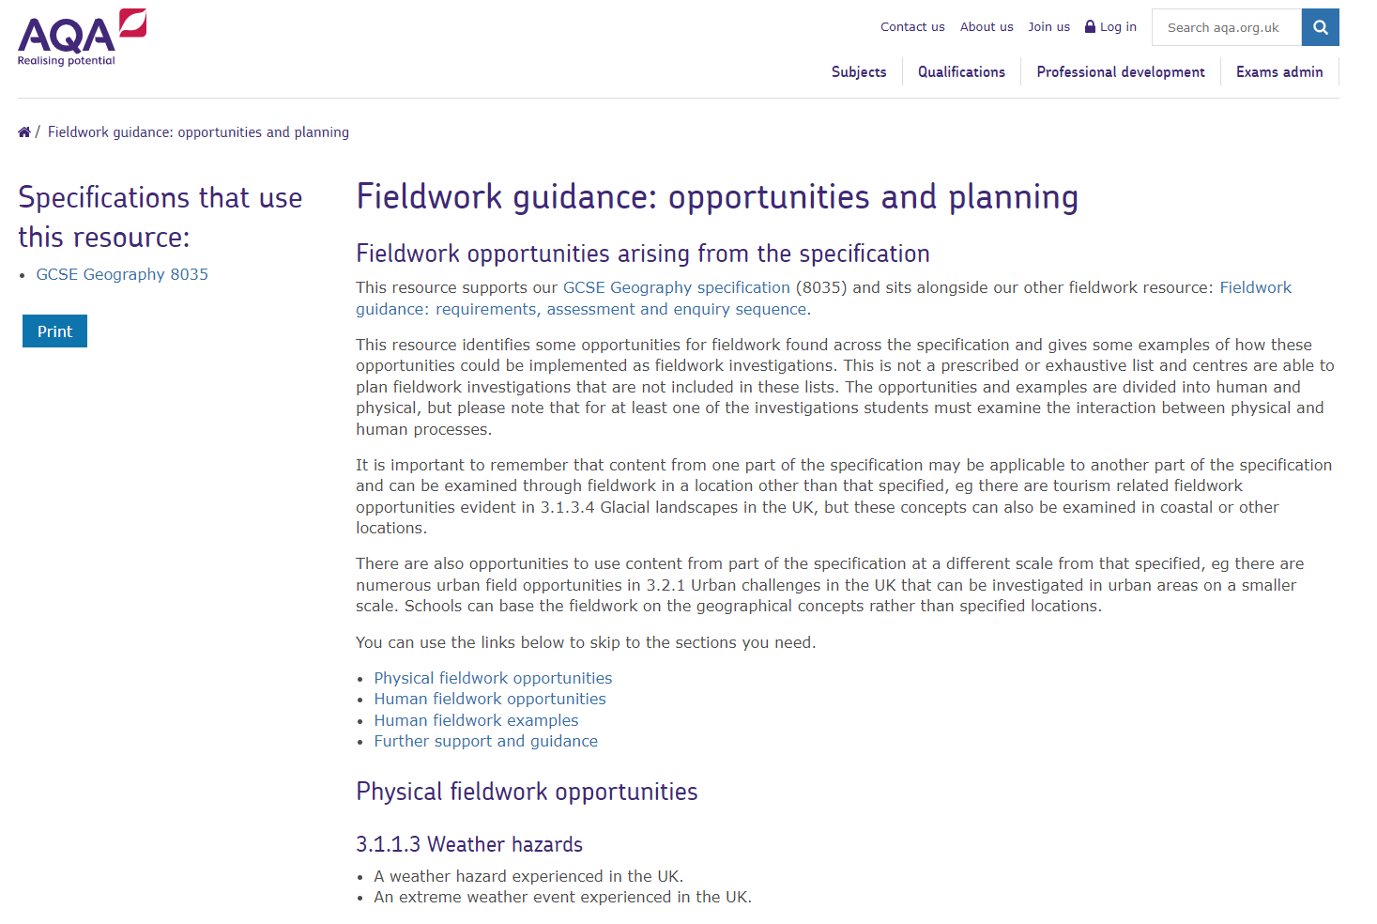
Fieldwork support
We’ve updated the fieldwork support on our website, providing some guidance on assessment, updated advice on covering the enquiry sequence and answering common queries (for example issues with students attending)
We’ve also updated out fieldwork planning guidance with some ideas for more local, innovative fieldwork opportunities

Slide 17
Fieldwork requirements – some general advice/guidance
You can chose a key question or hypothesis
Keep it simple – your students need to be able to write them both in their exam
Your fieldwork does not need to be perfect
There are NO AO1 (knowledge) marks at all in Paper 3. This means that questions cannot appear that ask students to tell us things like ‘what they did’ or ‘how they did it’
Students needs much more awareness of the ‘why’ as opposed to the ‘what’
Why did you chose this location to carry out your investigation?
Why was systematic sampling the most appropriate sampling technique?
Why is it important to carry out a risk assessment?
Fieldwork skills are also assessed generally in the Paper 3 exam, so working on fieldwork skills outside of those 2 investigations is important
Notes:
Mention the opportunity to contact us for advice on fieldwork planning

Slide 18
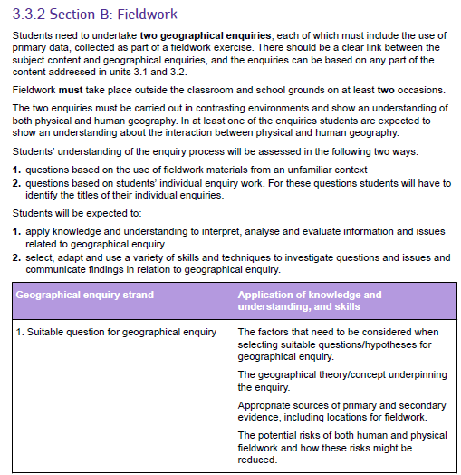
Enquiry Strands
Students need to be familiar with these – all fieldwork questions (both familiar and unfamiliar) are based around these enquiry strands.
The 9 mark question will always target more than 1 of these enquiry strands.
There are more details on the specification (pages 27-28)
ENQUIRY STRANDS
1. Suitable question for geographical enquiry
2. Selecting, measuring and recording data appropriate to the chosen enquiry
3. Selecting appropriate ways of processing and presenting fieldwork data
4. Describing, analysing and explaining fieldwork data
5. Reaching conclusions
6. Evaluation of geographical enquiry

Slide 19
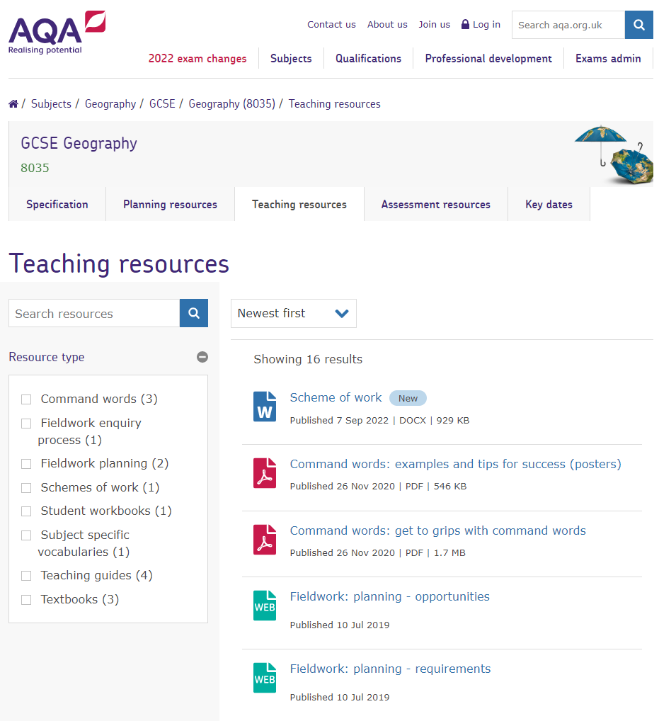
Equality, diversity and inclusion in the curriculum
We’ve produced an updated scheme of work covering the full GCSE Geography specification
These changes will support you in delivering our current specifications in a way that maximises opportunities for breadth, diversity and inclusivity in the curriculum as well as improve the accessibility of our resources
AQA | News and insight | Geography: equality, diversity and inclusion in the study of people, places and economies

Slide 20
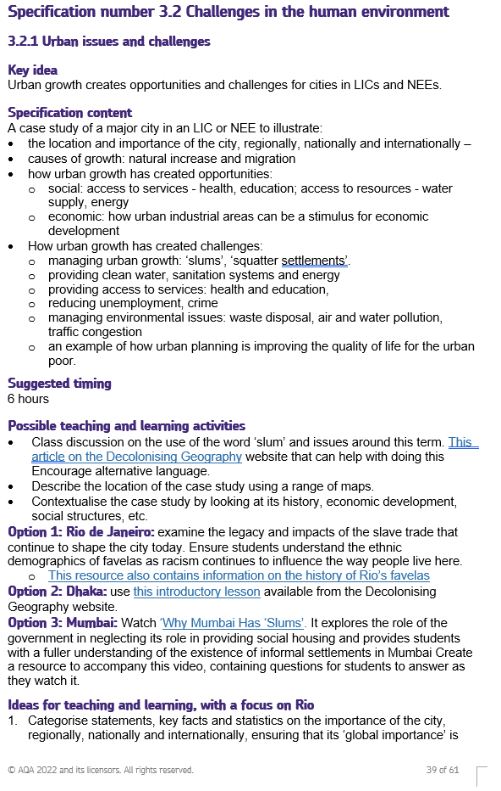
Equality, diversity and inclusion in the curriculum

Slide 21
Further support

Slide 22
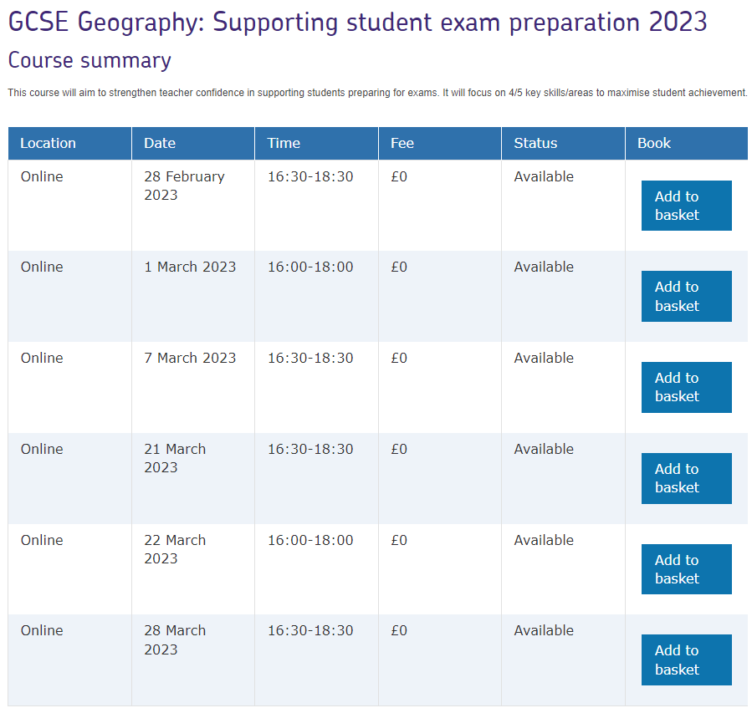
Free online CPD events: preparing for exams
AQA | Professional development | Course details

Slide 23
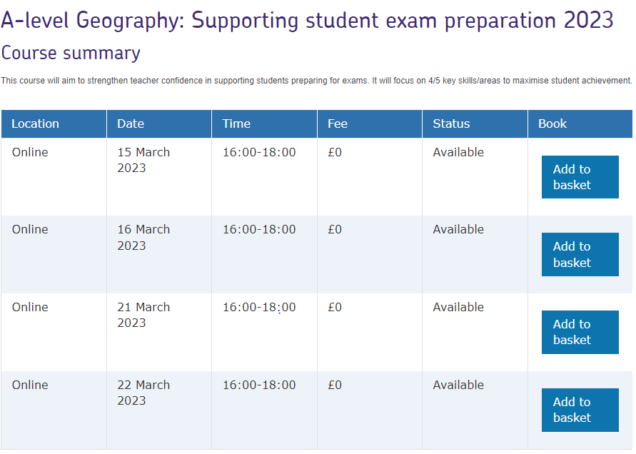
Free online CPD events: preparing for exams
AQA | Professional development | Course details

Slide 24
Free on demand marking guidance
AQA | Professional development | Course finder

Slide 25
Questions?

Slide 26
Thank you
geography@aqa.org.uk
Copyright © AQA and its licensors. All rights reserved.
Follow us on Twitter @AQACPD

