Slide 1
Hike by Pete Oswald (2020) Candlewick Press. ISBN: 153620157X
HIAS MOODLE OPEN RESOURCE
Presentation for GA Live: A world in books
Kate Broadribb
Autumn 2023
Final version

Slide 2
'Hike'
HIAS MOODLE OPEN RESOURCE
This wordless story is the basis for a KS1 medium term planning available on the open Moodle. It was shared during the Geographical Association's 'Geog Live' webinar and this resource outlines the geographical learning opportunities from the book.
The story begins with a father and child waking up early in the morning to hike the local forest and mountains.
From planning their hike, packing the car and driving through the town the story takes in beautiful landscapes of the forest from the river and waterfall to the dense woodland and vast summit peak.
Father and child plant a tree sapling before returning home past the shops and buildings of the city to document their adventures in the family album.

Slide 3
The Human Environment
HIAS MOODLE OPEN RESOURCE
The storytelling begins at the first double page of the title sequence.
Instead of the 'usual' publishing information here the scene is set for the start of the tale with the home of the father and child.
Support children to observe the types of home here, with the family bungalow clearly in evidence. Other homes along the street are depicted as single-story with similar trees planted in the front garden.
In the background we notice the skyscraper style blocks supporting discussions about activities that could happen here introducing terms like offices, business and shops

Slide 4
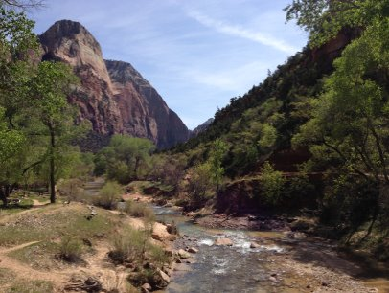
The Physical Environment
HIAS MOODLE OPEN RESOURCE
There is a vast array of features from gentle to more steep sided hills, valleys, waterfalls, lakes, river, mixed woodland and the summit peak
There are lots of animals to spot in each image from bluebirds to eagles.
Seasons: there is some snow on the ground and the characters have a snowball fight, yet flowers are out in some scenes with buzzing bees providing the opportunity to discuss weather and seasons.
During an interview in 2021 Pete Oswald described how he based the landscape on the forests of Utah he used to hike with his dad such as Fishlake forest or Zion National Park
Photograph of Zion National Park taken by K.Broadribb

Slide 5
Medium Term Planning – Hike for KS1
HIAS MOODLE OPEN RESOURCE
Find six sessions developed around geographical enquiry questions on the Open geography Moodle suitable for Years 1-2.
Course: Medium Term Planning (hants.gov.uk)

Slide 6
Enquiry Questions
HIAS MOODLE OPEN RESOURCE
The overarching question for six sessions is:
What geographical features can we find during a hike and why is it so special?
These are then broken into subsequent questions to explore:
What is a hike?
What geography features would you expect to see on a hike?
Where is Utah and what is it like?
What is the landscape like in Hike?
Where are hot environments and how are they different to those in our area?
What is the most common feature in our local landscape?

Slide 7
Geography
HIAS MOODLE OPEN RESOURCE
Kate Broadribb – Geography Advisor
Kate.broadribb@hants.gov.uk
For further details on the full range of services available please contact us using the following email:
htlcdev@hants.gov.uk

Slide 8
Upcoming courses
HIAS MOODLE OPEN RESOURCE
Keep up-to-date with our learning opportunities for each subject through our Upcoming Course pages linked below. To browse the full catalogue of learning offers, visit our new Learning Zone. Full details of how to access the site to make a booking are provided here.
English
Maths
Science
Geography
RE
History
Leadership
Computing
Art
Assessment
Support Staff
SEN
TED
MFL

