Slide 1
Overview of the session
Geography updates
Highlights from summer 2024
Understanding the assessments:
Low tariff questions
Case study questions
Level marked questions
Extended response questions (8 and12 mark)
Preparing for 2025
Explore resources and support available

Slide 3
What do Subject Advisors do?
Support ELC, GCSE A and B and A Level Geography teachers
Answer questions and offer advice on our qualifications
Commission, write and review resources
Commission, write and review professional development
Write blogs/ recruit blog authors
Advise and work closely with internal teams on our qualifications (Assessment Standards, Compliance and teacher support)
Attend events, conferences, network meetings PGCE/ITT groups
Network with examiners, publishers and teachers
You can read more about what Subject Advisors do here

Slide 4
About you
How many years’ experience do you have teaching Geography?
What is your role at your centre? (ECT, Teacher, HoD, HoF, other?)
How long have been teaching OCR Geography?

Slide 5
Geography Updates

Slide 6
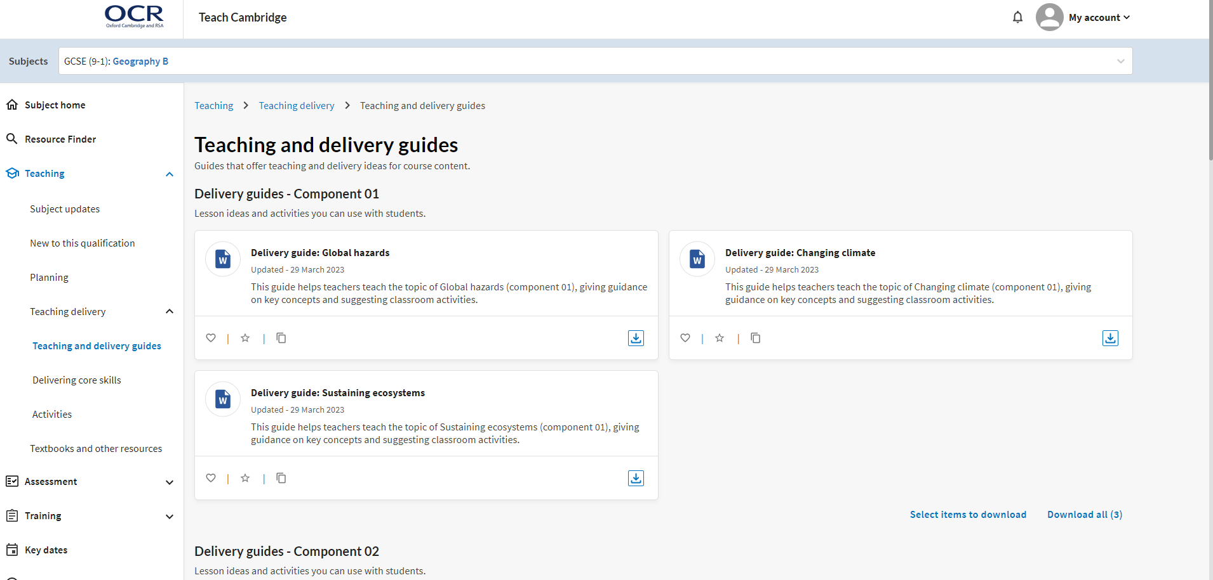
Teach Cambridge Teach Cambridge is our personalised and secure website that provides teachers with a single point of access to all support and resources. You can: - use the search function to find resources, training, and support over multiple pages - create a profile so that you only see updates and resources, content and training, relevant to your subjects - favourite the content, so resources you need regular access to are easy to find every time - rate resources to help others Summer 2024 exam papers, mark schemes, candidate exemplars and examiner reports will only be available via Teach Cambridge. If you haven’t already got a login, please speak to your Exams Officer.

Slide 7
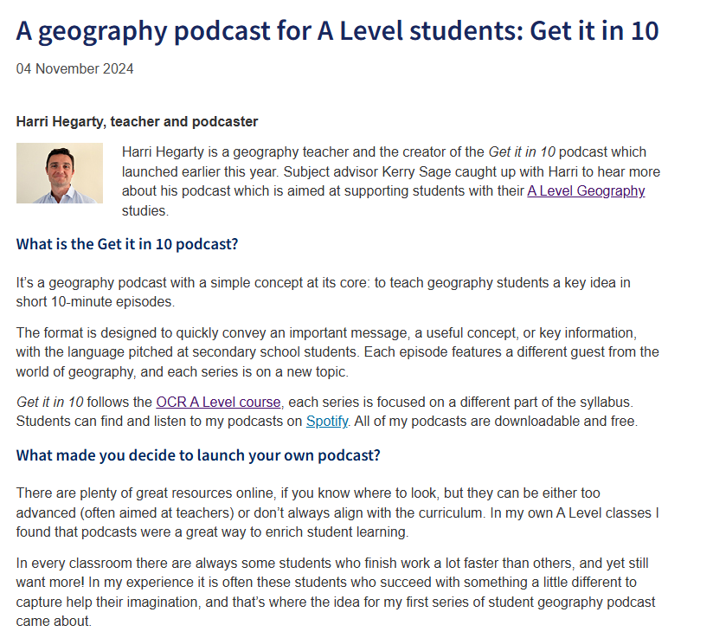
Have you seen our most recent blog?

Slide 8
GCSE Geography B Review and Refresh
What have we reviewed?
✅ Manageability – striving to reduce the amount of content
✅ Accessibility – reviewing assessments to ensure all students have a positive exam experience
✅ Relevance – revisiting content to ensure its relevant to today’s world
What have we done?
external and internal reviews
focus groups and surveys
engaged with experts/organisations
refreshed and updated content
streamlined specification and case studies
greater focus on own fieldwork experience
enhanced accessibility
submitted to Ofqual summer 2024
Next steps?
Ofqual will review our qualification
aiming for first teach 2025
resource bank for teachers
Notes:
Ofqual will review our submitted specification, sample assessment material and assessment strategy against their General Conditions, as well as qualification and subject level conditions, including the DfE’s Geography GCSE requirements.
After this review, Ofqual may accredit the qualification. Alternatively, they may request we make some changes. This review and feedback process can take a few months. However, it’s necessary to ensure we develop the best possible qualification for you and your students. We'll collaborate closely with Ofqual throughout.
You can learn more about Ofqual’s accreditation process here.

Slide 9
Visit our dedicated J386 webpage to learn more about our refresh and download our draft specs
Download the mapping guide for J386
Sign up for email updates to be kept in the loop
Engage with our Professional Development opportunities
Sign up to our GCSE and A Level Geography networks
Read our latest blogs
Follow us on X: @OCR_Geography
Email: geography@ocr.org.uk

Slide 10
Structure of the course
GCSE B J386 |  | GCSE B (Geography for Enquiring Minds) J384
Our Natural World (01) Weather Hazards and Changing Climate Dynamic Landscapes Sustaining Ecosystems Fieldwork | 35% of total GCSE | Our Natural World (01) Global Hazards Changing Climate Distinctive Landscapes Sustaining Ecosystems Fieldwork Geographical Skills | 35% of total GCSE
People and Society (02) Urban Populations Global Development Resource Reliance Fieldwork | 35% of total GCSE | People and Society (02) Urban Futures Dynamic Development UK in the 21st Century Resource Reliance Fieldwork Geographical Skills | 35% of total GCSE
Geographical Exploration (03) Geographical Skills Decision Making Exercise Includes inclusion of synoptic assessment | 30% of total GCSE | Geographical Exploration (03) Geographical Skills Decision Making Exercise Includes inclusion of synoptic assessment | 30% of total GCSE

Slide 11
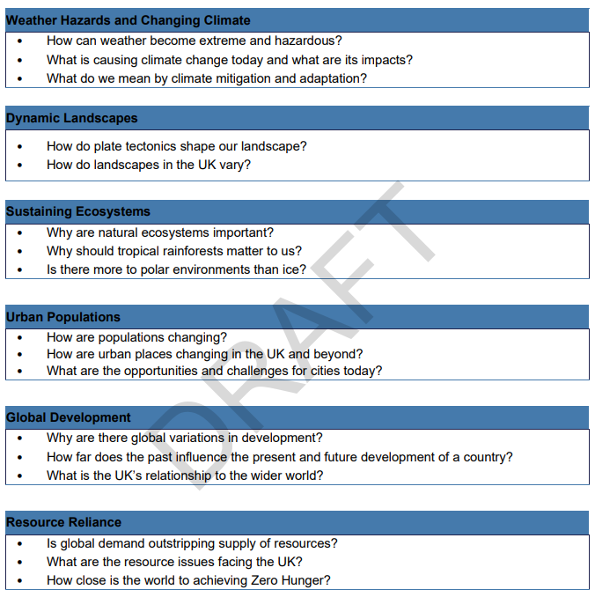
Topic overview

Slide 12
What are your thoughts about the refreshed GCSE B qualification (J386)? What are the immediate priorities for your team? What support will your team need to deliver J386?

Slide 13
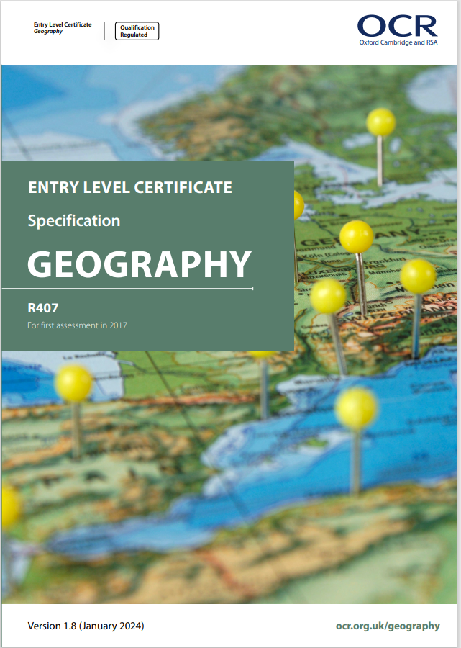
Geography progression routes
At OCR we have a suite of Geography qualifications
Entry Level Geography
R407
GCSE Geography
A (J383) and B (J386)
A Level Geography
H481
Notes:
Discuss progression routes through the different qualifications. Hyperlinks included in the spec covers
ELC run alongside GCSE

Slide 14
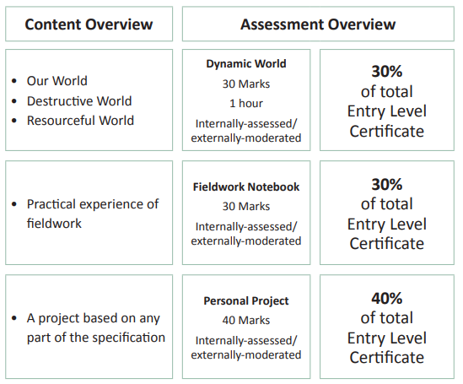
Entry Level Geography
Growing candidate entries year on year
Accessible and contemporary content
Co-teachable specification with GCSE
Assessment tasks which enable students to develop their skills
Clear marking grids, helpful for non-specialists
Notes:
https://www.ocr.org.uk/news/reformed-entry-level-for-geography-r407/
https://www.ocr.org.uk/news/new-ocr-geography-entry-level-2016/

Slide 15
Highlights from summer 2024 exam series

Slide 16
Reflections on summer 2024 exam series
How did you and your students find the exams this year?

Slide 17
Reflections
What went well | Areas for improvement
There seems to be an improvement in candidates understanding of command words and their corresponding answers. Demonstrated effective use of resources and used their geographical skills (numeracy, graphicacy) with accuracy. Candidates who are able to develop their responses across all three papers are the most successful. In 2024 comprehensive responses to the ‘familiar fieldwork’ questions show that for most candidates, conducting fieldwork is back post-covid. | Accuracy of describing location/distribution using compass directions. Understanding and using geographical language. Choice of case studies. Numeracy questions are still not well answered. Candidates not reading question and not giving answers to the correct decimal place. Candidates simply not completing numeracy questions Candidates not showing their working when asked.
Notes:
Across all papers; candidates who are developing their answers well are scoring the best.
I will elaborate briefly on the choice of case studies point on the next slide.
Numeracy questions – the Exam report highlights that it’s worth speaking to the maths department to see if they can teach the maths alongside some of the geography answers, provide them with some of the geographical questions and get students to apply the method they have learnt in maths. But we know there are differences in how certain areas of the numeracy are taught by maths and science, so OCR have produced a guide to geographical skills which is 100 pages of advice and tips on geographical skills and was produced with the help of the FSC and the maths team at OCR to help understand how these skills would be approached in maths as well. Link on the slide.

Slide 18
GCSE Geography A

Slide 19
GCSE Geography A (01) - Examiner Report extracts
 | GCSE Geography A (2024) | GCSE Geography A (2023)
Candidates who did well on this paper generally | showed good knowledge of the geographical terms used in the specification, such as traction, deposition and median knew and understood likely future changes in energy supply and the success of different energy strategies developed their explanations beyond simple statement applied their understanding to unfamiliar contexts (the information about Exeter in Question 2 (d) for example) understood the difference between ‘reasons’ and ‘impacts’ showed competent and accurate statistical and cartographic skills understood how to use the higher order thinking required to evaluate, analyse and make judgements. | good knowledge of the geographical terms developed their explanations beyond simple statements applied their understanding to unfamiliar contexts (photographs in this case) explained links between two parts of the question showed competent and accurate statistical and graphical skills understood how to use the higher order thinking required to evaluate and make judgements
Candidates who did less well on this paper generally | did not know the meaning of words such as deposition did not know that the North Atlantic Drift is a warm ocean current misinterpreted resources such as the population pyramids and OS map calculated the mean rather than median found it difficult to interpret generic words used in the specification, which appeared in questions, e.g. reasons, impacts, consequences. | confused weathering with erosion wrote about incorrect contexts, e.g., river vs coastal landscapes did not specify where they were describing found it difficult to interpret generic words used in the specification e.g., modify, consequences, did not complete a pie chart accurately using the key

Slide 20
GCSE Geography A (02) - Examiner Report extracts
 | GCSE Geography A (2024) | GCSE Geography A (2023)
Candidates who did well on this paper generally | were able to interpret a climate graph showed a good understanding of the interdependence of plants and animals in a coral reef showed sound knowledge and understanding of sustainable use and management in a tropical rainforest were able to interpret development indicator data showed sound knowledge and understanding of migration (international and national) and its impact on the growth and character of an LIDC or EDC city had some understanding of the causes of drought showed a clear understanding of how volcanic eruptions can cause climate change showed good awareness and understanding of the consequences of climate change. | able to interpret data e.g., climate data, population pyramids sound knowledge and understanding of content e.g., threats to rainforest biodiversity could describe a relationship shown on two line graphs selected relevant named examples, gave developed ideas supported with valid place specific detail for all three case studies
Candidates who did less well on this paper generally | gave long responses to low tariff questions provided superficial place specific information to case study questions, without any relevant developed ideas gave a named AC city instead of an example from an LIDC or EDC gave a named LIDC or EDC country instead of a named city did not attempt more challenging medium and high tariff questions. | did not focus ideas on desert or tropical rainforest ecosystems did not know what HDI was gave an incorrect example for an LIDC/EDC country did not understand the causes and consequences of climate change gave only simple ideas for the impact of a drought event did not attempt more challenging questions

Slide 21
GCSE Geography A (03) - Examiner Report extracts
 | GCSE Geography A (2024) | GCSE Geography A (2023)
Candidates who did well on this paper generally | provided accurate details from sources included evaluations in 6-mark and 8-mark questions gave specific examples from their studies for Paper 1 and 2 to support their responses were well practiced at using statistical skills. | attempted all the questions showed their working used the figures to support their responses drew on their own fieldwork experiences.
Candidates who did less well on this paper generally | only answered some of the questions missed out information such as their working demonstrated limited fieldwork knowledge did not think synoptically. | did not attempt all questions did not show their working did not use the figures and resources did not have a clear understanding of their own fieldwork

Slide 22
GCSE Geography B

Slide 23
Grade boundaries
2024 | Max Mark | 9 | 8 | 7 | 6 | 5 | 4 | 3 | 2 | 1 | U
01 Our Natural World | 70 | 53 | 49 | 44 | 39 | 35 | 30 | 22 | 14 | 7 | 0
02 People and Society | 70 | 53 | 49 | 45 | 41 | 37 | 33 | 24 | 16 | 6 | 0
03 Geographical Applications | 60 | 52 | 47 | 43 | 38 | 33 | 29 | 21 | 13 | 6 | 0
Overall marks | 200 | 158 | 145 | 132 | 118 | 105 | 92 | 67 | 43 | 19 | 0
2023 | Max Mark | 9 | 8 | 7 | 6 | 5 | 4 | 3 | 2 | 1 | U
01 Our Natural World | 70 | 51 | 46 | 40 | 35 | 30 | 26 | 18 | 11 | 4 | 0
02 People and Society | 70 | 52 | 47 | 43 | 38 | 34 | 29 | 21 | 12 | 4 | 0
03 Geographical Applications | 60 | 47 | 42 | 38 | 34 | 29 | 24 | 17 | 10 | 3 | 0
Overall marks | 200 | 150 | 135 | 121 | 107 | 93 | 79 | 56 | 33 | 11 | 0

Slide 24
GCSE Geography GCSE B (01) - Examiner Report extracts
 | GCSE Geography B (2024) | GCSE Geography B (2023)
Candidates who did well on this paper generally | chose the correct case study knew case study-specific details wrote fewer, more well-developed paragraphs knew the difference between data collection and data presentation wrote about individual processes. | used place specific detail provided well developed responses had learnt key terms identified the correct case study used BUG to help decode the question
Candidates who did less well on this paper generally | confused case studies especially tectonic and non-UK weather hazards wrote generic responses which could apply to a range of locations wrote simple, basic lists of answers confused data collection and data presentation mixed up the explanation of how ash and carbon dioxide change the climate. | wrote generic responses used lists or very short sentences did not know what key words meant used the wrong case study

Slide 25
GCSE Geography GCSE B (02) - Examiner Report extracts
 | GCSE Geography B (2024) | GCSE Geography B (2023)
Candidates who did well on this paper generally | understood the command words of each question and were competent in responding appropriately understood subject-specific vocabulary and used specialist geographical terms in context demonstrated good numeracy skills through calculating ‘percentage increase’ and ‘median average’ demonstrated good graphicacy skills through the interpretation of data, maps and a population pyramid wrote well developed, place specific statements in relation to Case Studies thoroughly evaluated the merits and drawbacks of initiatives to promote sustainability reflected on the effectiveness of the methods they had employed in their human fieldwork investigation. | responded to the keywords and command words in the higher tariff questions demonstrated good mathematical skills and understanding developed their case study responses with accurate place specific detail understood the difference between data collection and data representation reflected thoroughly on the accuracy of their own fieldwork investigation
Candidates who did less well on this paper generally | misinterpreted the question wrote simple statements without explanation or development demonstrated a limited understanding of geographical vocabulary calculated a total percentage through selecting and adding the relevant values identified patterns demonstrated through maps and data described levels of development in their chosen LIDC identified more than one initiative to promote sustainability in AC cities described the methodologies employed in their human geography fieldwork. | did not respond to keywords and command words in the questions did not attempt mathematical or graphical questions selected incorrect case study locations for the higher tariff questions demonstrated limited geographical knowledge and understanding could not recall details of their human geography fieldwork investigation

Slide 26
GCSE Geography GCSE B (03) - Examiner Report extracts
 | GCSE Geography B (2024) | GCSE Geography B (2023)
Candidates who did well on this paper generally | demonstrated a sound understanding of the connections between Our Natural World and People and Society understood the complex social, economic and environmental impacts of developing the Amazon rainforest selected and developed appropriate information from the resource booklet demonstrated their understanding through extended explanations which were relevant to the question demonstrated sound numeracy skills through calculating percentage change and proportion demonstrated good graphical skills through the interpretation of maps and a line graph accurately completed a bar chart interpreted photographs and a written news article to support their responses. | developed their extended responses using links to the resources and their wider understanding were able to interpret climate graphs demonstrated good mathematical skills and understanding responded to the keywords and command words in the higher mark questions demonstrated competent skills of written communication
Candidates who did less well on this paper generally | understood some aspects of Our Natural World and People and Society wrote extended descriptions about deforestation in the Amazon rainforest used the exact wording of the text given in the resource booklet without development identified simple patterns from a line graph identified some features from a photograph accurately completed a bar chart selected text from a written news article to use in their response. | quoted text or data from the resources but did not develop their response misinterpreted the temperature and precipitation data from the climate graph did not attempt numerical or statistical questions responded with simple statements focussing on one source from the resource booklet were unable to identify links between a number of sources of information

Slide 27
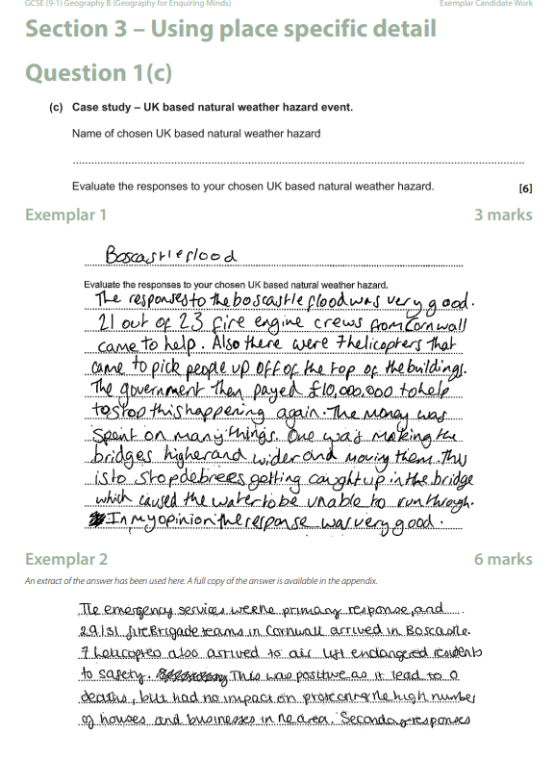
What support material already exists for exams?
Link to examiners' reports and candidate exemplars (2018 and 2019)
Examiners’ reports
Exemplar candidate work
Teach Cambridge
Notes:
The examiners reports are particularly useful to use with teachers as part of CPD after the exam series as a review of A very useful activity is going through an exam paper with the ER as well and making key notes. How your candidates did. You can also use Active results to compare how your students did against the national average, and then cross compare with the exam report to see what issues your students were likely having and what areas perhaps you need to focus on in your SoW.
The ECW documents provide marked examples of questions with the examiner commentary. They are great for teachers to help them understand the demands of the question, but also can be very useful in lessons to use with students as they provide clear examples (with legible handwriting) of answers that demonstrate certain features, e.g. good use of PLC or well developed answers. You can use full mark answers as exemplars, but also the answers that didn’t get full marks for students to see if they can identify the weaknesses and improve them.
All assessment material can now be found on Teach Cambridge. This is our new single sign on website. We have moved all qualification information, resources, assessment materials onto the TC area and teachers can also book professional development here. If they don’t have access, there Exams Officer need to set them up. Our website will have key information only.

Slide 28
Identifying a focus for teaching / revision
A very useful tool for data analysis is Active Results along with the examiners’ reports.
You can:
Identify the questions your students (on average as a cohort) did poorly on.
Compare these to the national average for the question.
Study the question, the mark scheme and the examiners’ report together.
Identify a solution/next step to tackling the issue in your schemes of work.
e.g., if the numeracy questions are identified as a common issue consider working these more explicitly into your schemes of work, embedding a numeracy question in every starter/do now/homework activity, working with the maths or science departments.

Slide 29
Low tariff questions

Slide 30
Describing patterns on maps and graphs
When completing ‘Describe the pattern’ question stems candidates should look initially for general patterns and then for more specific points. They should be confident applying this to a range of contexts.
GCSE
OR
General Comment
Specific examples
Exceptions
Trend
Evidence
Anomalies
Notes:
Another example would be REE
Relationship
Example
Exception

Slide 31
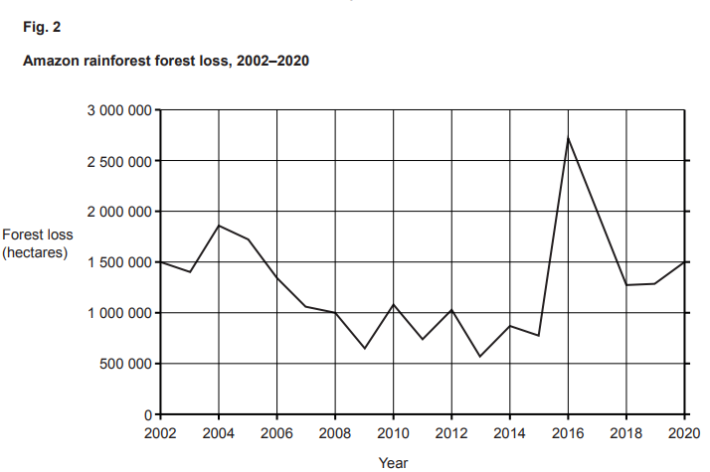
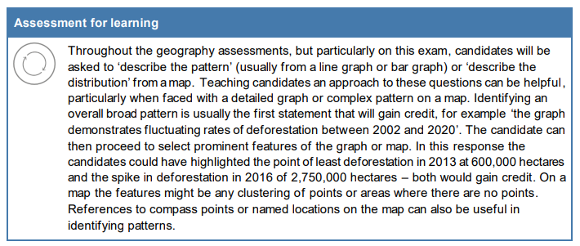
GCSE Geography B example (2024), Paper 3.
Describe the pattern
The line graph presented candidates with an extended representation of deforestation over 18 years, so there was much information to describe. Most successful candidates wrote an overall statement regarding the fluctuating pattern of deforestation demonstrated in the graph and then selected two prominent features of the pattern to gain 3 marks. Some candidates described the overall pattern through writing chronologically from 2002 to 2020 describing the features as they went; this was also credited at 3 marks. Other candidates simply selected prominent features of the pattern, such as the spike in deforestation in 2016, but did not describe the overall pattern. These responses were limited to 1 or 2 marks.

Slide 32
Describe the distribution/pattern/trend (maps/graphs)…
Typically, worth 2, 3 or 4 marks.
IF worth 2 marks, generally the marks are purely for the geographical pattern/trend visible.
IF worth 3 or 4 marks, there is a mark available for QWC (Quality of Written Communication) – how well the answer has been written/is it logical. (AO4)
For example: OCR Geography A specification 2022:
Component 1; A wind rose was the resource; 3 marks. 2 for pattern, 1 for QWC
Component 2; A world map was the resource; 3 marks. 2 for pattern, 1 for QWC
Component 3; A bar chart was the resource; 4 marks. 2 for pattern, 1 for QWC, 1 for data
Notes:
The last thing we’re going to touch on in this short answer section is the ‘describe the distribution’ questions. Which are very common across both exams and I think at least one has appeared on each spec every exam series. Sometimes more than one, but again, as with all/any of the short answer questions, there is no pattern or formula for when/where or how many might appear. As long as your students have vaguely decent locational knowledge, they should be straightforward to pick up marks.
Just to give you an example, in 2022 for the Geography A specification, there was one ‘describe the pattern/distribution’ on every paper, making a total of 10 marks, which is just under 6% of the total marks available. Which is some cases, is a grade boundary. So, students being familiar with these types of questions and how to answer them based on a wide range of different geographical sources (maps/graphs etc laid out in the specification) could really support them. You don’t necessarily need to have ‘revised’ and wrote learnt lots of case study material.

Slide 33
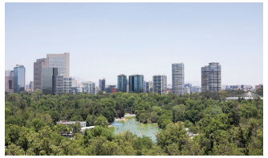
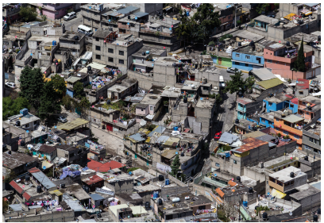
Using photographs
Accurately identifying features from a photograph is a common question in geography examinations. Candidates need to name something they can actually see in the photograph.
The two most commonly seen errors which would not be given marks in the examination are; candidates naming something that’s missing from the photograph, or candidates quoting an opinion not a feature.
Candidates should be reminded that when the question asks for one feature, it is the first feature in their response which the examiner will give marks or not to, as appropriate

Slide 34
Numeracy Questions
“Questions which require students to do calculations are often the least successfully answered questions on the paper.” OCR B Examiners’ Report 2023, Component 2
Examiner report states that the most common reason for mistakes and not gaining full marks is not giving a response to one decimal place or showing working out.
Candidates need to read the questions more carefully to ensure they:
a) write answers to the correct decimal places (often the most common error to numeracy questions) and;
b) show workings when asked.
Geography B - J384/02 - Summer 2024 Question 3(b)(i) / Question 4(b)(ii)

Slide 35
Case study questions

Slide 36
Case Studies
How do you approach case studies with your students?

Slide 37
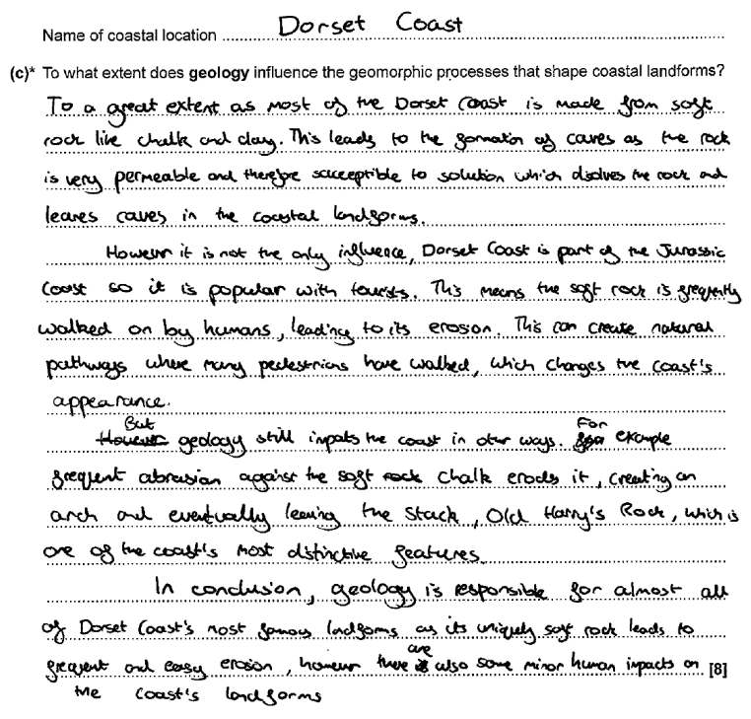
GCSE Geography B example (2024), Paper 1.
Question 3c – Distinctive Landscapes: level marking
This was not well answered with candidates providing a large amount of description about the formation of coastal landforms with little or no accurate reference to the geology of their specific coastal location. Candidates were able to accurately describe and explain the formation of a stack, going through the whole process from crack to stump without any reference to the geology. These responses usually were given 1 mark for a correctly named coastal landform (usually Old Harry). Other responses explained the four types of erosion, and the impact that they might have on a cliff, again, with no reference to the geology.
A further misconception candidates had was the use of the term soft rock. Clay was often cited as a soft rock that easily erodes and can therefore quickly become a cave before turning into an arch. There was no appreciation that the soft rock would not be strong enough to support the top of an arch. Chalk was also described as a soft rock when in most examples it was the harder of the two rocks used in the explanation. The term harder and softer maybe more appropriate than hard and soft.
Notes:
In this exemplar the candidate has a valid coastal location however they do not choose a specific landform but try to write about the whole coast.
In the first paragraph they identify that chalk and clay are the main rocks in this area, which is true for the Swanage Bay area but not for Lulworth Cove.
They also correctly identify the role of permeability, but it is not clear whether they are referring to clay or chalk. By the third and fourth paragraph they have decided that chalk is the softer rock, which is incorrect.
The response was given Level 2, 3 marks as there is some development of the idea that soft rock erodes faster and more permeable rocks form caves through solution but was not given further marks as the place-specific detail is not accurate enough.

Slide 38
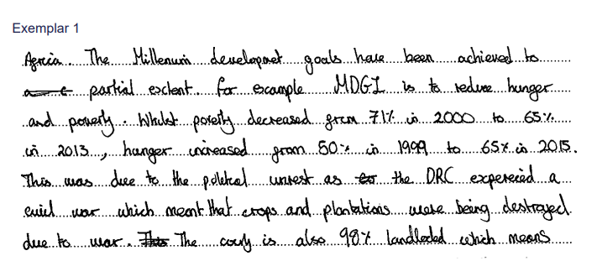
GCSE Geography B example (2024), Paper 2.
Question 2c – Dynamic Development: level marking
Many candidates achieved Level 2 or Level 3 on this question, some demonstrating well-developed ideas about their chosen LIDC and its effectiveness in achieving MDGs.
Zambia, Ethiopia and DRC were the most common countries chosen and candidates provided supporting evidence and statistics which were, for the most part, accurate.
Some candidates showed an extensive knowledge of some of the MDGs; primary education, gender equality and reducing the spread of diseases being the most popular.
Candidates included place specific detail, but many were unable to develop their responses sufficiently to achieve Level 3.
Some candidates when examining the success of increasing access to primary school education, reflected on the role of ‘room to read’ as a named charity and described the significance of improving literacy rates, particularly in women to make sure they have a brighter future.
A significant number of candidates were unable to identify a specific MDG, these candidates wrote generically about the problems facing an LIDC, some referring to education, healthcare or named agricultural strategies to improve food security.
Notes:
This candidate achieved Level 3, writing well-developed statements supported by place specific detail about named MDGs and addressing the question of ‘to what extent’ the goals have been achieved.
In the extract the candidate writes about MDG 1 ‘reduce poverty and hunger’ suggesting it has only been partially achieved in the DRC.
The candidate uses appropriate data to support their point of view and develops their response by offering an explanation of why the development has been hindered.

Slide 39
Level marked questions

Slide 40
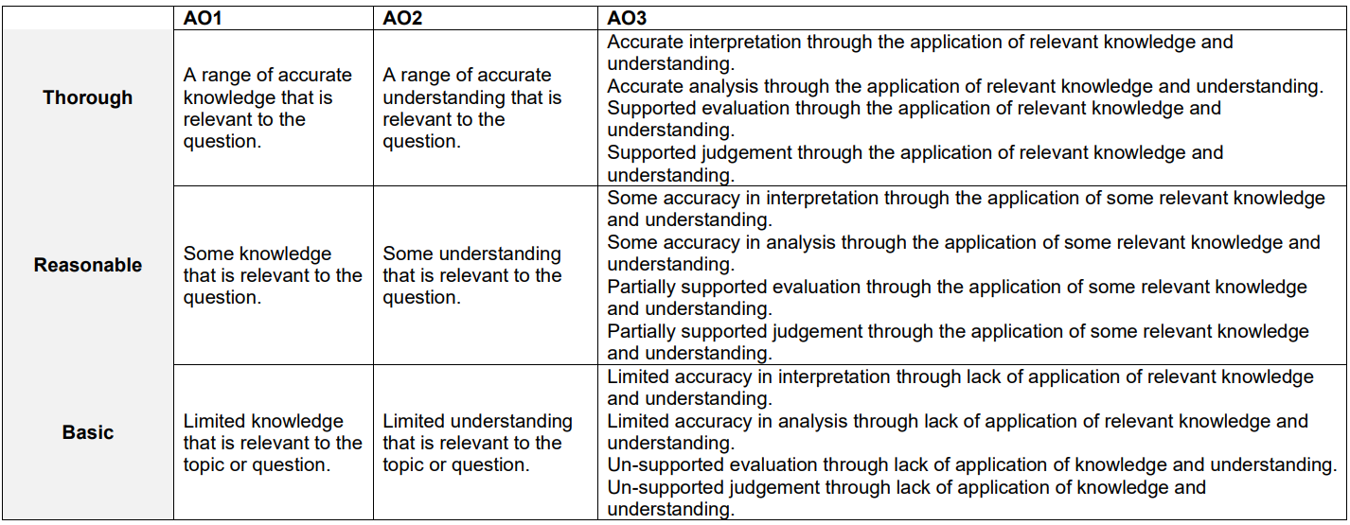
‘Levelled responses’
These are not ‘point’ marked like all the other examples we have seen so far.
Examiners look at the answers holistically and decide which ‘level’ an answer best fits in and then determines the marks from there.
‘Development’ of points is the key thing to all levelled answers.
© OCR 2023

Slide 41
Developing extended responses
“Less successful responses were more likely to provide a greater number of ideas, with each in less detail. This contrasted with more successful responses that demonstrated fewer ideas but in more detail and with a greater degree of analysis as candidates understood the command words, such as 'assess’.” OCR Geography B, Component1 Examiners’ Report, 2022
“Candidates scored best where centres had encouraged them to structure their extended writing skills into three paragraphs covering benefits, problems and conclude with a judgement.” OCR Geography B, Component 2 Examiners Report, 2019
“To help candidates, centres can practice writing evaluations using a PEEL structure – making a point, using evidence, explaining the evaluation before linking to the question.” OCR Geography B, Component 1, 2019
Resource available from OCR: Strategies to Support Students in Developing Level Marked Questions
© OCR 2023
Notes:
The examiners report from 2019 does explicitly reference using a writing frame, like PEEL… as does the examiners report for 2023 as well!

Slide 42
Approaching the Level Marked Questions
Across all 3 components the wording of questions can sometimes be challenging. For many candidates' interpretation of the question affects the number of marks achieved.
Some techniques that were successfully used in the Geographical Exploration component included:
BUG the question
BUST the question
Box the command word
Underline key parts Glance back over
Box the command word
Underline key parts Substitute key words
Think
As in Components 01 and 02 development of points is crucial to access Level 2 and beyond.
Notes:
Level marked questions are 6, 8 and 12 mark questions. These questions require students to develop their ideas.

Slide 43
‘BUG’ing the question
Money, jobs, infrastructure,
Insurance spending
Mitigating
Repairing
Global scale
More serious?
Worse?
Harder to fix?
Developed points (this mean that etc)
Extended response
Paragraphs
Conclusion
Natural environments
Species
Habitats
Extinction
How far do you agree?
Argument needed
Judgement needed
Conclusion
© OCR 2023
Notes:
We can’t really look at extended response questions unless we’ve considered how the questions break down and therefore what we are being asked to do.
This comes from various courses and resources aimed at getting students to go to this extent o break down exam questions.

Slide 44
Tackling Levelled Marked Questions
2 key things that examiners are looking for in level marked questions:
‘Thorough’ understanding; well developed responses (AO2/AO3).
- ‘however’ (AO3)
- ‘because’
- ‘therefore’
- ‘this means that’
2) ‘Thorough’ knowledge; use of place specific detail (for case study AO1 questions) OR depth of accurate knowledge to demonstrate understanding (AO2)
Notes:
The examiners reflect that students who clearly use a structure or have been taught a writing technique to scaffold their answers and producing better longer answers. Developed responses are those which move beyond simple statements and are able to show cause, or consequence, or linking either using resources (common in Unit 3) or own knowledge.
Thorough knowledge is shown by place specific detail. Simply naming the case study location is not enough. There needs to be specific information which sets the case study apart from what would otherwise be a generic response. In general, if the examiner can put their finger across the line where students write the name of the case study and would still be able to decipher the case study location from the answer, THAT is place specific detail. Examiners also do research the place specific detail (and it’s often a relatively narrow range of case studies that are used, so candidates who are ‘creative’ with the PLC will also not get credit.

Slide 45
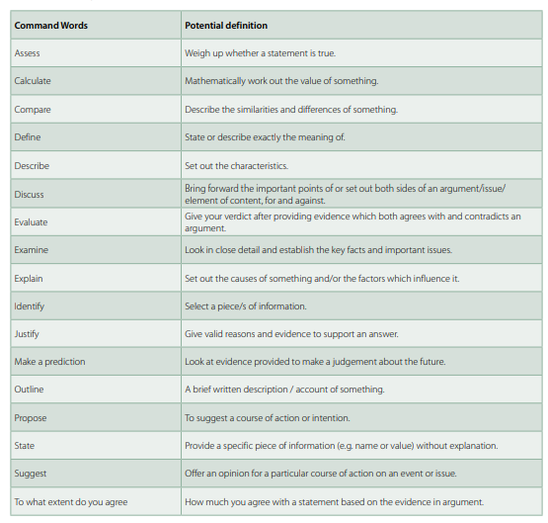
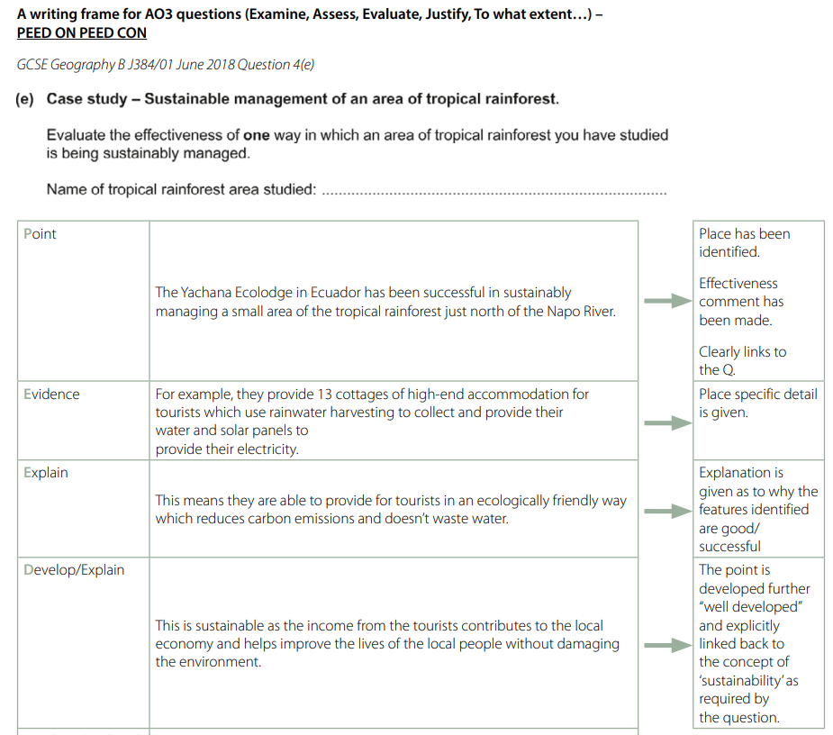
What support material already exists?
Webinars:
‘Understanding the Assessment’ (from last year, now available on Teach Cambridge)
Content
Strategies to Support Students in Developing Level Marked Questions
Command word resource

Slide 46
Preparing for 2025
How do you prepare your students for exams?
Any top tips?

Slide 47
Command Words and preparing for 2025 exams

Slide 48
Why are command and key words important?
Command words
Indicates what the examiner wants from the question and the style of response needed
Important for understanding the demands of the question
Key words
Show links to the specification
Give a geographical context i.e., what the candidate needs to write about
Help candidates to focus their answer rather than include ‘all they know’
Case study – the landscape of a UK river basin.
Discuss the influence of geology in the formation of river landforms within your chosen river basin.
Command word resource
Command word
Key words

Slide 49
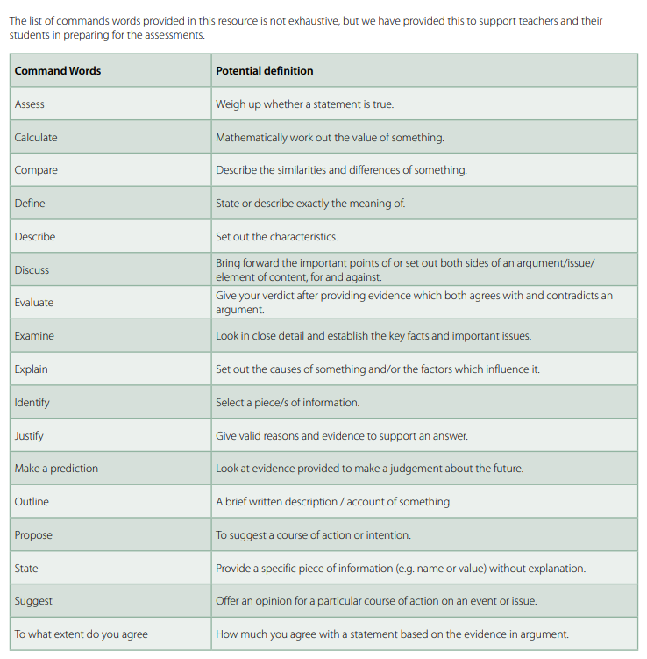
Command Words
How do you use command words in lessons and with your students?
Notes:
Hyperlink built into the Command Word image

Slide 50
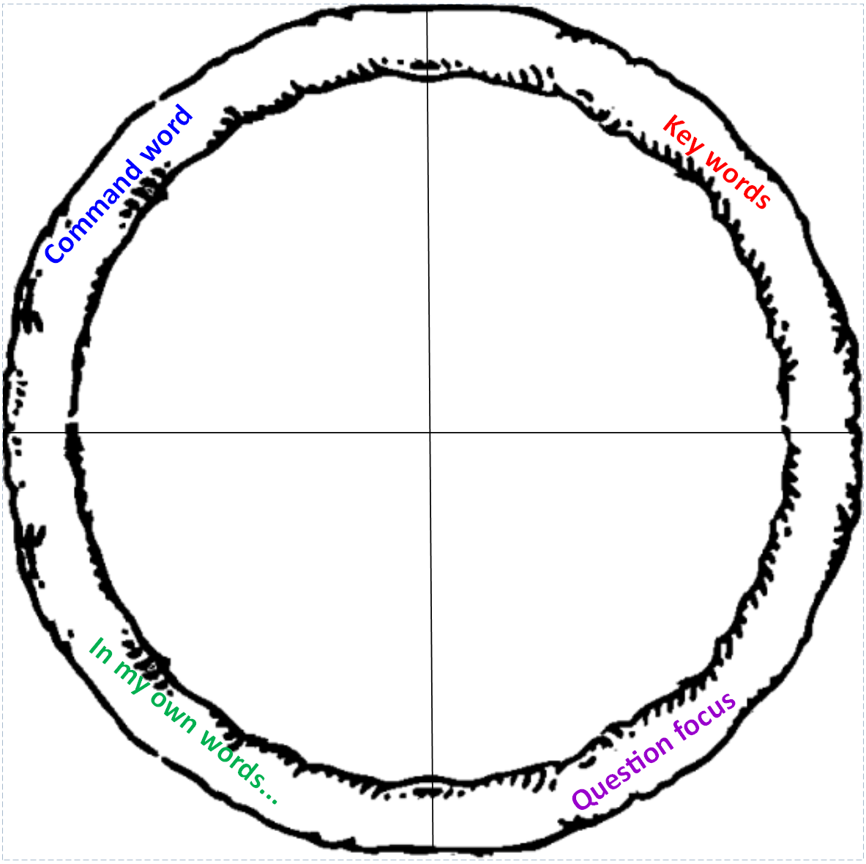
Student activity - ‘Slicing up’ the question
GCSE A
Human activities have a greater impact on the landscape in your chosen river basin than geomorphic processes.’
To what extent do you agree?
12 marks
What the examiner said: “Many candidates struggled with the term ‘geomorphic processes’ or even omitted them completely from their responses. Their responses would discuss human activities, but many struggled to go beyond stating erosion, or possibly deposition.”
Notes:
This is an example of how a teacher could ‘slice up’ (chunk up) a question to help unpick what the demands are and what the expectation is of the student.
This comment from the Senior Examiner helps illustrate the importance of key terms as well as command words. Students were able to discuss (meeting some of the command word) but could not develop their response to demonstrate knowledge and understanding of the key processes.

Slide 51
Going beyond BUG
In my own words, this question means I have to:
Make a judgement about which are the most serious? The economic impacts or the environmental impacts?
What knowledge do I need? | How do I use the knowledge to respond to the command word? | How am I going to structure my answer?
Economic impacts:
Environmental impacts:
Which one if more serious? What evidence do I have to back it up?
How many paragraphs?
Paragraph structure?
Conclusion
Notes:
Often though, bugging the question isn’t enough for students to make sense of what they have to do.
Writing the question in their own words can help them, particularly the lower ability, and then engaging with the knowledge they need to access. This can also set up an exam question lesson really well as once they’ve identified the knowledge they need, they can revise it/rehearse it in preparation to scaffold their answer.
OCR resource which could be helpful here: ‘Strategies to support students in understanding level marked questions’
https://www.ocr.org.uk/Images/627768-strategies-to-support-students-in-tackling-level-marked-questions.pdf

Slide 52
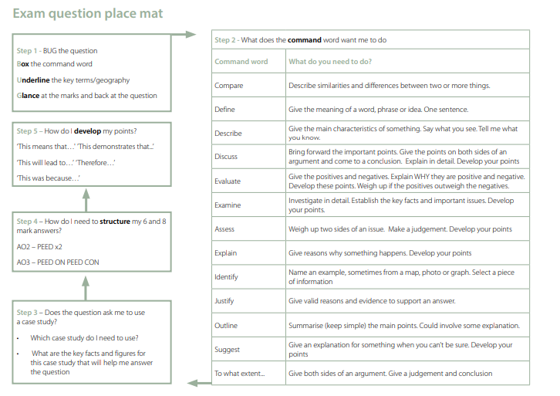
Notes:
Example of an exam question place mat to support students breaking down exam questions. This is available on the ‘Strategies to support students with level marked questions’ resource.
This would need to be used with quite a high degree of scaffolding at first to support students working through it, but gradually, removing the scaffolding so that students can work through it independently until they are fluent enough to be able to do it on their own.
OCR resource which could be helpful here: ‘Strategies to support students in understanding level marked questions’
https://www.ocr.org.uk/Images/627768-strategies-to-support-students-in-tackling-level-marked-questions.pdf

Slide 53
Start with the conclusion
To what extent do you agree?
Environmental impacts are more concerning.
“I disagree, the environmental impacts are more concerning than the economic impacts.
Economic impacts are worse to an extent...
“The economic impacts are worse to a certain extent…”
100% - economic impacts are worse.
I completely agree that the economic impacts are more concerning…
Notes:
Before students have even put pen to paper, get them to think about their conclusion first. Make them put themselves somewhere on the continuum line for the extent to which they agree. This can be a class discussion or a debate; students have to position themselves and argue their case verbally to classmates.
This also helps them to generate an appropriate sentence starter.

Slide 54
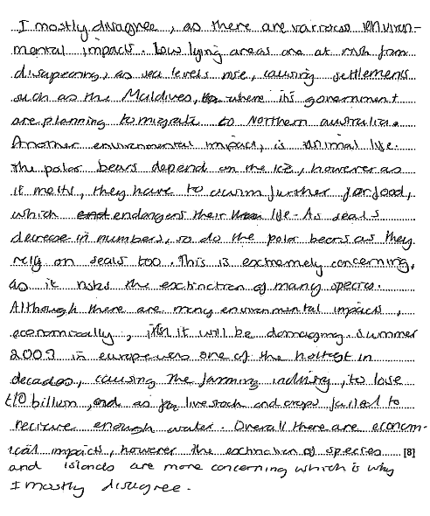
Structuring answers
Idea from a geography consultant who uses PEE, PEEL & PEED with students
Potential structure
Paragraph 1:
Economic impacts
Paragraph 2:
Environmental impacts
Conclusion
What the examiner said: “Reasonable understanding of the economic and environmental impacts would only allow a candidate to reach Level 2. This needs to be more than a sentence stating why one is worse than the other or making an implied judgement that is never fully stated.”
Notes:
This answer follows a more classic ‘PEEL’ structure. This answer got 5 out of 8 because it demonstrated reasonable understanding.
PEE:
Point
Evidence
Explain
PEEL:
Point
Evidence
Explain
Link back to Q
PEED:
Point
Evidence
Explain
Develop

Slide 55
Question: Human activities have a greater impact on the landscape in your chosen river basin than geomorphic processes.’ To what extent do you agree? [12 marks]
“To what extent” = agree and disagree (for and against), by how much.
0%
100%
Plot on the line how much you do agree or disagree – think of your “amount” word (partially, mainly, completely etc).

Slide 56
Question: Evaluate the impact of geomorphic processes on the formation of landforms in your chosen coastal landscape. [12 marks]
Think of all the possible ideas / case studies / knowledge, that you might use when answering this question. Now write it all round the outside of the circle.
Main
Introduction
Conclusion

Slide 57
Question: Evaluate the impact of geomorphic processes on the formation of landforms in your chosen coastal landscape. [12 marks]
Now look at all of your possible ideas – decide which ones are going to make the cut.
Write them in a logical order inside the circle.
Main
Remember it is an evaluate question so you will need to choose things that you can make a judgement about.
Which geomorphic processes were involved in the formation of landforms?
What else was involved in the formation of landforms?
Was one process greater than another?
Introduction
Conclusion

Slide 58
Question: Evaluate the impact of geomorphic processes on the formation of landforms in your chosen coastal landscape. [12 marks]
Intro sentence: what is your chosen coastal landscape? What landforms will you mention?
Main
Introduction
In your circle you now have a plan – USE IT!
Conclusion
Conclusion sentence: remember to make a judgement, and include key words from the question, impact, geomorphic processes, formation of landforms

Slide 59
Question: Assess how far transport developments have been the main reason for more sustainable energy use in cities across the UK. [8 marks]
“Assess” = make an informed judgement..
But what does “assess” look like?
It is evaluative - weighing up the importance of things. Advantages and disadvantages.
There are often a number of possible explanations. You need to give the main ones and then say which you tend to go for.

Slide 60
Question: Assess how far transport developments have been the main reason for more sustainable energy use in cities across the UK. [8 marks]
Transport development
Transport development
Other development
Now “assess” it. For what you have identified comment on whether it was successful or not.
Finally state which was most successful and why. ( This is evaluative – making a judgment.)

Slide 61
Fieldwork questions

Slide 62
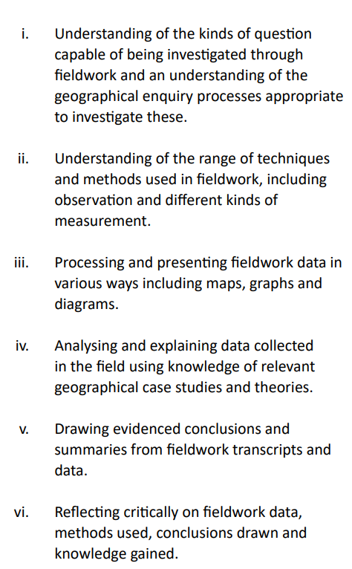
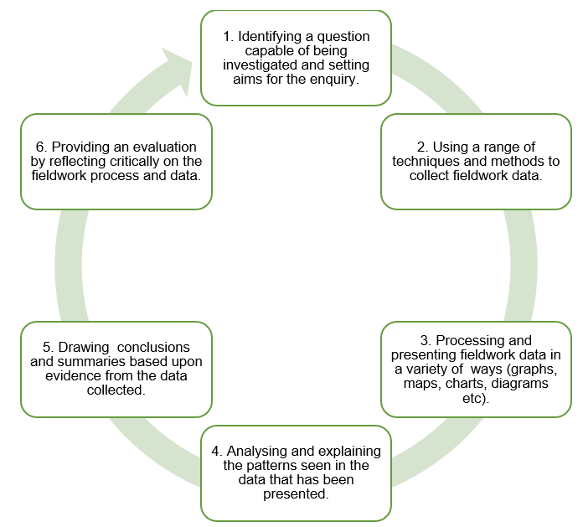
Assessment of fieldwork skills
Fieldwork skills factsheet This resource unpacks the 6 skills listed.
Fieldwork skills listed in the specification. Exam questions will target these.

Slide 63
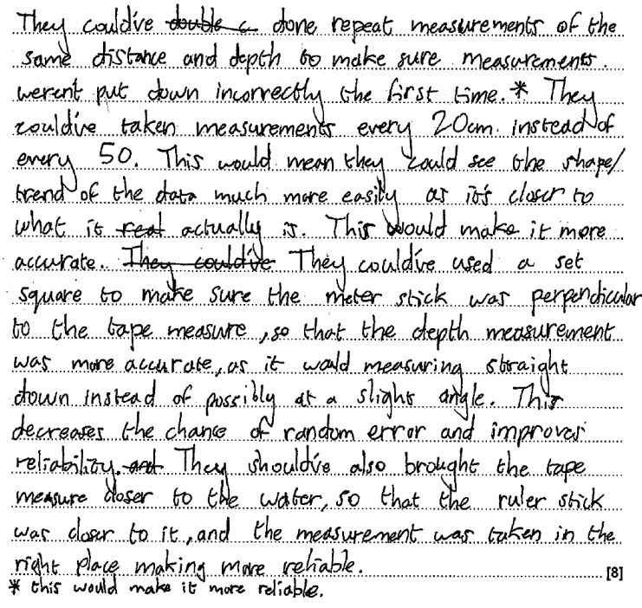
GCSE Geography B example (2023), Paper 1.
Question 5ciii – Physical Geography Fieldwork level marking
In this exemplar the candidate has identified several different improvements that could be made. Each improvement is developed by explaining how they would make each measurement more accurate and what impact this would have on the results. They have used the graph to see that results were taken every 50cm and have suggested that this changes to every 20cm as this would make the data more representative, allowing a more detailed shape of the river to be identified. In the second point, they have tried to make sure that the measurements are more precise by ensuring the metre stick is vertical as this will help to decrease the chance of random error.
This was given Level 3, 8 marks.

Slide 64
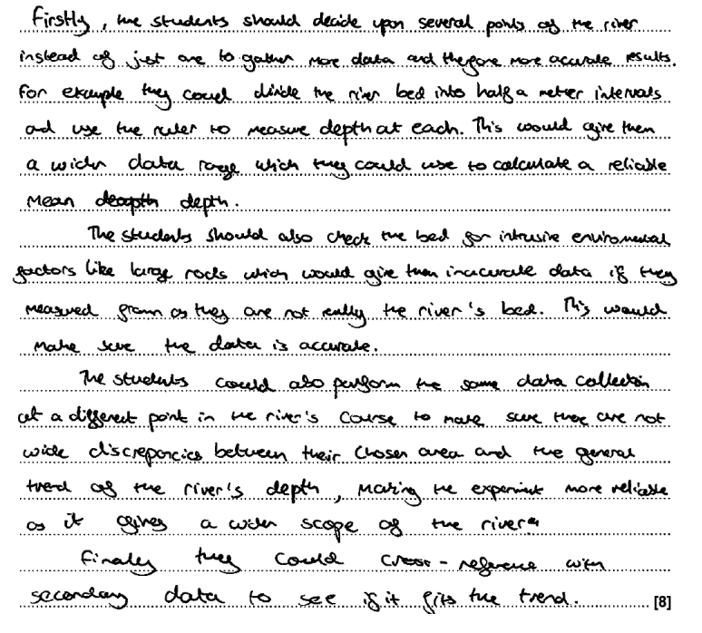
GCSE Geography B example (2023), Paper 1.
Question 5ciii – Physical Geography Fieldwork level marking
In this exemplar the candidate has identified several different improvements that could be made. They have seen in Fig. 4 that only one depth measurement has been made and suggested that more are taken, suggesting every 50cm. This is then weakly developed suggesting it would provide more data. They suggest calculating a mean from this data, but it is not clear how a mean would make the data more accurate and/or reliable. The second paragraph was given no marks, large rocks are part of the riverbed and should not be removed or not measured. They are not an anomaly. The final paragraph suggests visiting other locations as there might be a wide discrepancy in the data, but Bradshaw’s model suggests that you would find wide discrepancies in depth along the river, and this does not make the data measured more reliable or accurate.
This was given Level 2, 3 marks.

Slide 65
Further support

Slide 66
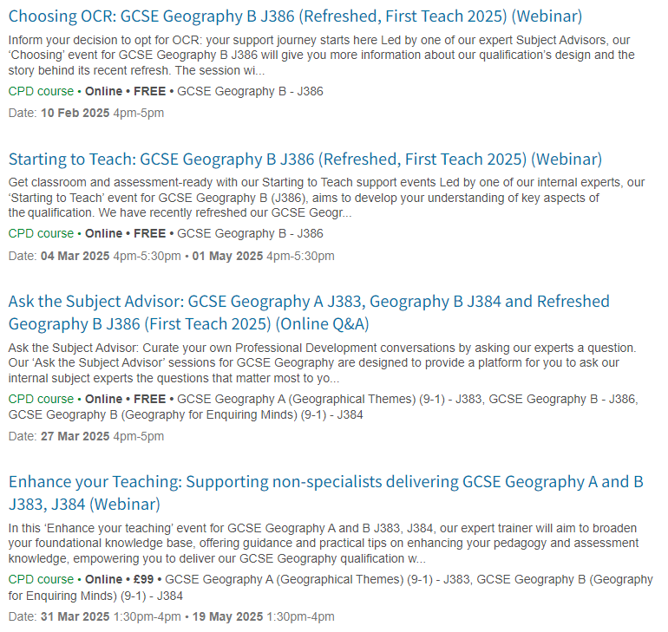
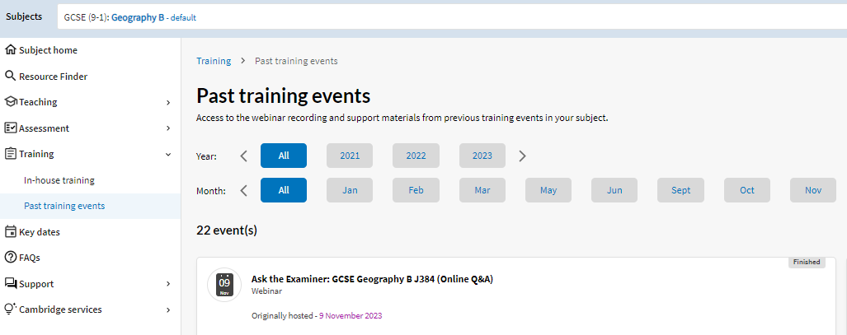
Professional development
Past courses – materials are available to download from Teach Cambridge
Exam review: GCSE geography
How to prepare students for exams GCSE Geography B
Enhancing your teaching geographical and fieldwork skills
Exam

Slide 67
Geography teacher networks

Slide 68
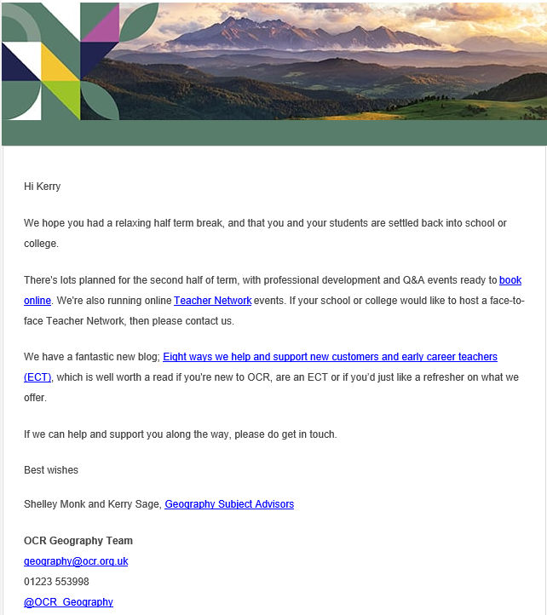
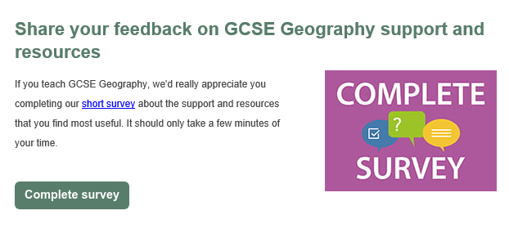
Geography Newsletter
Notes:
You can sign up to our Geography Newsletters here: https://ocr.org.uk/qualifications/email-updates/

Slide 69
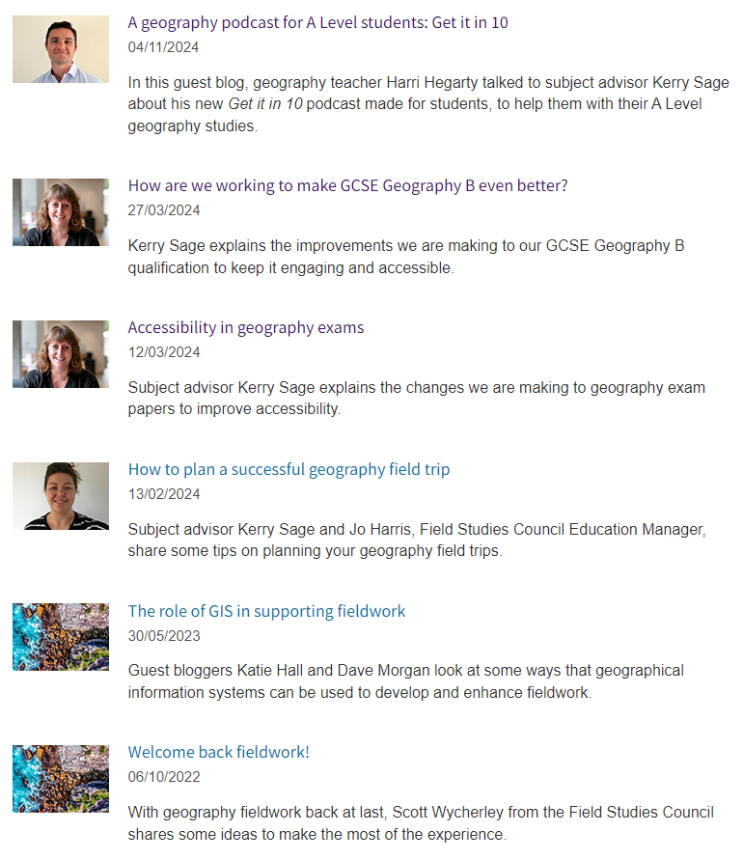
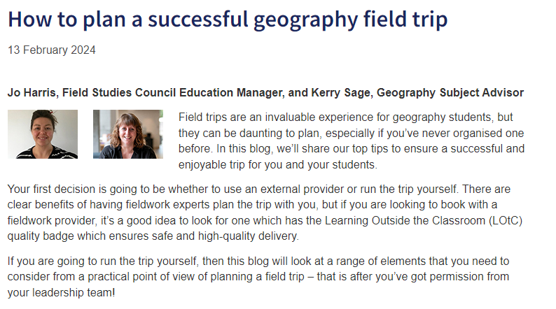
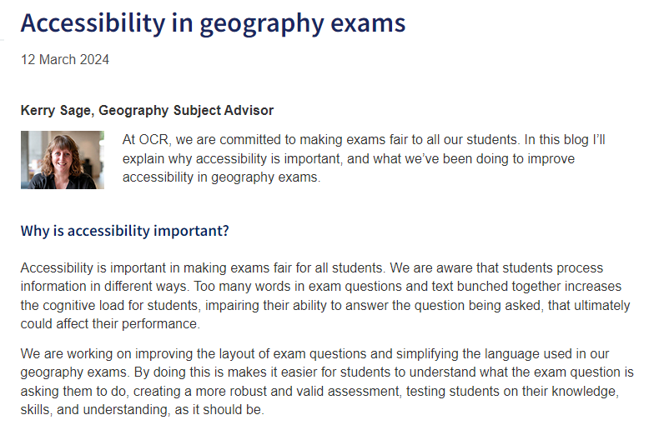
Geography Blogs
Notes:
You can find OCRs Blog page here https://www.ocr.org.uk/blog/

Slide 70
Would you like to be an OCR Geography Examiner or Moderator?
Notes:
We are still recruiting examiners; you may not have thought about this before, but it is a great opportunity for your own development
You can find out more about our Current Vacancies here: https://asrecruit.cambridge.org/search/?createNewAlert=false&q=geography&optionsFacetsDD_title=&optionsFacetsDD_facility=&optionsFacetsDD_location=

Slide 71
Next steps
download the specification - Geography B (Geography for Enquiring Minds) J384
sign up for our newsletters email newsletters
sign up for our events Geography Professional Development Events
complete our teach with OCR form
read our latest blogs
follow us on Twitter @OCR_Geography
sign up to Teach Cambridge
sign up for the teacher network events
contact the subject advisor with any questions or to arrange a follow up call/teams meeting by calling our support centre on 01223 5538998 or emailing support@OCR.org.uk

Slide 72
A big thank you for attending today any final questions? Do stay in touch........ geography@ocr.org.uk

