Slide 1
The proposal to build the waste incinerator was rejected in June 2020. Do you think this was the correct decision? Yes No Use evidence from the resources booklet and your own understanding to explain your answer [9+3]
If something is pivotal, it is very important because other things depend on it:
Task: 1: BUG the question.
2: Highlight the pivotal words.
3: Write a reduced meaning for each pivotal word.
What does it actually mean?
Notes:
We noticed that our students were able to interpret the questions but did not actually know what they meant. They were able to tell us what the command words meant, but the pivotal words within the questions often lacked the understanding.
Now before we attempt any question and during lessons we break down the meanings of pivotal words.

Slide 2
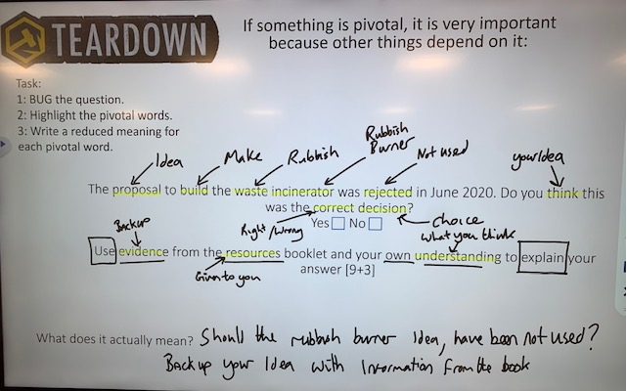
Notes:
Here is an example of how we would do this as a class.

