Slide 1
Virtual fieldwork opportunities
Walking tours

Slide 2
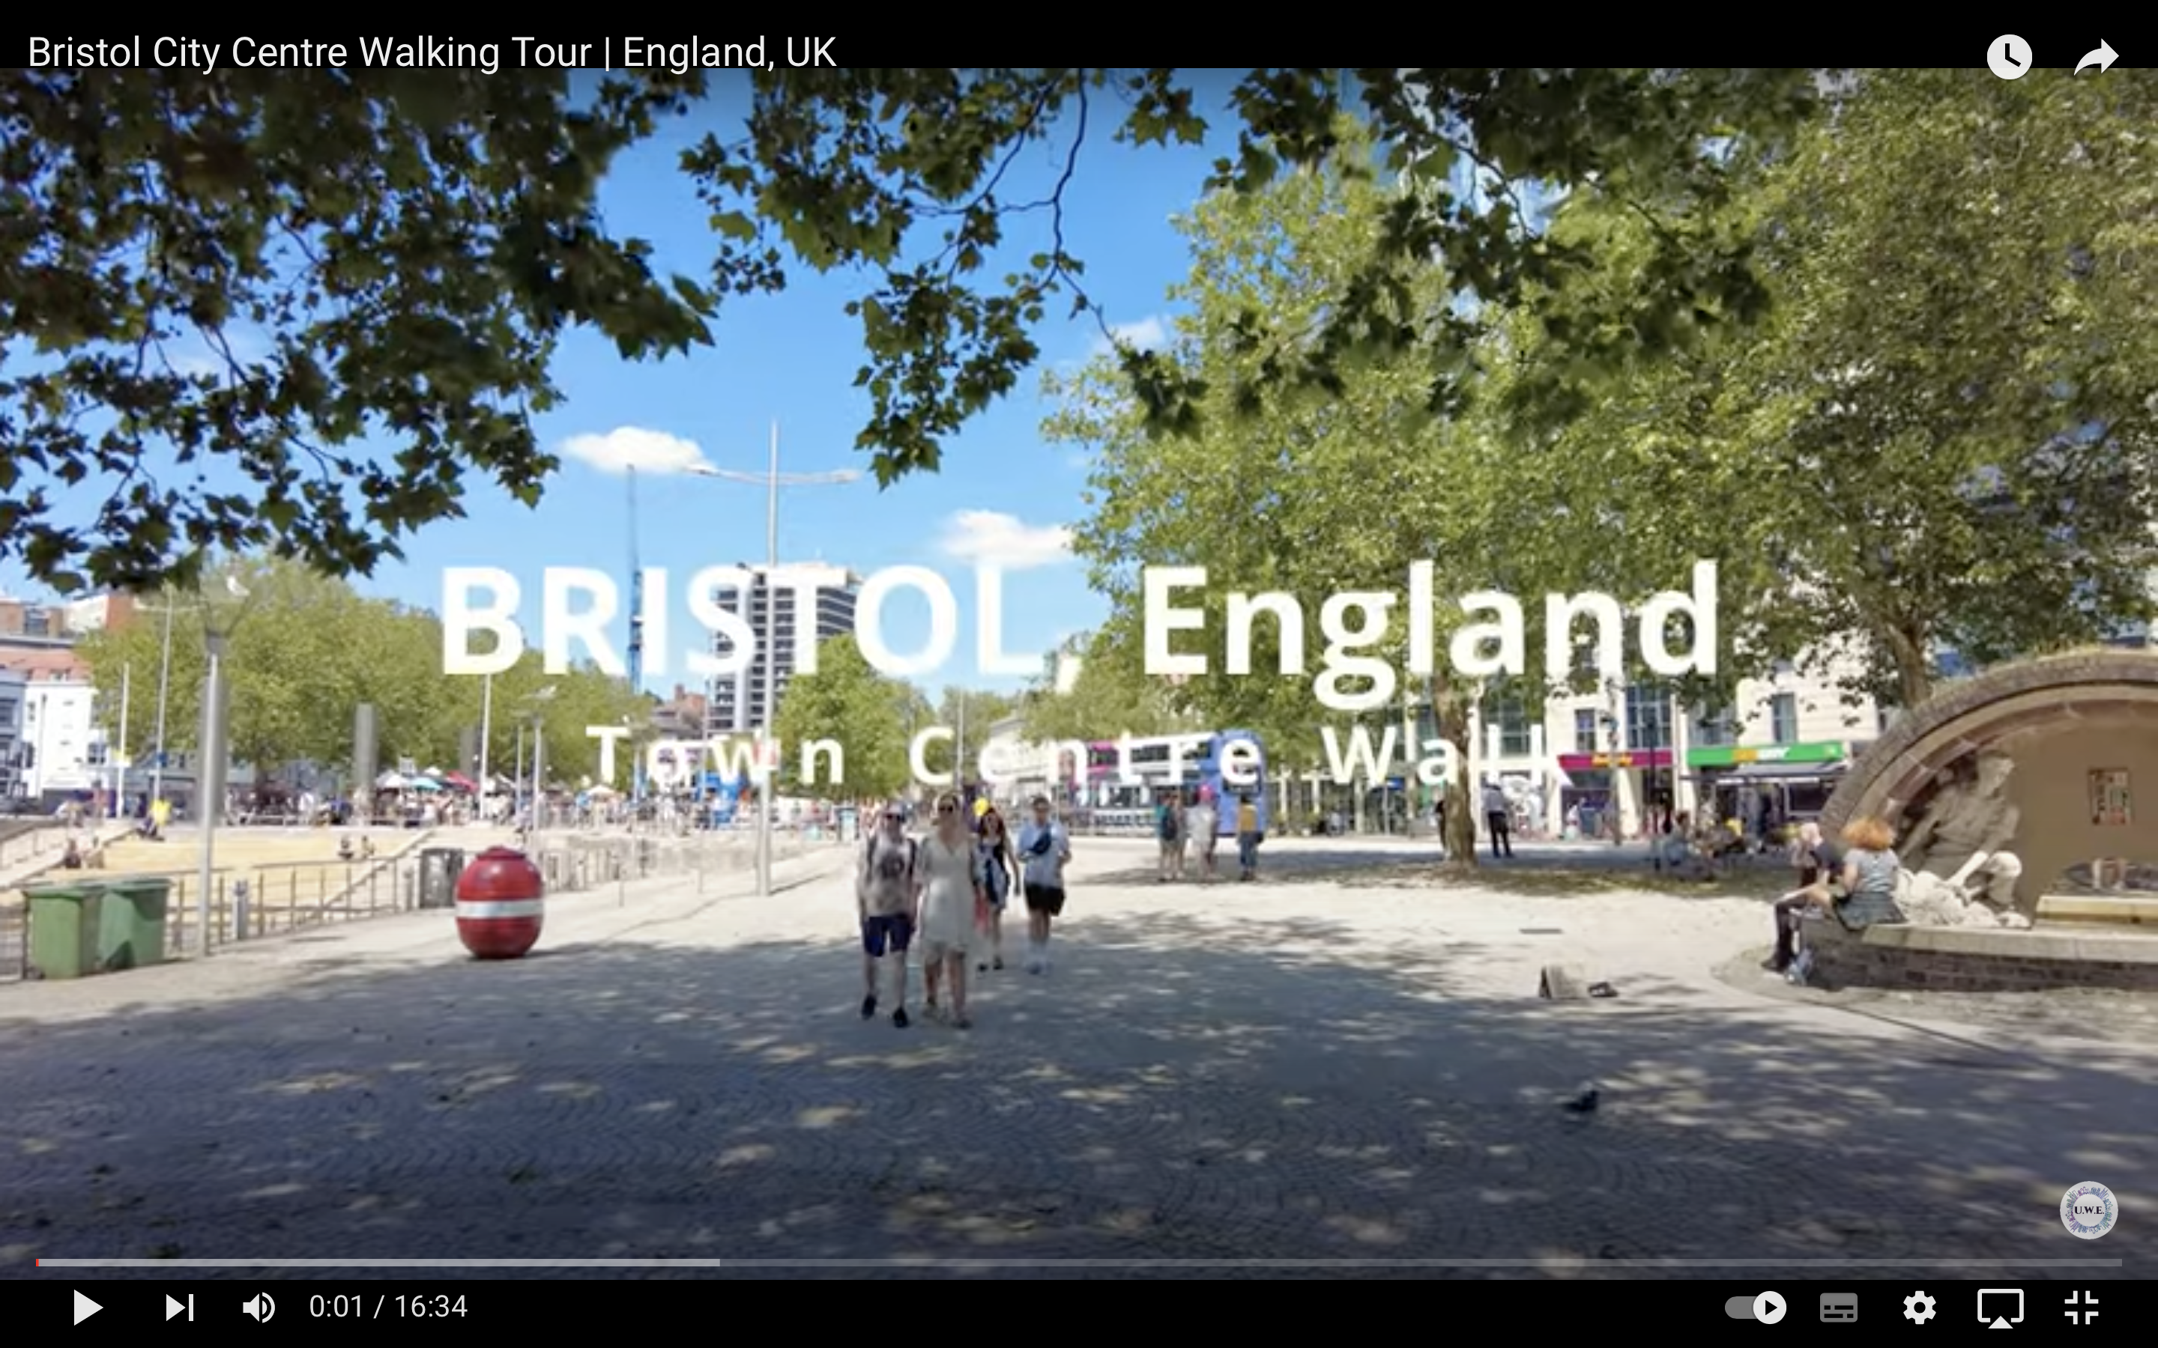
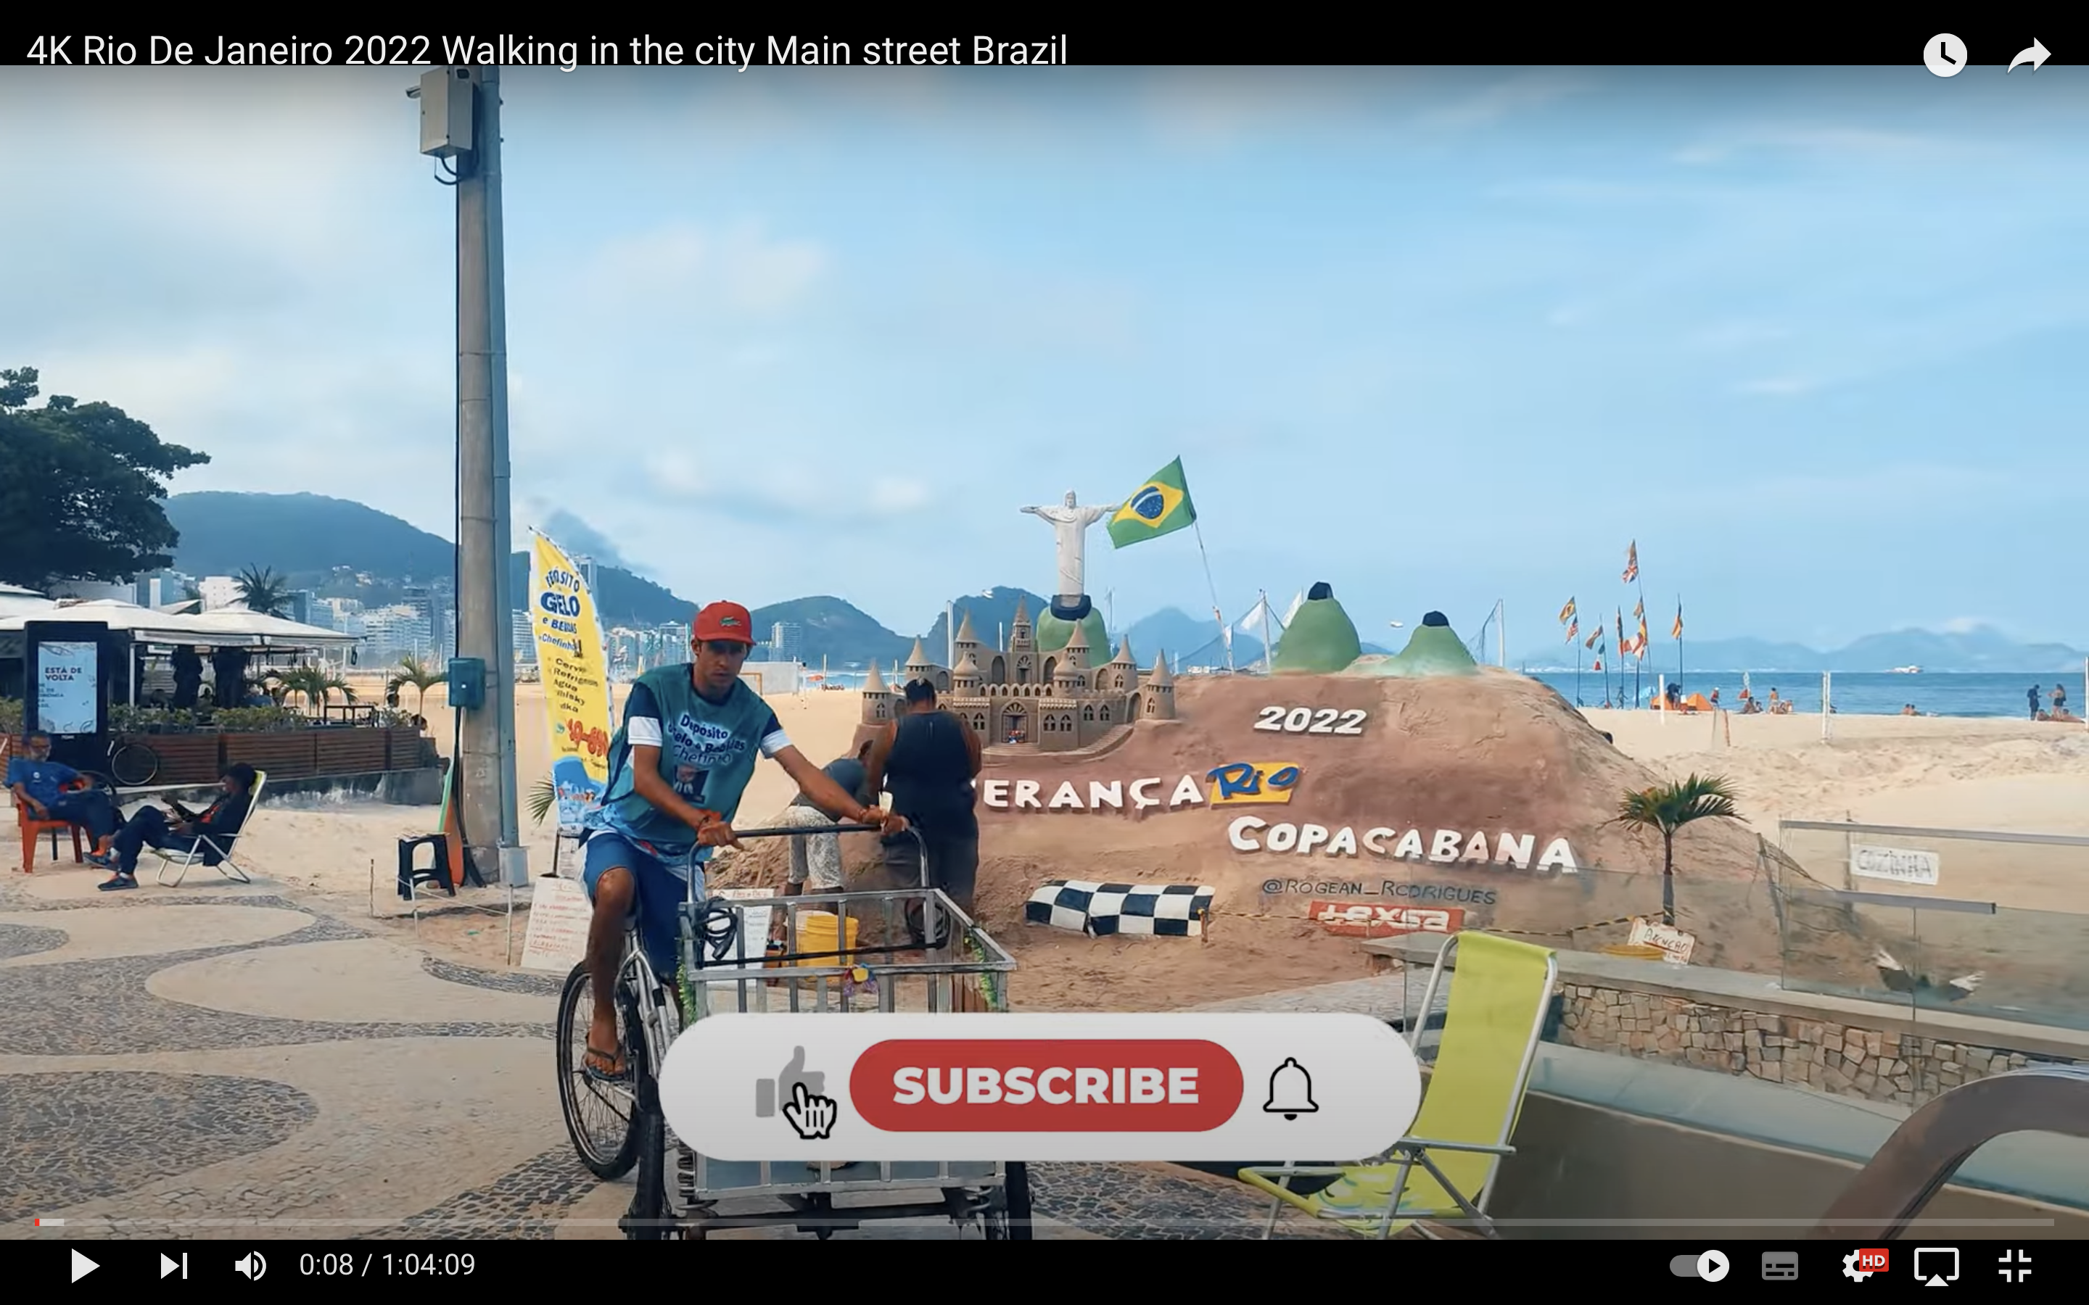
Building more fieldwork into SOWs/SOLs
Using walking tours of places has allowed us to access more places and give classes more insight in places that they may not have already visited.
UK city
Environmental quality survey
Land use survey
Building quality survey
Crime prevention mapping
LIC/NEE city
Epitmome words – perceptions
Activity mapping
Field sketches

Slide 3
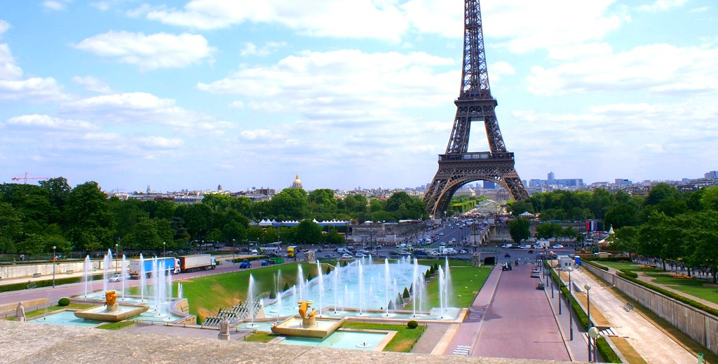
Example: Which is the most globalised city? Year 7
1. Prediction – which is the most globalised?
2. Methodology
Language survey
Brand survey
Re-photography
3. Conclusions
4. Evaluation
Cairo - https://www.youtube.com/watch?v=NHHbMBz92uc
Tokyo - https://www.youtube.com/watch?v=DppENuARxNk
Rio De Janiero - https://www.youtube.com/watch?v=rZwXrjFFWcw

