Slide 1
A trip around the world: All continents are the same…
To embed geography knowledge of the UK and continents using geography skills

Slide 2
All continents are the same…
Do you agree?
Class vote: Yes or No

Slide 3
Where is Asia?
https://www.youtube.com/watch?v=IG_CfbUQKqI
Notes:
Note: Stop at the end of Indonesia as it goes into Australia

Slide 4
Where is Asia?
Blank A3 map of the world continents
Label the continent of Asia and the surrounding oceans
Describe the location of Asia from the UK using the eight point compass directions, continents and oceans.
Extension – which continents, seas and countries would you cross on your way to Asia

Slide 5
What are the major countries in Asia?
Find the following countries on the A4 Asia map;
China, India, Japan, United Arab Emirates, Indonesia
Label the countries on your Asia map
Choose one country and describe where it is to your partner using continent and compass directions.
Describe a journey between all of the countries - you choose where you start.

Slide 6
What is Asia like?
Use the maps to find out about the human and physical patterns of Asia.
Which maps are physical? What does physical mean?
Which maps are human? What does human mean?
Look at the maps using the following TIP
T – Title – what does it say?
I – Information – what does the key show?
P – Pattern – what is the pattern of the map
Physical
Settlement

Slide 7
What is Asia like?
Look at the maps using the following TIP
T – Title – what does it say?
I – Information – what does the key show?
P – Pattern – what is the pattern of the map
Identify the main human and physical features using the human and physical maps
Annotate your map with words or symbols and a key to show your findings

Slide 8
WAGOLL

Slide 9
A trip around the world: All continents are the same…
Do you still agree?
Class vote: Yes or No
What evidence have you found this lesson to back up your opinion?

Slide 10
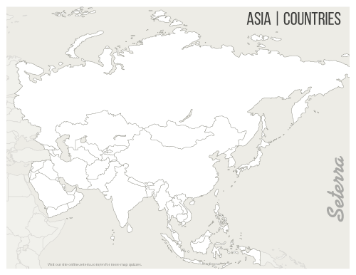

Slide 11
Key vocabulary
Continents – Europe, Asia, Oceania, Africa, South America, North America (and Antarctica)
Oceans – Arctic, Atlantic, Indian, Pacific, Southern
Directional vocabulary – south, south west, west, north west, north, north east, east, south east,
Positional vocabulary – equator, northern hemisphere, southern hemisphere, Tropic of Cancer, Tropic of Capricorn, Arctic Circle, Antarctic Circle, latitude, longitude, Greenwich Meridian

Slide 12
Work completed by the end of the lesson
Spoken
Describe the location of the continent and a country
Describe a journey to the continent and between countries
Discuss the patterns found on the human and physical maps
Discussion as to whether ‘All continents are the same’
Recorded
Blank A3 world map with continent and ocean labels
Blank A4 map of continent with the countries and seas labelled
Blank A4 map of continent with annotations showing the main human and physical features

