Slide 1
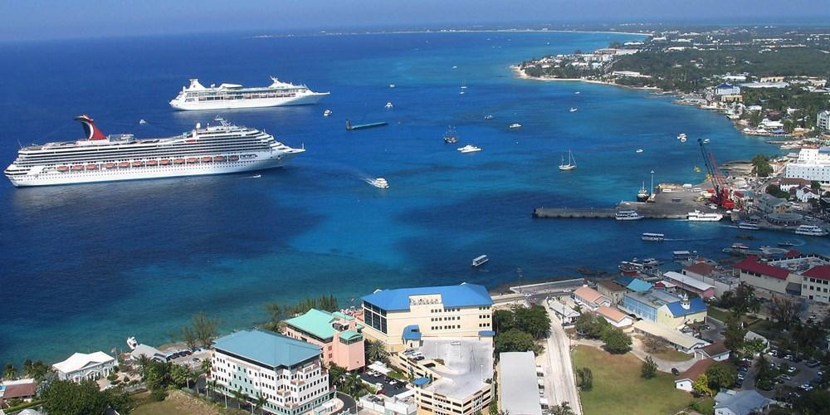
Tourism and Development in the Cayman Islands
Paper 3 – 2023
16th June 2023 (PM Examination)
Issue Evaluation:
The aim of the issue evaluation is to assess your critical thinking and problem-solving skills and to provide you with the opportunity to demonstrate geographical skills and their application of knowledge. The assessment is synoptic and will give you the opportunity to use your learning across the specification in order to analyse a geographical issue, consider and select proposed solutions and justify choices.
This will be your definitive guide to this year’s issue evaluation. It is important that you engage with the figures in the resource booklet by reading them, re-reading them, highlighting key concepts, geographical theory, and processes. Alongside this, you should include annotations that link the figures and information to any relevant parts of the specification.
The questions in pink are the ones which have been written in the style of the questions we are likely to see on the exam itself.

Slide 2
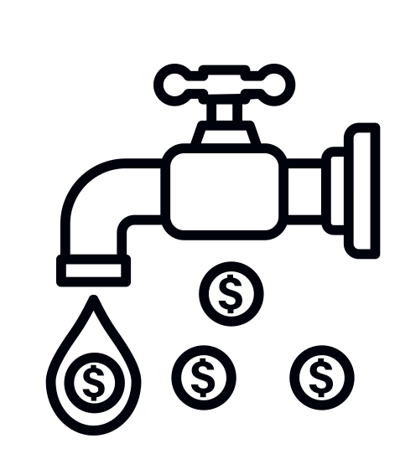
Paper 3 is a synoptic paper which means we are required to make links between the key topic and other areas of the specification.
Task: Now you have read the resource booklet, create a mind map which displays the links to other parts of the specification.
Challenge of Natural Hazards
Living World (Ecosystems)
Tourism & Development
Changing Economic World
Resources
Urban Issues & Challenges

Slide 3
Bb hgg
Glossary of Key Terms
Multiplier Effect |  | Multi-use redevelopment project
Cumulative Causation |  | Dredging
Balance of Trade |  | Taxes
Income distribution |  | Stay-Over visitors
Dependency |  | Long-stay visitors
Wastewater |  | Revitalisation Initiative
Tourism Revenue |  | Coral Transplanting
Ecotourism |  | Cargo Trade
Cultural Heritage |  | Regeneration

Slide 4
Figure 1 – Tourism & Development
Insert ‘tourism and development and ‘income distribution effect of tourism’ info box here
Summarise the information in 3 key points:
-
-
-
Match the correct element of the multiplier effect to the correct box:
Workers spend wages locally
Employment increases in tourist industries such as hotels and restaurants
Taxes paid increases
Work increases for businesses supplying the tourist industry such as the construction sector
Increased income for government spending
Other local businesses are supported by their spending
Overseas visitors are attracted to an area

Slide 5
Figure 1 – Tourism & Development
Insert ‘international tourists by world region graph’ here
Describe the pattern of international tourist arrivals by world region [3 marks]
Suggest one reason why Europe has the most international tourist arrivals [2 marks]
Suggest reasons why international tourism has increased since 1950. Use the picture clues to help.
Conversely, what can stand as a threat to the tourism industry?
Notes:
Reasons for increased tourism:
Improved Travel (Commerical planes 1950s, rise of the budget airline etc)
Technology – ease of booking etc
More disposable income in both West and, more recently, emerging economies
Social Media – exposes consumers to ‘far away’ places
Different types of holidays available e.g Cruises, all inclusive, package, ecotourism etc

Slide 6
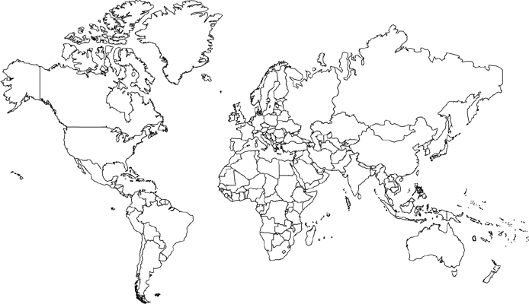
Figure 1 – Tourism & Development
Insert blue list of 20 countries most reliant on tourism here
Task: Plot the top 20 destinations most reliant on tourism
Describe the spatial pattern of the top 20 destinations reliant on tourism:
Mind-map the reasons why these destinations are successful in attracting significant tourism numbers:
Insert ‘which countries rely most on tourism’ info box here
Bullet point the challenges facing countries who are reliant on tourism as a key economic activity:
-
-
-
-

Slide 7
Suggest why economic reliance on tourism could be a challenge for the Government’s of LICs/NEEs [4 marks]

Slide 8
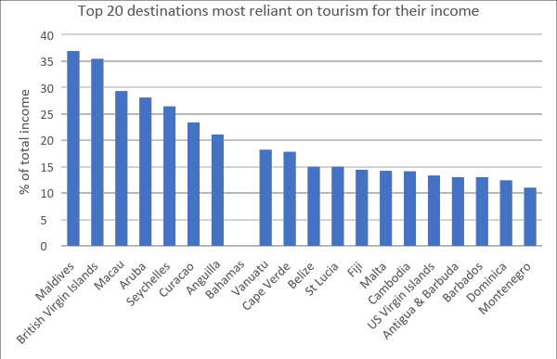
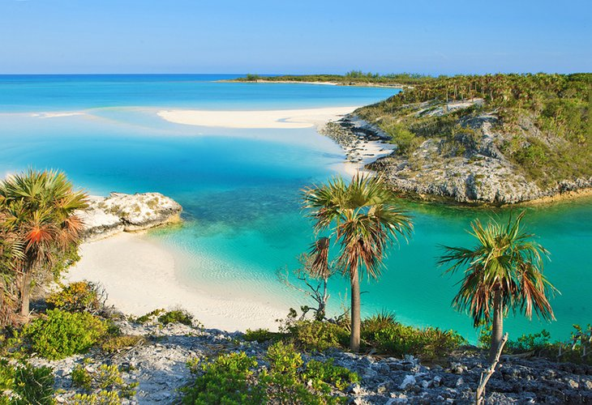
Figure 1 – Tourism & Development
Small island developing countries such as The Maldives and the Bahamas continue to be popular tourist destinations
Complete the graph to display the percentage of income The Bahamas generates through tourism [1 mark]
Outline two ways that tourism can help a country to develop [2 marks]
Suggest one reason why HICs are less reliant on tourism [2 marks]

Slide 9
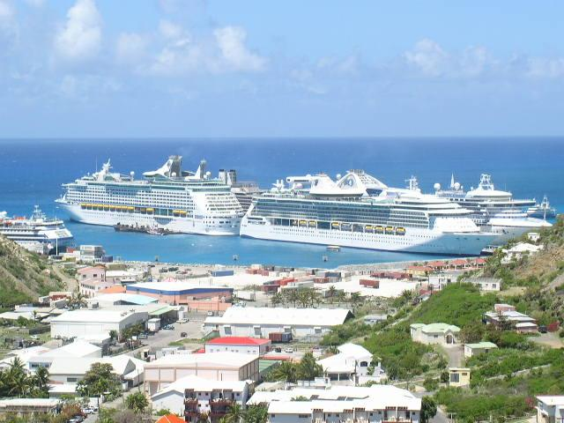
Figure 1 – Tourism & Development
Insert the ‘growth of cruise tourism’ and ‘cruise industry overview’ here
(Using the graph) Describe the growth of cruise passengers between 2009-2018 [2 marks]
Insert the ‘is tourism worth the trouble in the Caribbean’ here
Using the information in figure 1, describe the advantages and disadvantages of cruise tourism in the Caribbean
Advantages | Disadvantages

Slide 10
Study Figure 1 – Tourism & Development. Tourism is essential for the development of LIC/NEEs.
Do you agree? Explain your answer [6 marks]

Slide 11
Tourism should be seen as a development opportunity rather than an environmental problem.
Do you agree? Explain your answer [6 marks]

Slide 12
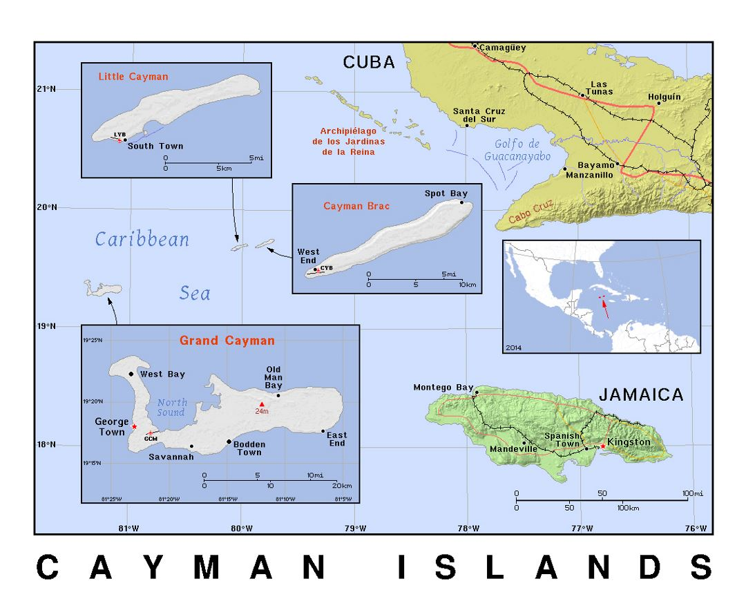
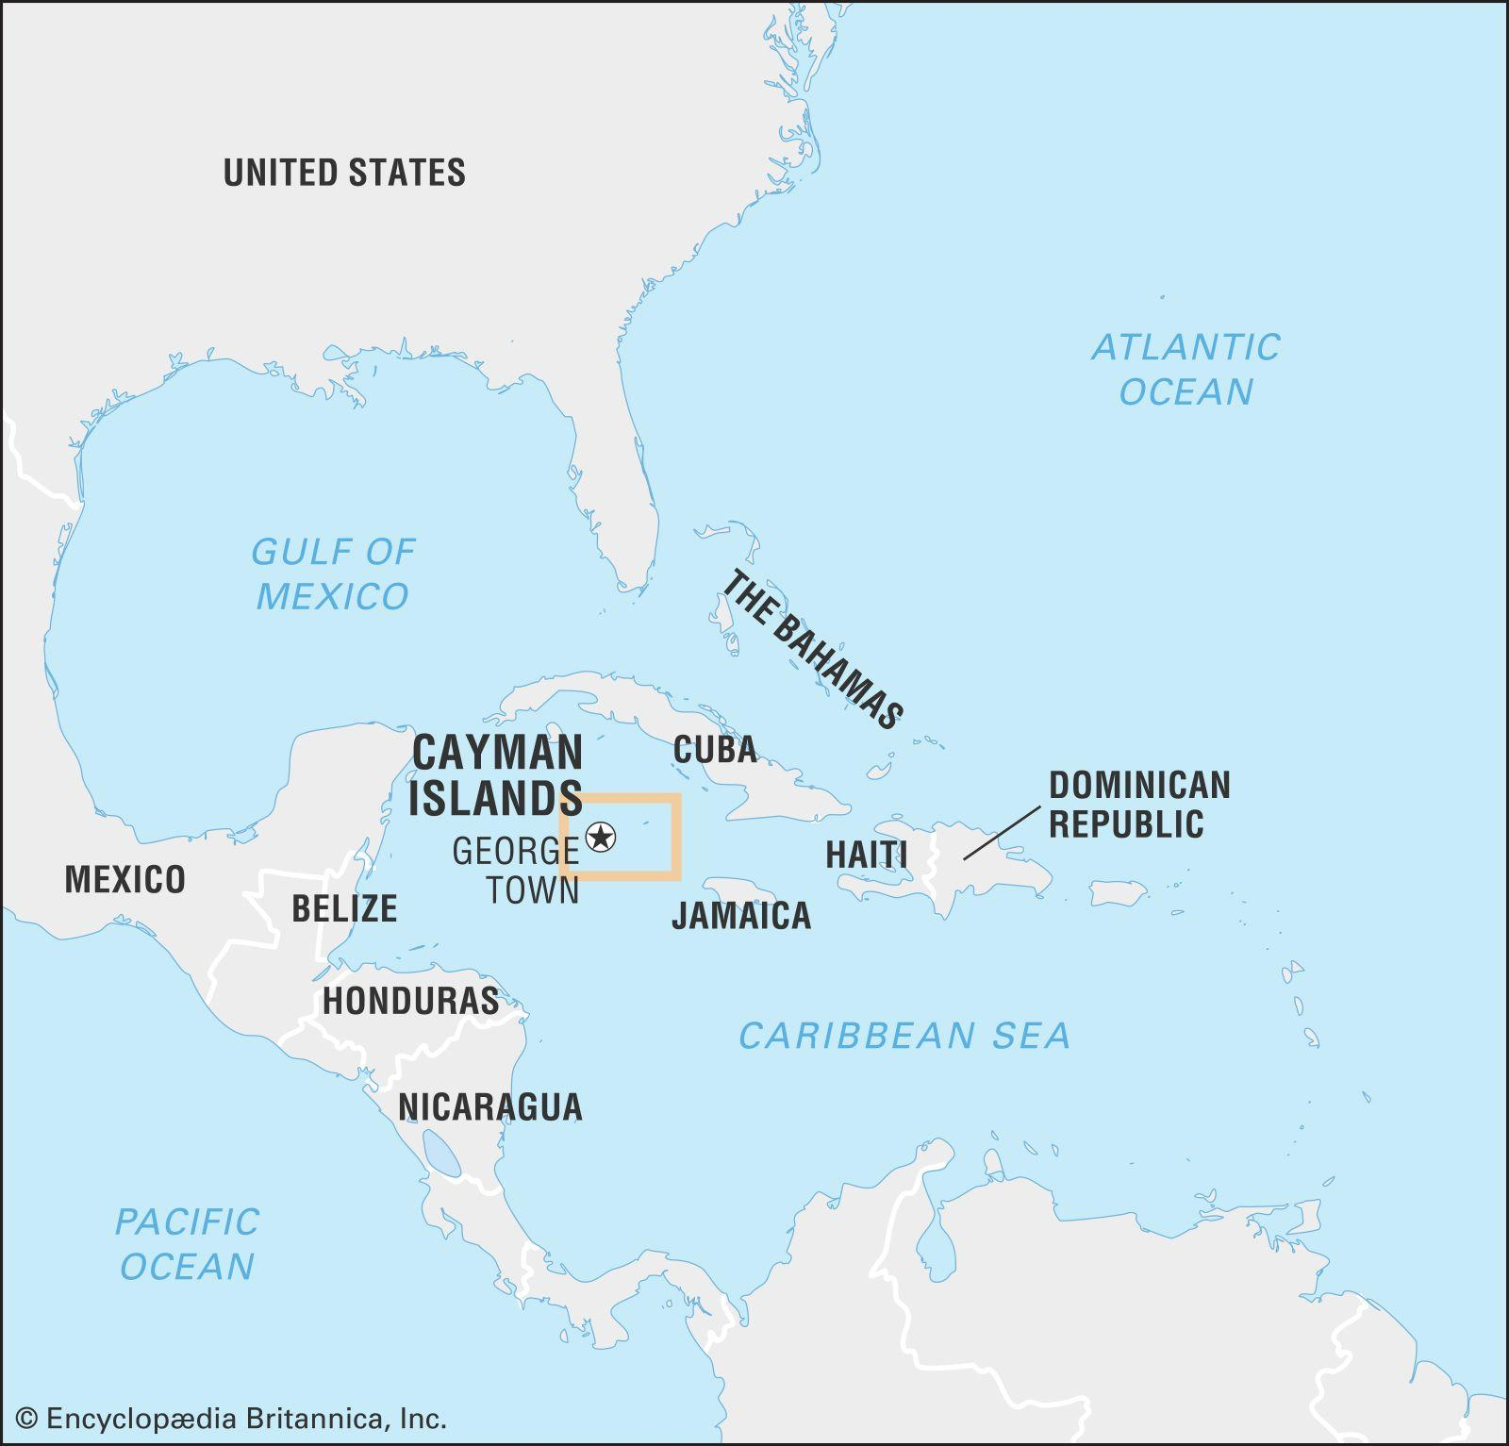
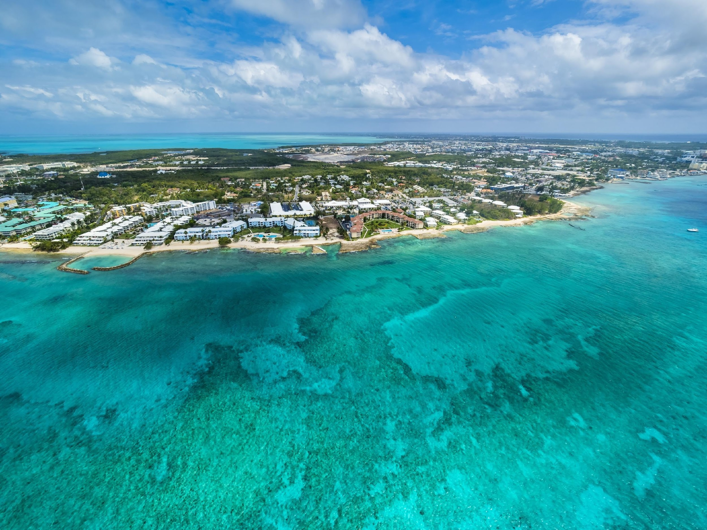
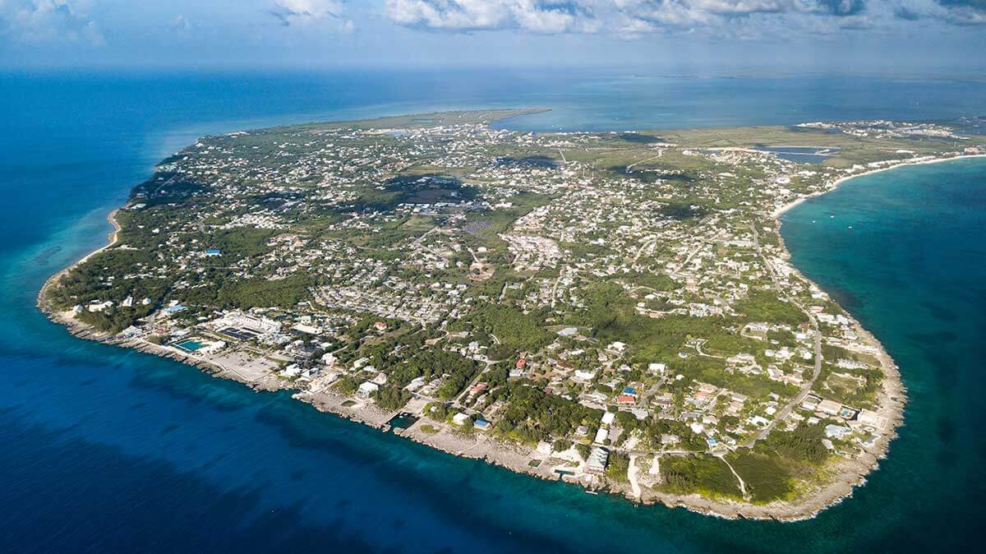
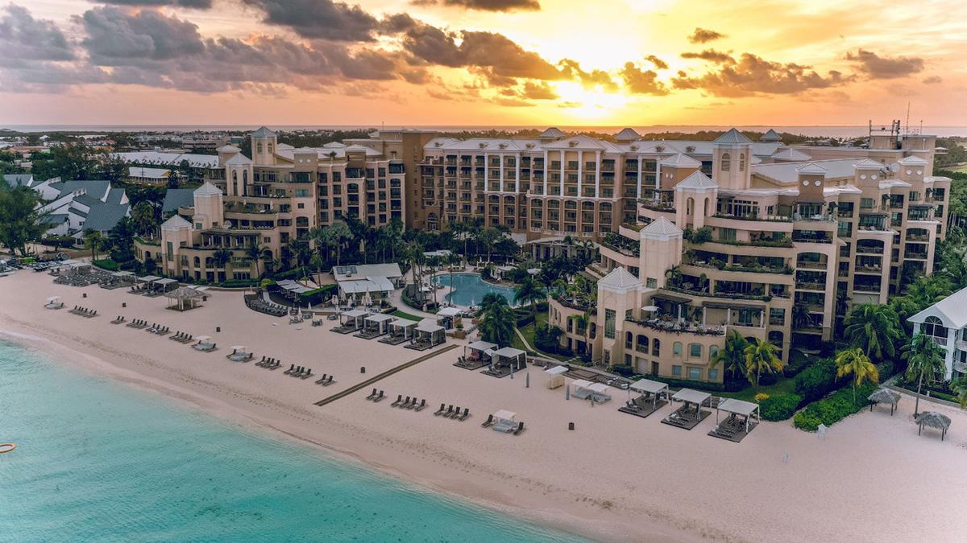
Figure 2 – A new cruise ship terminal and port for the Cayman Islands
The Cayman Islands are an overseas UK territory made up of three islands: Grand Cayman, the largest and most developed (approximately 22 miles long), Cayman Brac (15 square miles) and Little Cayman (10 square miles). The Cayman Islands lie 480 miles south of Miami, 150 miles south of Cuba and 167 miles northwest of Jamaica. The islands are generally low-lying with the highest point being only 20 metres above sea level. The islands are located on a conservative tectonic margin between the North American and Caribbean plates. Minor tremors from this tectonic movement are sometimes recorded. A pleasant tropical climate is one of the territory’s main assets, tourism being of primary importance to the economy. Temperatures are moderate throughout the year, averaging about 27 °C annually. This tropical climate means that the islands are at risk from Hurricanes from June through to November.
Approximately 78,500 people live in the Cayman Islands. About one-fifth of Caymanians are of European, mainly British. There is also a significant proportion of the population employed in the tourism sector from Jamaica, Haiti and other neighboring Caribbean islands.
The economy depends on banking, tourism, and other services. The Caymans have the highest per capita income in the Caribbean.
The physical beauty and superb climate of the islands have made them a haven for tourists. The government invested heavily in promoting tourism, which increased eightfold between the mid-1970s and the early 1990s. Since then tourism has continued to grow steadily, as the islands have developed a good reputation for diving. Most visitors are from the United States.
International finance has become a major component of the economy. The Cayman Islands are renowned as an offshore banking centre or a ‘tax haven’, due to the absence of direct taxes and loose banking laws that generally ensure confidential transactions. Hundreds of banks and trust companies, including most of the world’s 50 largest banks, are registered in the Caymans, making the islands one of the largest financial centres in the world. Financial services create thousands of jobs on the islands along with revenue generation for the Government.
Summarise the background information on the Cayman Islands in 5 points
-
-
-
-
-

Slide 13
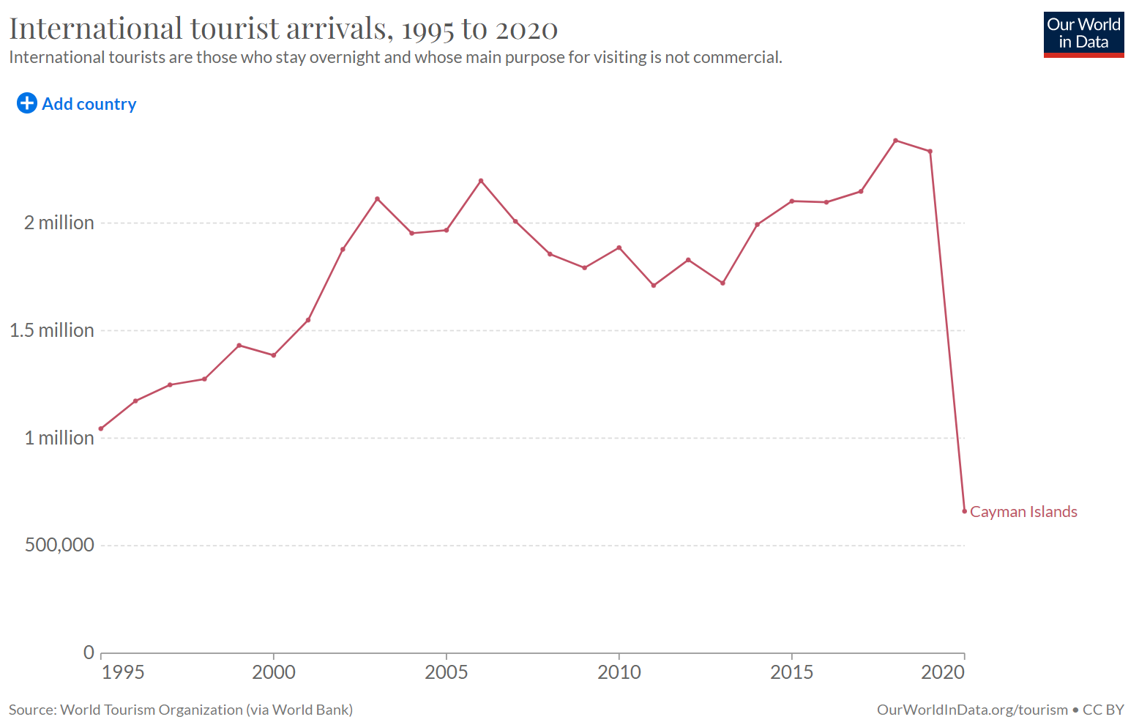
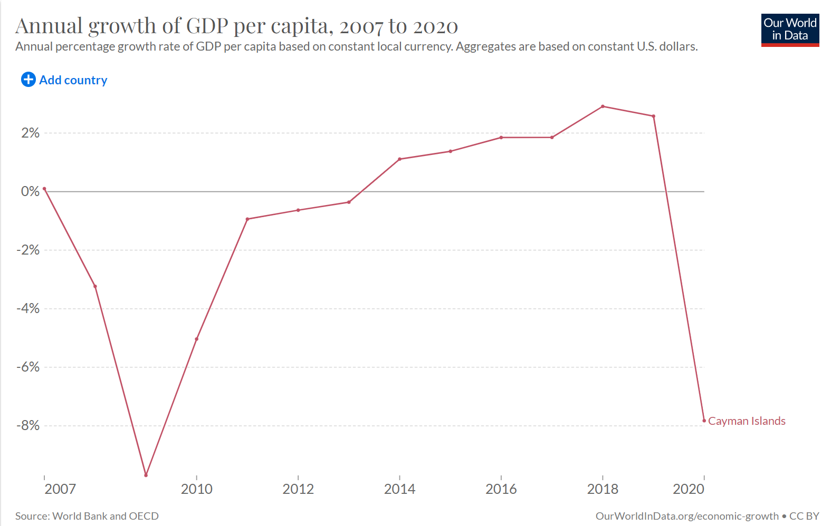
Figure 2 – A new cruise ship terminal and port for the Cayman Islands
Insert ‘visit the Cayman Islands’ yellow info box here
Notes and observations:
Suggest one reason why tourists may be attracted to the Cayman Islands [2 marks]
Calculate the:
Annual temperature range in the Cayman Islands [1 mark] Show your working
Annual range in hours of sunshine in the Cayman Islands [1 mark] Show your working

Slide 14
Figure 2 – A new cruise ship terminal and port for the Cayman Islands
Insert the ‘The existing port’ info box here
Most of the islands’ goods and commodities, including food, must be imported. The main crops grown on the islands are citrus fruits and bananas, as well as mangoes, plantains, coconuts, sweet potatoes, yams, and tomatoes. Some livestock is raised, chiefly cattle and poultry. Turtles raised on a government-operated turtle farm provide food, shells, and leather. Exports are few. The major imports are recreational boats, passenger and cargo ships, refined petroleum, gold and cars. The United States is the Caymans’ primary trading partner in both imports and exports.
Suggest one reason why imports have increased between 1977-2018 [2 marks]
Give two reasons why there is a need for a new port development in the Cayman Islands [2 marks]
Why will growing imports be a challenge for the Government of the Cayman Islands in the future
[2 marks]
Compare the pattern of imports in tonnes to cruise passenger numbers [2 marks]
Insert the ‘proposed port development’ info box here

Slide 15
Figure 3 – Different views about the proposed cruise ship and port facility in Grand Cayman
Insert the ‘Creating opportunity in George Town’ info box here (also include the yellow boxes titled ‘impact assessment of the proposed development’
Insert the ‘tourism development in the Cayman Islands – question of economy vs environment’ info box here along with green fact box
Explain why ‘while the number of visitors has consistently increased, per visitor spending has decreased over the last 30 years’ in the Cayman Islands [2 marks]
Suggest one reason why 54% of all cruise arrivals are from the USA [2 marks]
Suggest one reason why arrival statistics may not always be accurate [2 marks]

Slide 16
Suggest why environmentalists might have a negative view of the port development [4 marks]

Slide 17
The Cayman Islands’ Government are determined to keep environmental impacts of the proposed port development to a minimum. Explain why this is unlikely [4 marks]

Slide 18
Study Figures 1 and 2. Suggest why Governments should focus more on attracting ecotourists and long-stay visitors than cruise visitors. [4 marks]

Slide 19
Figure 3 – Different views about the proposed cruise ship and port facility in Grand Cayman
Insert the whole of page 7 here
Using the resource booklet, identify which players (different groups of people) are likely to be for against the port development with a summary of their justification
For the Port Development | Against the Port Development
Your thoughts:

Slide 20
The proposed port development could be a source of regeneration for George Town. The social and economic opportunities created as part of the regeneration will not outweigh the environmental challenges created as a result.
Do you agree? Explain your answer. [6 marks]

Slide 21
The Cayman Islands’ Government cannot successfully develop their tourism industry and protect their environment at the same time.
To what extent do you agree with this statement? [6 marks]

Slide 22
The final question is typically worth the most marks and will likely require you to make a decision as to whether or not you believe the proposed cruise ship port facility should be built.
It will probably be phrased along the lines of:
Do you think the proposed port facility should be built? (Tick the box of your choice).
Yes
No
Use evidence from the resource booklet and your own knowledge to explain your answer. [9 marks + 3 SPaG]
You will need to be able to construct a balanced argument. To do this you will need to look at arguments both for and against building the new cruise ship port facility. You will also need to be able to use evidence to support your points of view so remember to cite data from the three figures. If you fail to do this, you will be merely stating an opinion which is not substantiated with any evidence. Synthesis of the evidence is also encouraged. This means layering the evidence from the different figures instead of using them in isolation.
Essay plan
Before we start planning your essay, read back through the whole pre release booklet. Highlight in green any arguments which suggest the port should be built. Highlight in pink any arguments you find against building the port. We will now plan out an answer to the essay using the grid on the next page.
Introduction – set the scene: Where do they want to build the port and why? Why is this site appropriate? Why is this plan controversial?
Outline arguments for building the port. Ensure you include evidence from the resource booklet. The best students will categories these arguments into social, economic and environmental factors.
Outline arguments against building the port. Again, be sure to include evidence from the booklet. The best students will categories these arguments into social, economic and environmental factors.
Conclusion – come to a balanced view. Recognise the merit to both sides of the argument but you will ultimately need to make a decision. Stronger students may be able to suggest a better way to use tourism to support economic growth without promoting more cruise ships.

Slide 23
Introduction: Set the scene
 | Arguments for building the port | Arguments against building the port
Economic
Environmental
Social
Conclusion: Do you think the port should be built?

Slide 24
The final question is typically worth the most marks and will likely require you to make a decision as to whether or not you believe the proposed cruise ship port facility should be built.
It will probably be phrased along the lines of:
Do you think the proposed port facility should be built? (Tick the box of your choice).
Yes
No
Use evidence from the resource booklet and your own knowledge to explain your answer. [9 marks + 3 SPaG]

