Slide 1
Scheme of Revision
Yateley School
Natasha Self, Head of Geography
Elaine Williams, Teacher of Geography

Slide 2
The Rationale
Maximise lesson time
Increase time for deliberate practice/modelling answers
Increase student ownership over revision
Notes:
Give context – relatively small cohort 3 classes between 2 teachers –students taught in mixed ability classes
Target grades in all three classes ranged from 1-8
Also mention impact of covid.
Structuring revision in a way that meant we had time to cover all topics
Also mention 100 minute lessons - as teachers we are their best resource in the classroom – ensuring we use that wisely by modelling answers etc

Slide 3
General Organisation
Students have 3 different coloured books (one for each paper)
Students are given 3 revision folders with a condensed completed knowledge organiser at the start of each paper.
Students organise and store their revision in these folders and take home every time there is an assessment throughout year 10 and store at home in year 11.
Notes:
Worth mentioning we introduced this at the start of this cohort
Again helped with organisation of students (all but particularly SEND disadvantaged etc)

Slide 4
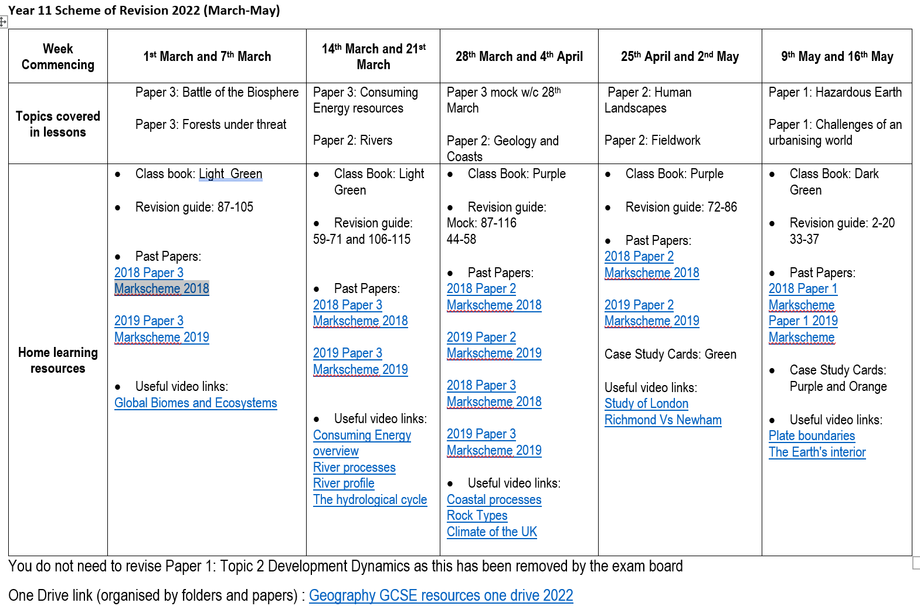
The Revision Timetable
Shared with students/parents via schools comms/twitter
Interactive so students and parents could click on the links to access past papers/ case study cards and the one drive link which organised revision by paper
Students were informed of what was coming up in lessons
Homework was set alongside this to prepare – e.g. sections on SENECA and they had to make a revision resource

Slide 5
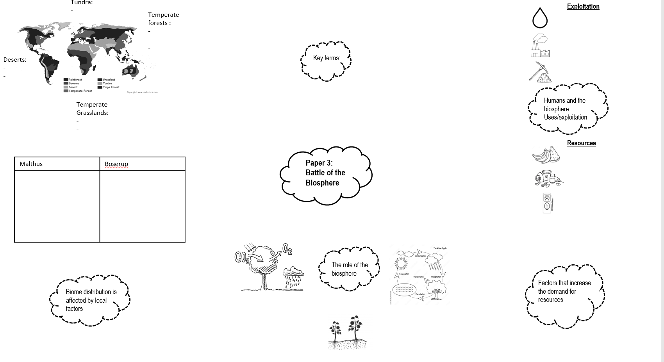
Lesson Activity (1)
Students spent 10-20 minutes completing a knowledge organiser with all of their secure knowledge
They then worked with someone else and used their revision guides to fill in the gaps in their knowledge (with a different coloured pen)
Notes:
Designed to be a quick activity
Used the noun project for dual coding– to help SEND in particular but also visual learners
Students brain dumped knowledge from their revision and also identified the gaps they still had

Slide 6
Lesson Activity (2) Deliberate practice
Students spent 20-30 mins completing a variety of exam questions
These focused around 2/4 markers and the skill 3 markers (maps and graphs)
Students completed these independently
Notes:
Designed to be a quick activity
Used the noun project for dual coding– to help SEND in particular but also visual learners
Students brain dumped knowledge from their revision and also identified the gaps they still had

Slide 7
Lesson Activity (3) Modelling answers
Model answers were shown to students for them to compare their responses to
Students then added to their answers in a different coloured pen
Time for extended answers (8/12/16 markers) was built in to the scheme of revision
Modelling WAGOLL/teacher marking/peer and self-assessment were key
Notes:
Designed to be a quick activity
Used the noun project for dual coding– to help SEND in particular but also visual learners
Students brain dumped knowledge from their revision and also identified the gaps they still had

