Slide 1
A trip around the UK: All of the UK is the same…
To embed geography knowledge of the UK and continents using geography skills

Slide 2
All of the UK is the same
Do you agree?
Class vote: Yes or No

Slide 3
What does the UK actually look like?
https://www.bbc.com/bitesize/articles/z4v3jhv

Slide 4
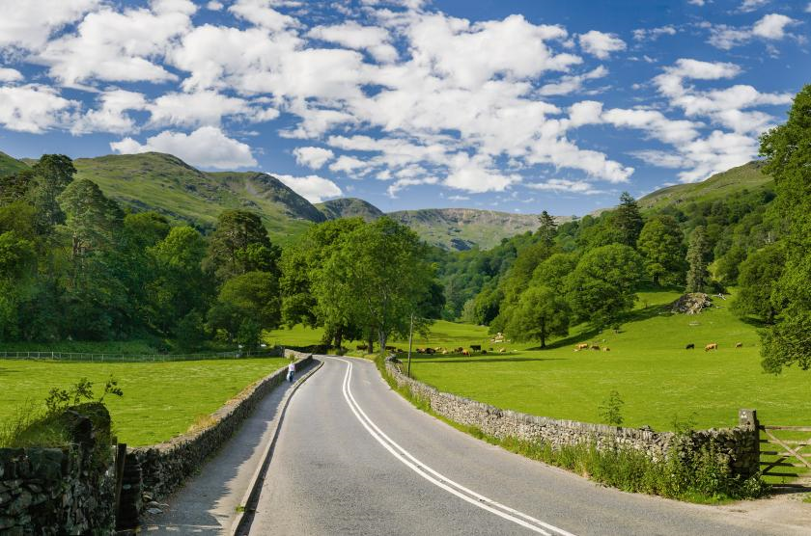
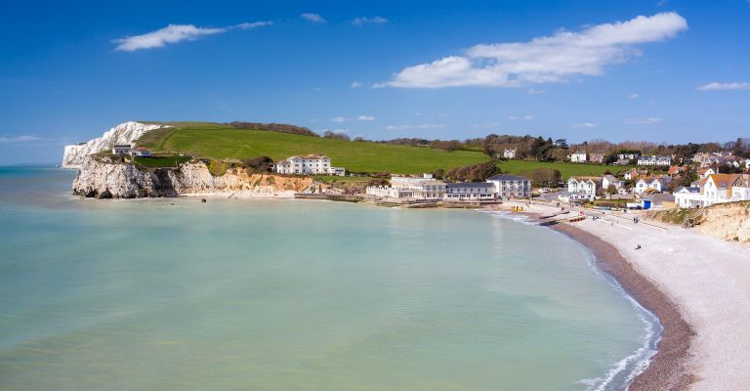
England

Slide 5
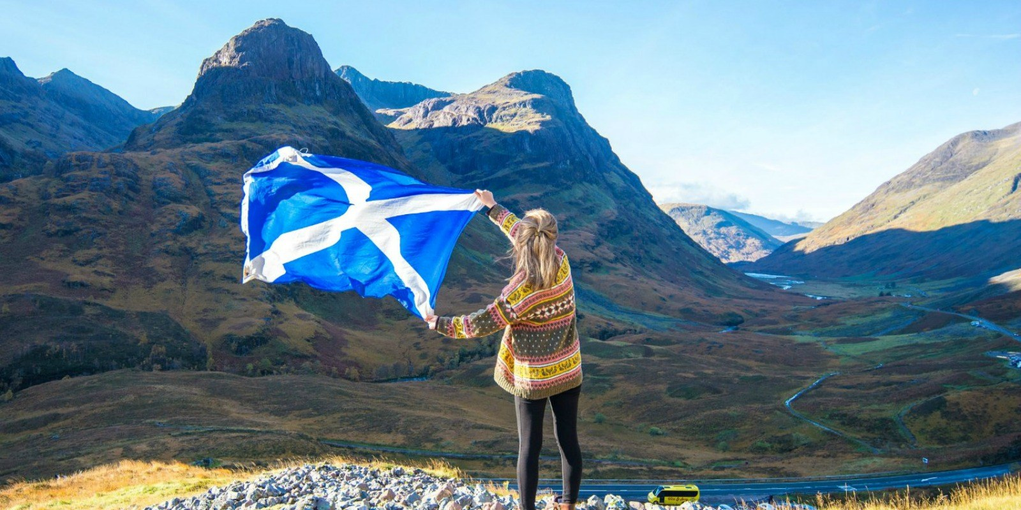
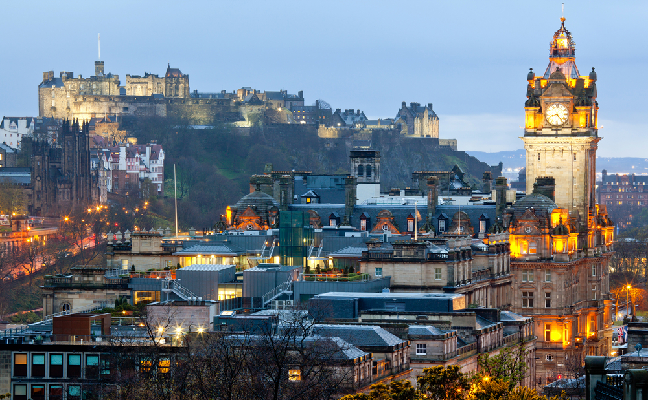
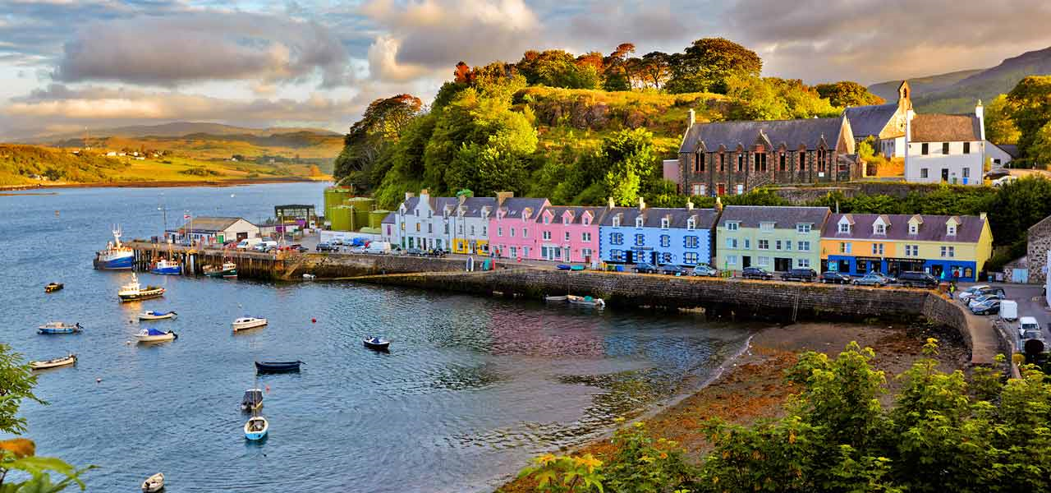
Scotland

Slide 6
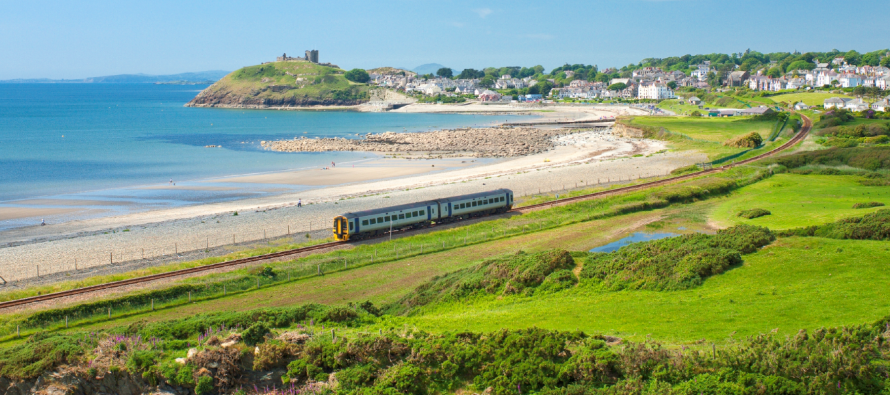
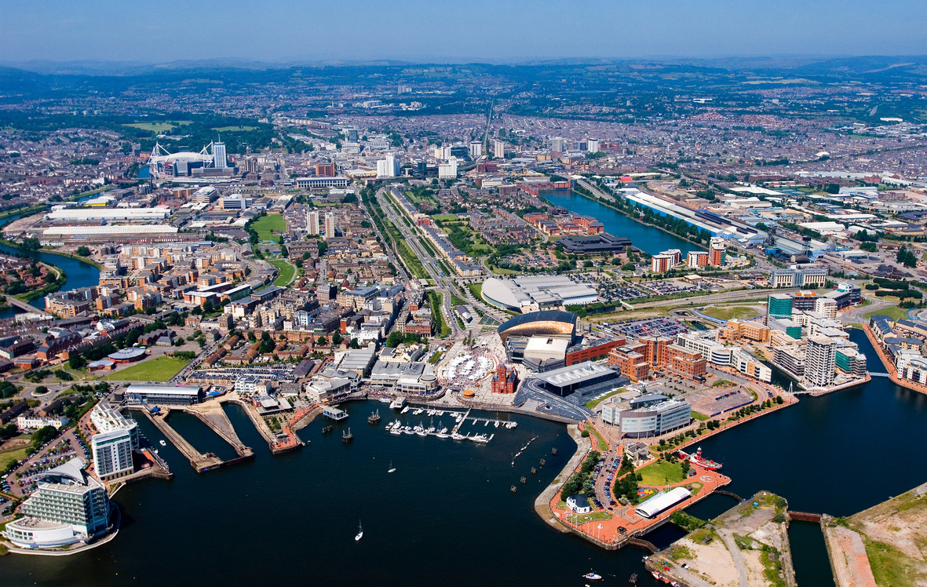
Wales

Slide 7
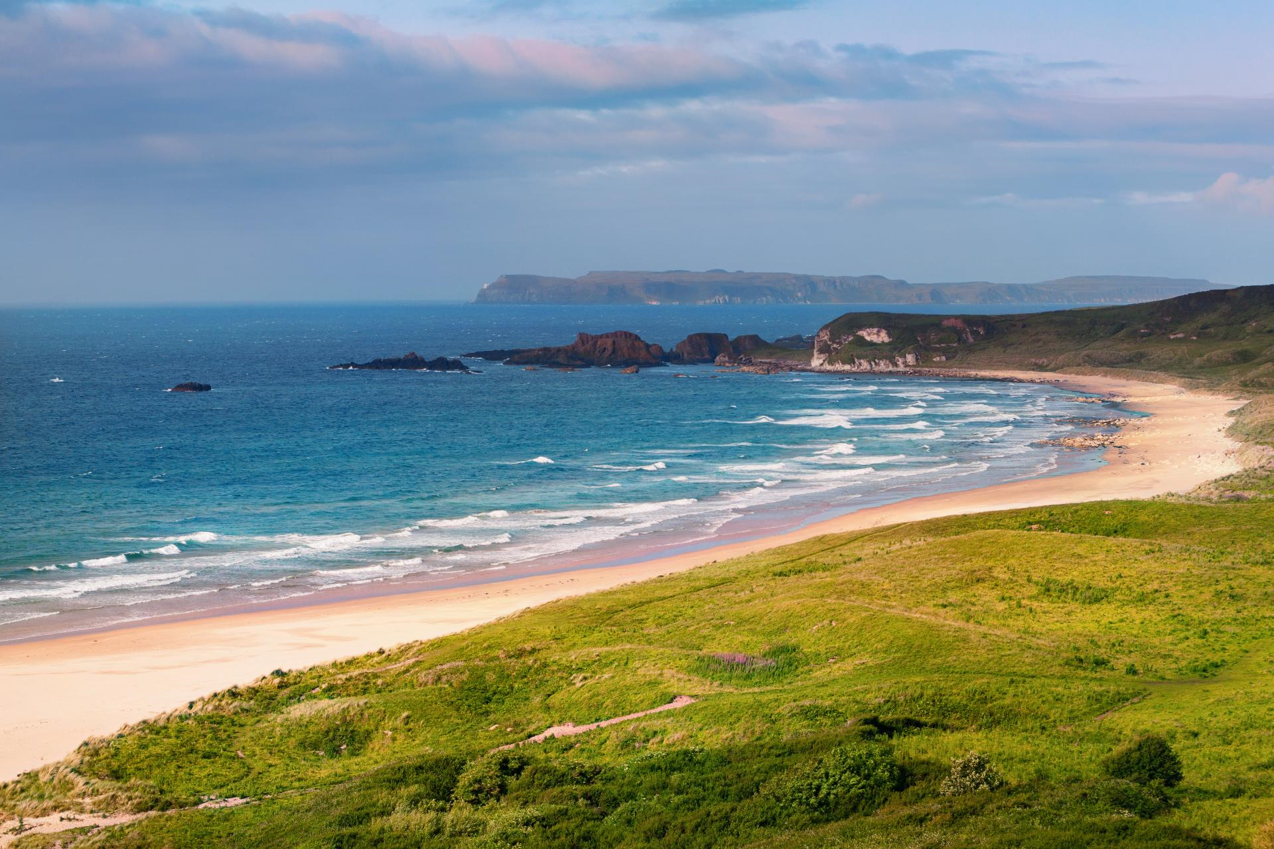
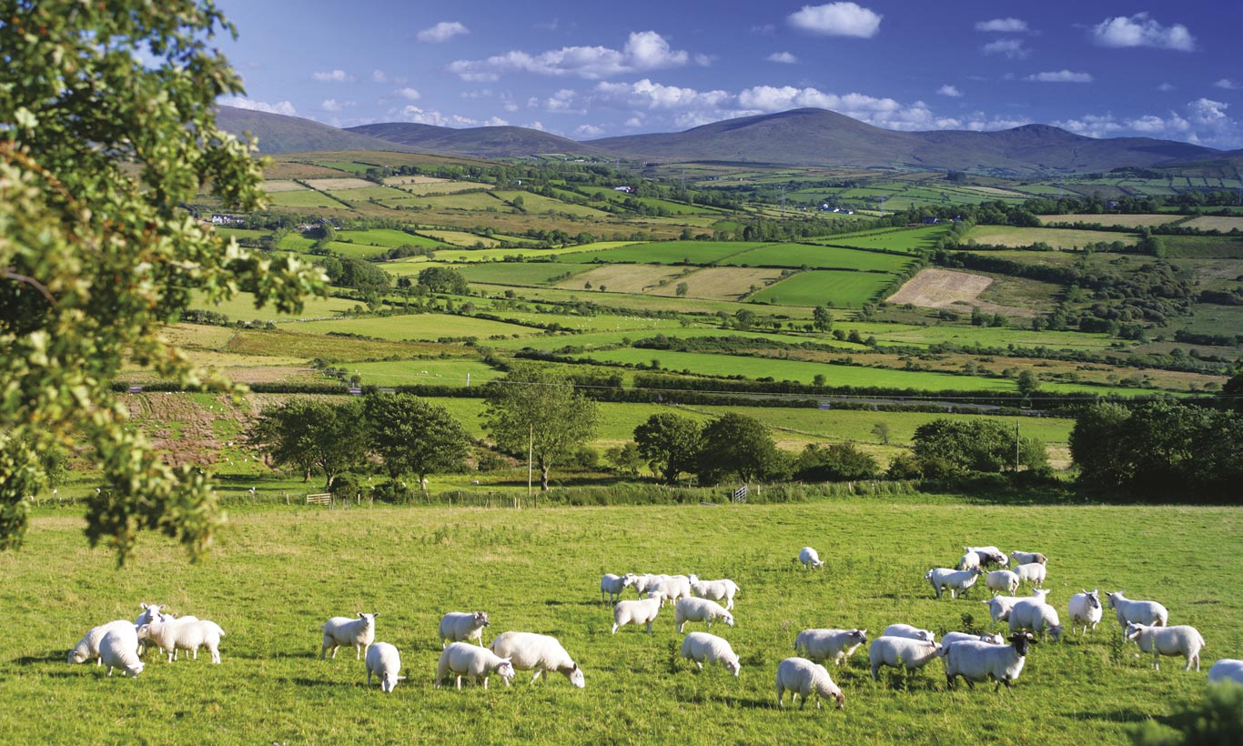
Northern Ireland

Slide 8
Where is the Isle of Wight in the UK?
Blank A4 map of the UK
Find the Isle of Wight on a map of the UK
Label it on your map
Find other islands around the UK
Where are most of the islands of the UK?
Describe the location of the Isle of Wight including compass directions, nearby cities and London

Slide 9
What are the countries in the UK?
Find the four countries of the UK
Find the four capital cities of the countries of the UK
Find the seas that surround the UK
Plan a circular journey from the Isle of Wight to other islands and capital cities including compass directions, countries and seas.
Label the countries, capitals and seas on your UK map

Slide 10
What is the UK like?
Maps show us information about places and their human and physical features.
Which maps are physical? What does physical mean?
Which maps are human? What does human mean?
Look at the maps using the following TIP
T – Title – what does it say?
I – Information – what does the key show?
P – Pattern – what is the pattern of the map
Physical – mountains, rivers,
Settlement – cities, population density

Slide 11
What is the UK like?
Look at the maps using the following TIP
T – Title – what does it say?
I – Information – what does the key show?
P – Pattern – what is the pattern of the map
Identify the main human and physical features using the maps
Annotate your map with symbols and a key to show your findings

Slide 12
All of the UK is the same
Do you still agree?
Class vote: Yes or No
What evidence have you found this lesson to back up your opinion?

Slide 13
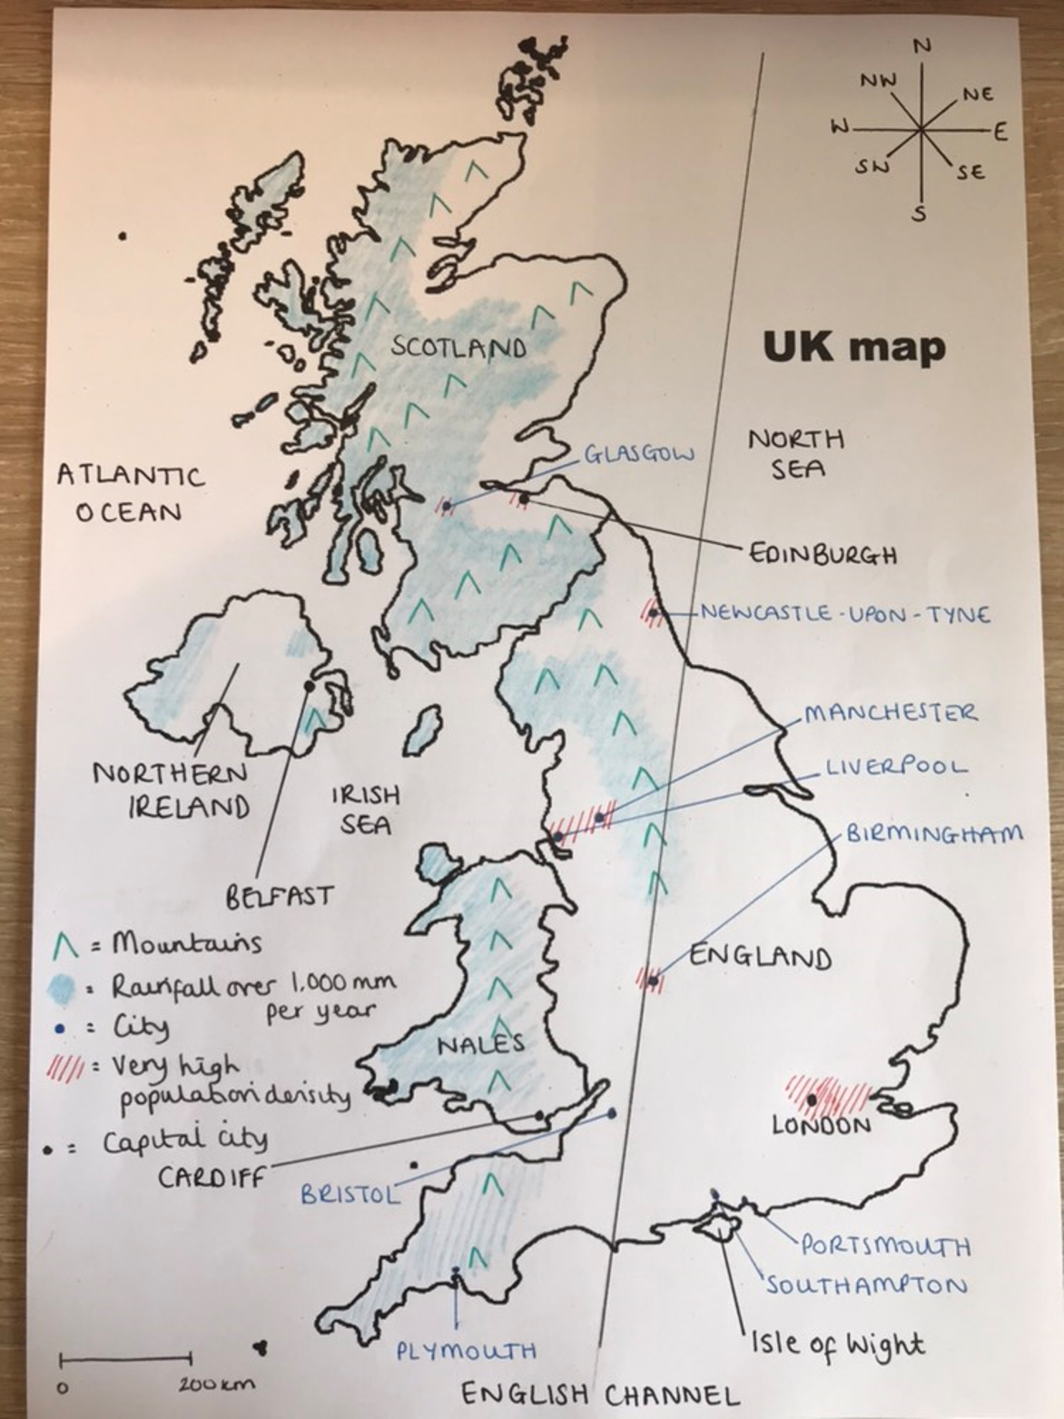
WAGOLL

Slide 14
Work completed by the end of the lesson
Spoken
Describe the location of the IOW
Describe a journey from the IOW to other islands and capital cities
Discuss the patterns found on the human and physical maps
Discussion as to whether ‘All of the UK is the same’
Recorded
Blank A4 UK map with countries, capitals and surrounding seas labels, symbols and a key showing the main human and physical features in the UK

Slide 16
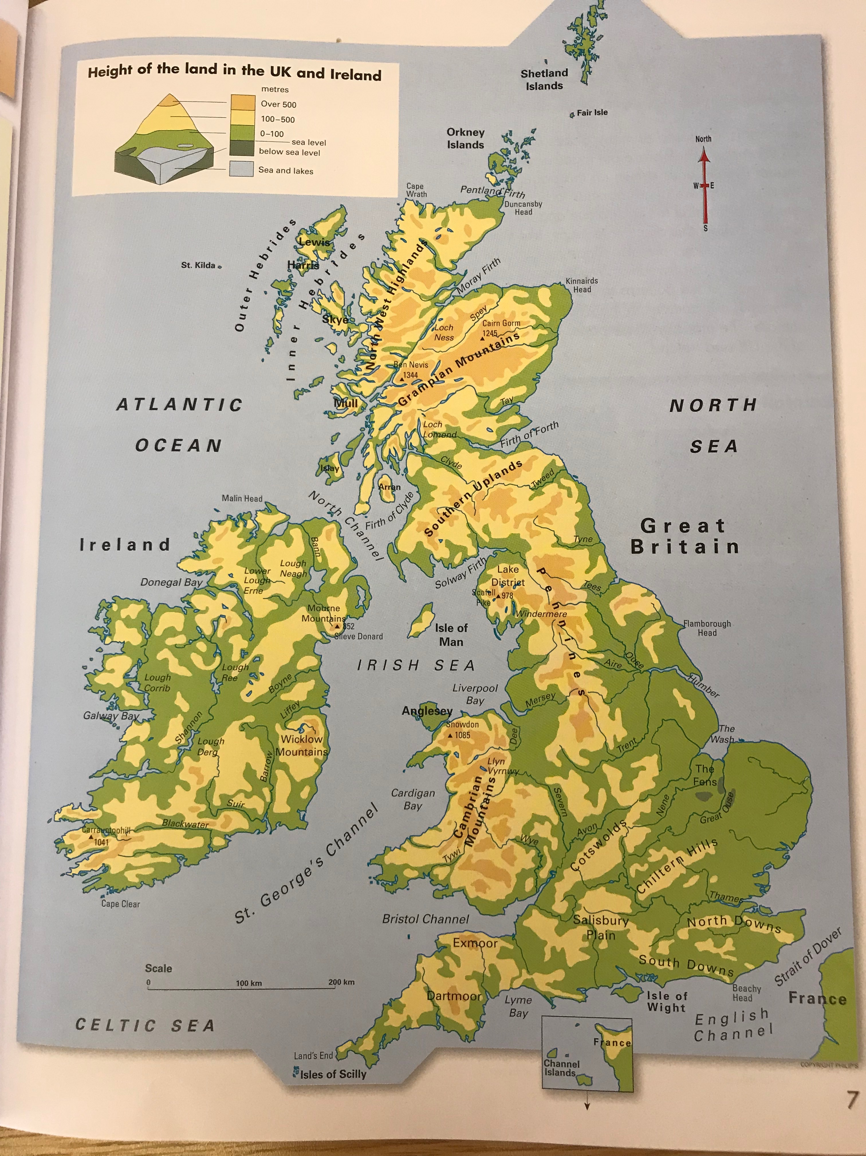
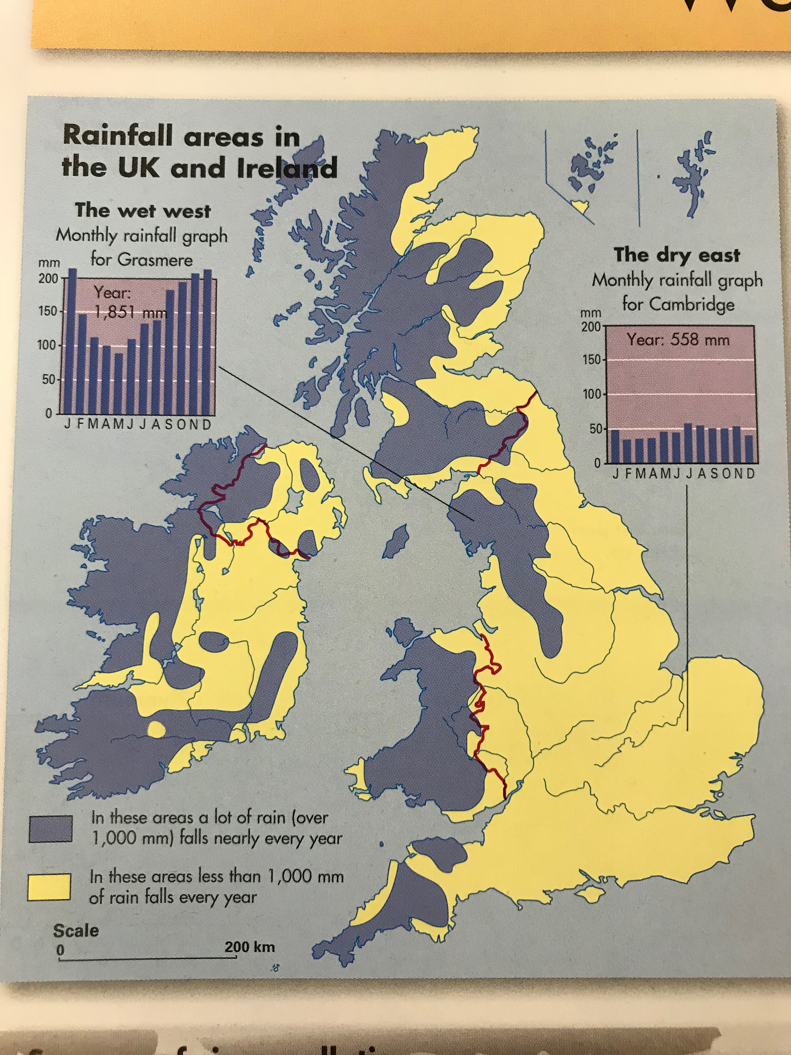

Slide 17
