Slide 1
Summer results 2024: GCSE Geography
Jon Boden-Wright – Subject Support Manager, Geography

Slide 2
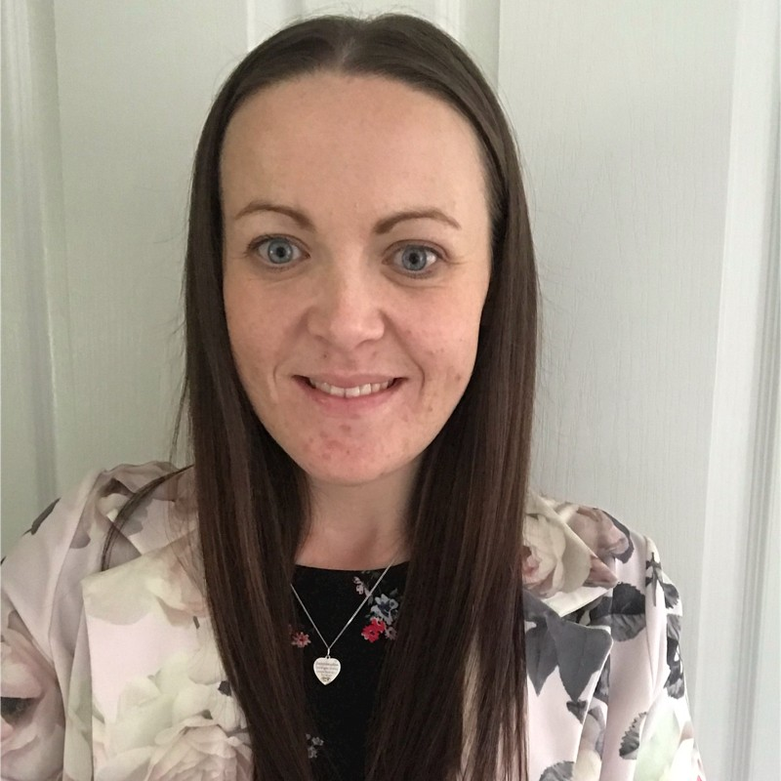
Meet the Geography Team
Stacey Hill – Subject Lead for Geography
Jon Boden-Wright – Subject Support Manager for Geography

Slide 3
Content
The Future of GCSE Geography
Summer series headlines & reminders
Grade boundaries & outcomes
High level summary of themes were students excelled and where students struggled nationally
Paper 2
Upcoming support

Slide 4
Future of GCSE Geography

Slide 5
AQA Submission to Curriculum and Assessment Review - Headline Summary
In some areas there is too much content that is expected to be covered, [or] the content is outdated or mechanistic.
In GCSE Geography there are two units of study, plus fieldwork expectations and decision-making geography. It has always been reported to be too much for teachers, and we are regularly questioned about how it meets Ofqual’s criteria when it comes to guided learning hours (GLH). GCSE Geography also assesses 10% maths skills; however, the requirements exceed foundation maths. More consistency across maths in different subjects would be welcomed at reform.
A-level Geography is set up better to allow centres to refresh the content they teach by regularly updating case studies and examples. However, the current specifications contain some quite challenging, undergraduate level geography and there is a big gap between GCSE Geography and A-level Geography expectations. We are now seeing a decline in uptake.

Slide 6
AQA response – overarching themes
Evolution not revolution: We agree with the government's evolutionary approach. In the GQ space, we are advocating for a subject-by-subject approach to reform. We think the vocational and technical space is riper for systemic, faster paced reform, though we would still advocate for an evolutionary approach.
Digital by default: We know that going digital is the right thing to do and that any reform proposals should be digital by default. Going digital will solve a number of the government’s problems, such as providing alternatives to resits, increasing fairness and increasing digital fluency. We have examples of where this is possible, including digital exams, Stride, numeracy, Welsh and Scottish Alphaplus tests.
GCSE end point over-examination: We agree with the government that there is too much end point examination at GCSE and that there are alternatives worth exploring, including digital.

Slide 7
When will reform happen? Will you redevelop the specifications?
The current qualifications are tied to the Subject Content Criteria produced by the DfE in 2015 – any meaningful changes to our specification would need these to change.
At this point in time, we do not know when reform will come.
Outcomes from the Curriculum and Assessment Review are expected in September – this will give us a better indication.
We have decided to not make any changes to current specifications at this time; we are aware of teacher workload and do not want to over burden teachers with change, especially when upcoming change dictated by the DfE is likely.

Slide 8
Summer series headlines & reminders

Slide 9
Changes we saw this series
Paper 3 exam time was extended to 1 hour 30 minutes
We did this to allow students more time to attempt all questions and to re familiarise themselves with the pre-release and their own fieldwork, in response to teacher feedback
We did see more students attempting a greater number of questions
Less non-attempts, particularly on the final 9-mark question at the end of the paper, though these are still quite high
More students getting into level 2 and level 3 on the 6 and 9-mark questions
An increase in mean mark compared to 2023, from 32 to 37 marks
Changes to the layout of skills questions requiring students to complete a graph
We did this to see if it would help students to not miss these questions
We did see higher engagement on some items, but this was not the case across the papers
Many students, even those with very high marks still missed out some of these skills questions

Slide 10
Paper 3 - 2025
Exam date is Thursday 12th June.
Pre-release date is Thursday 20th March.
Part of the accreditation of the qualification means that there must be exactly 12 weeks between the exam date and the release.
Timetabling is determined by the JCQ – consultation for the proposed timetable is normally released in February.

Slide 11
Grade boundaries and outcomes

Slide 12
Entries
The entry increased significantly this series. Largest increase since the beginning of the specification
The entry is expected to continue to increase until 2027
Year | AQA | % of market | Total entries*
2018 | 155,800 | 60.8% | 256,420
2019 | 165,061 | 62.2% | 265,169
2020 | 170,696 | 63.1% | 270,311
2021 | 179,157 | 63.6% | 281,741
2022 | 185,157 | 64.0% | 289,352
2023 | 189,554 | 64.6% | 293,319
2024 | 197,828 | 66.5% | 297,411
*entries for England, Northern Ireland and Wales

Slide 13
Grade boundaries & results statistics
AQA GCSE statistics 2024 with data from 2023 for comparison. The table shows the cumulative percentages at each grade. These are AQA only data: AQA outcomes are very similar to the national outcomes published by JCQ for all GCSE's in England​.
Grade | 2024 mark (/252) | Cumulative % 2024 | Cumulative % 2023
9 | 202 | 4.78 | 4.7
8 | 182 | 12.88 | 12.5
7 | 162 | 24.73 | 24.0
6 | 142 | 38.73 | 37.2
5 | 123 | 52.58 | 51.0
4 | 104 | 65.69 | 64.2
3 | 76 | 81.52 | 80.1
2 | 48 | 92.57 | 91.2
1 | 20 | 98.64 | 98.0
Grade boundaries at qualification level for GCSE Geography
Cumulative percentages represent the percentage of students achieving that grade (and above)
Comparable statistics to 2023 outcomes
You can access notional grade boundaries at paper level here

Slide 14
Lead examiner report highlights

Slide 15
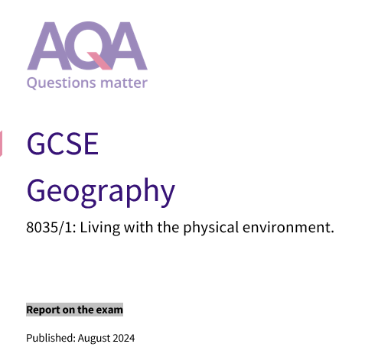
Lead Examiner reports
This year we've worked hard on improving the quality of these reports.
They now include example answers and commentaries and are grouped by question type and Assessment Objectives (AOs).
This should mean it's more user friendly and allow you to see real student answers to questions that exemplify the point the lead examiner is making.

Slide 16
Areas where students excelled
Paper 1
Paper 2
Paper 3
More students were able to handle the wide variety of ways in which geographical data was presented to them.
Students were able to bring reasonable knowledge of geographical content and application of understanding to figures.
More students introduced pertinent case study material in support of answers particularly where this was stated as a requirement
Case study information was often well known and utilised well to evidence answers.
At the top end, students were really engaging with the question set and not relying on pre-learned answers.
The way students engage with figures in questions of all kinds is improving.
Geographical and mathematical skills were generally done well.
Many students really excelled at engaging with the theme of the issue evaluation.
Students were better able to describe the Physical Geography of the area using the OS map extract than previously.
Overall, students seemed much more engaged with the fieldwork this series, and this was evident in the outcomes - More students seemed able to respond to questions.

Slide 17
Areas where students struggled
Paper 1
Paper 2
Paper 3
Understanding of physical processes was often confused, and recognition of landforms shown on photographs was limited (3.6, 4.6 and 5.6).
Some students remain confused by key command words such as explain, compare, suggest and discuss.
Basic map skills proved a challenge for many, including the description of relief and drainage or the description of coastal features.
Whilst the way students engage with figures is improving, it's still a challenge in responding to AO2/AO3 questions.
Many were unable to locate their LIC/NEE case study on the world map.
In the 9-mark questions (1.11 and 02.9) students struggled decoding the question and responding appropriately to the command word. These questions required an element of reorganising knowledge to be able to apply it correctly (AO3).
Students seem to struggle to use evidence to develop a point or idea in many 2–3-mark questions (01.2; 04.4; 05.2 and 05.3).
Whilst there is an improvement in how students engage with the pre-release booklet, many are simply lifting material without explanation.
Some students selecting evidence from the incorrect enquiry.
Students struggled to recall their fieldwork titles

Slide 18
Key areas for improvement

Slide 19
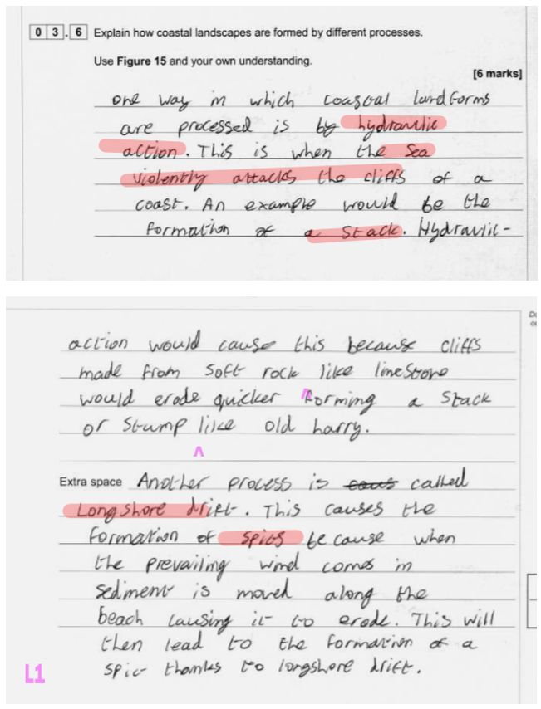
Paper 1
"Understanding of physical processes was often confused, and recognition of landforms shown on photographs was limited (3.6, 4.6 and 5.6)."
This answer lists hydraulic action and longshore drift but shows limited geographical understanding of the formation and development of landforms associated with a changing coastline (AO2).
There's also limited application of knowledge and understanding in analysing the changing coastline that is shown in Figure 15 (AO3) and scores 2 marks

Slide 20
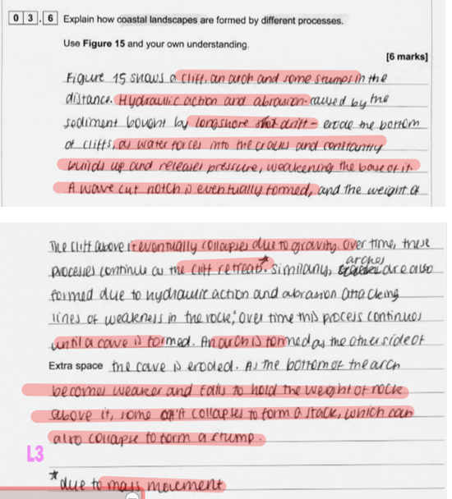
Paper 1
"Understanding of physical processes was often confused, and recognition of landforms shown on photographs was limited (3.6, 4.6 and 5.6)."
The student focuses on only one set of coastal landforms (cliffs, arches and stumps) however they fully integrate the explanation of processes and explain the sequence of landscape development (AO2).There is detailed application of understanding as the student analyses the Figure (AO3), and a thorough understanding of the named processes of erosion.
This answer was awarded 6 marks

Slide 21
9-mark questions (Paper 1 & 2)
These always assess AO1, AO2 and AO3
Often, they come with a figure to apply knowledge and understanding to but not always
They can refer to quite broad themes, allowing students to bring in their knowledge from across the unit
Case study knowledge is sometimes required in the question, however even if it isn’t, students can gain credit from using appropriate case study information to support the points they make
The required knowledge and understanding assessed can come from any part of the specification content, and can relate to Geographical concepts as well as events and case studies
It’s important that whatever exam technique you use in the classroom, students can answer the question they are being asked

Slide 22
Paper 2
“To what extent do energy and water conservation make cities more sustainable?”
This is an example of a 9-mark question that does not come with a figure and relates to a broader concept.
The AO3 marks come from the addressing of the command ‘to what extent’ and students applying their knowledge and understanding of water and energy conservation specifically to sustainability.
Bringing in examples of water and energy conservation students have been taught can gain credit
Students would be expected to tackle both energy and water in their response, however it need not be balanced
Even at Level 1, students can gain some marks by showing some understanding of water and energy conservation, sustainability or a basic attempt to address the command

Slide 23
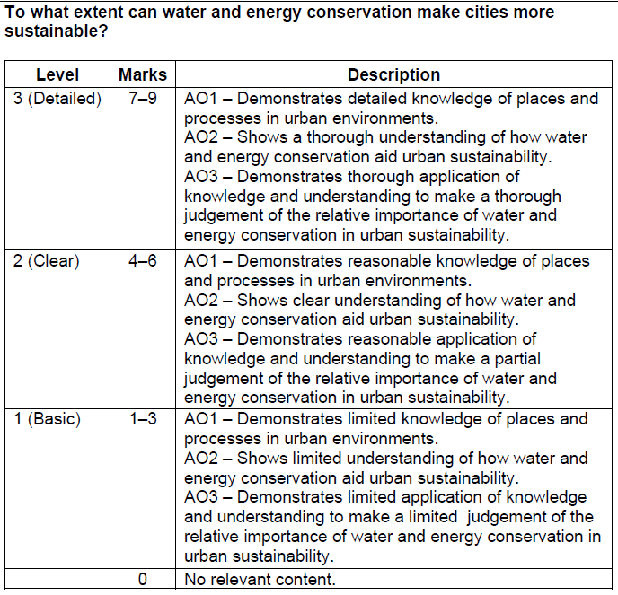
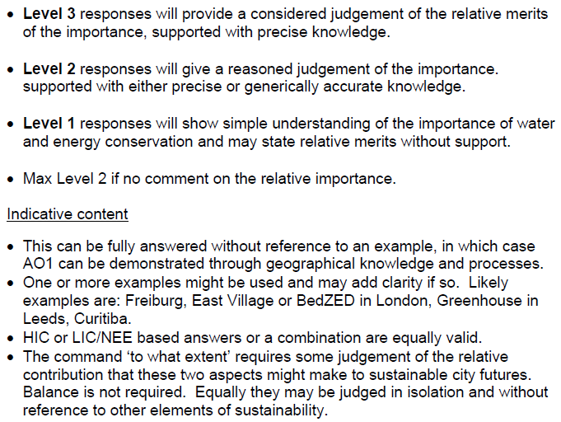
9-mark question

Slide 24
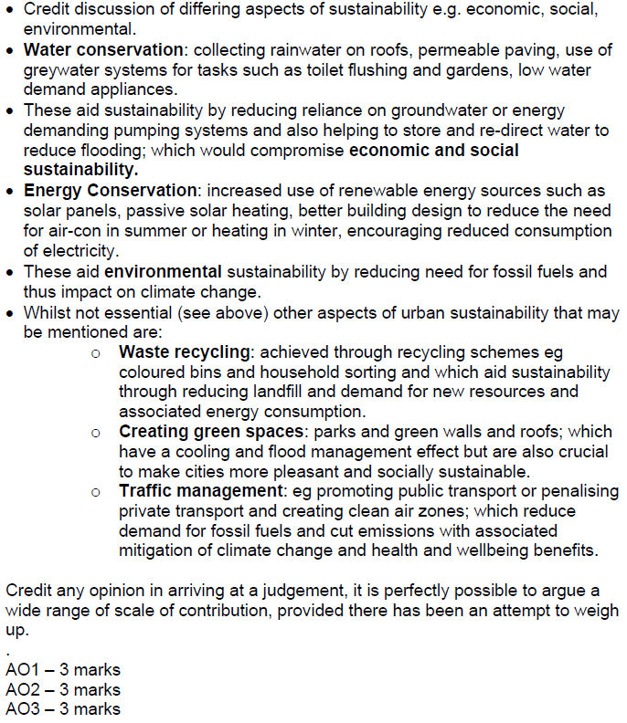
9-mark question

Slide 25
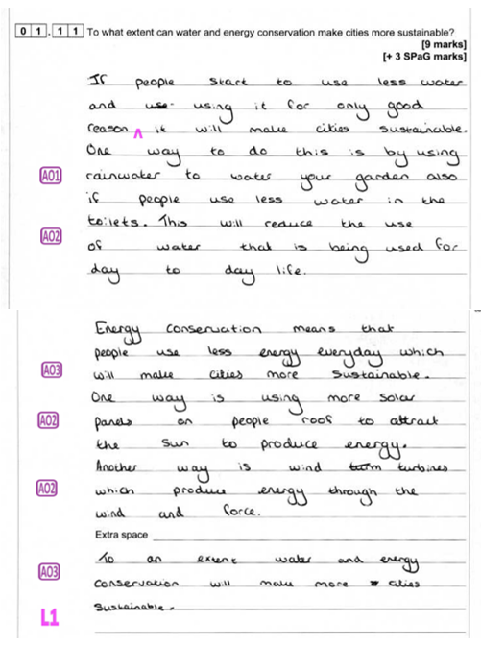
Response A

Slide 26
Response B

Slide 27
Paper 2
"In the 9-mark questions (1.11 and 02.9) students struggled decoding the question and responding appropriately to the command word. These questions required an element of reorganising knowledge to be able to apply it correctly (AO3)."
Where students struggled to move through the levels it was largely because the AO1 was not strong enough or offered vague theoretical ideas. This answer does address all 3 AOs but the AO3 application is simple and largely an assertion, there is some simple understanding (AO2) of how a basic strategy (AO1) will work, achieving
3 marks (+2 SPaG)

Slide 28
Paper 2
"In the 9-mark questions (1.11 and 02.9) students struggled decoding the question and responding appropriately to the command word. These questions required an element of reorganising knowledge to be able to apply it correctly (AO3)."
Demonstrates detailed knowledge of place (AO1), showing a thorough understanding of how water and energy conservation aid urban sustainability (AO2), as well as making a thorough judgement of the relative importance of water and energy conservation (AO3) 9 marks (+3 SPaG)

Slide 29
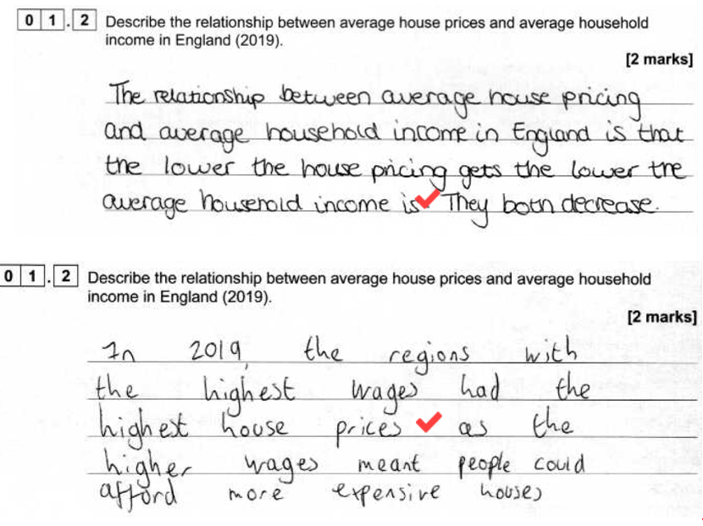
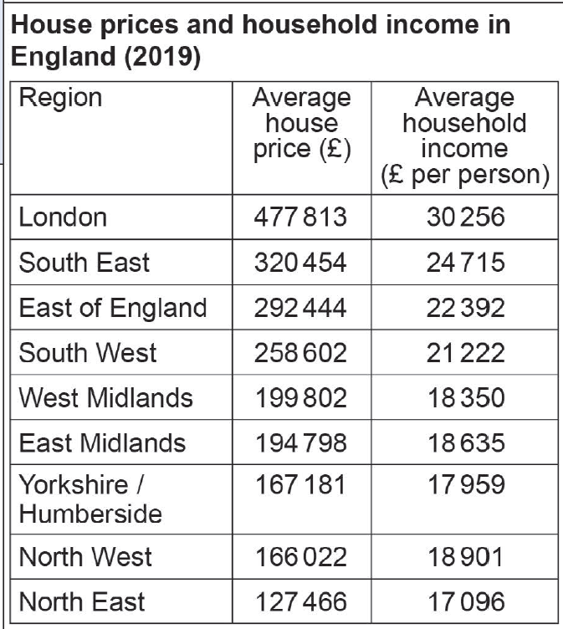
Paper 3
"Students seem to struggle with 2–3-mark questions. To use evidence or develop a point or idea (01.2; 04.4; 05.2 and 05.3)"
Two-mark questions can target AO2, AO3 or AO4. If the question is targeting AO4 it will generally be asking a question which involves using data as evidence, an example of this is question 01.2 which is really asking students to consider a numerical relationship. Data within the resource booklet which expresses or challenges a relationship lends itself to this type of question. The two examples below express an understanding of the relationship, but they don’t support their observation with the use of evidence. Scoring 1 mark.

Slide 30
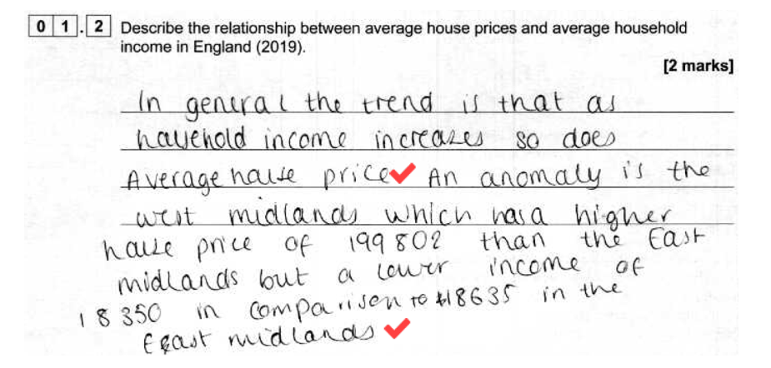
Paper 3
"Students seem to struggle with 2–3-mark questions. To use evidence or develop a point or idea (01.2; 04.4; 05.2 and 05.3)"
This answer develops the point to consider that the relationship was not always straightforward. Identifying anomalies and considering how the differences in house prices and incomes varies across the country and overtime. 2 marks

Slide 31
Key take away messages
When it comes to formation of physical landforms, ensuring that students sequence their response appropriately and demonstrate good understanding of the role of processes will move them into level 2 and level 3.
It’s important that students can decode the question in front of them and respond to the specific ask. Where there is no figure to refer to, students demonstrate the AO3 through strong judgements supported by evidence (AO1 & AO2).
Even if not required, students are credited for referring to appropriate case study information to support those judgements.
A number of marks can quickly accumulate where students miss out when not developing points. It’s important to focus on turning those basic points into developed points.

Slide 32
Paper 2

Slide 33
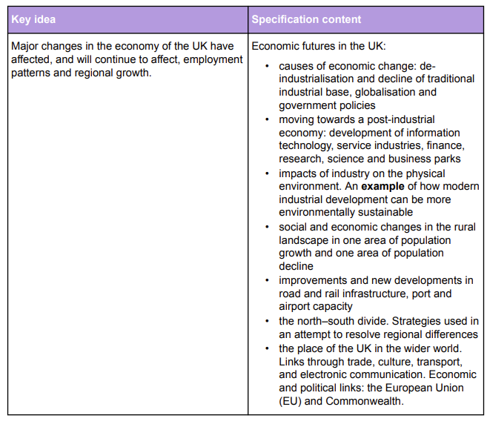
UK case study
Consider how much of this part of the topic can be applied to your local geographic setting.

Slide 34
Useful websites to find local examples
Key projects - Network Rail,
National Highways - Delivery Plan 2020-2025,
UK airport expansions - Aviation Environment Federation,
The British Ports Association,
Department for Business and Trade - GOV.UK,
Statistics on UK-EU trade - House of Commons Library,
Enterprise Zones - GOV.UK

Slide 35
UK case study
Don’t over think/teach the final bullet point about the place of the UK in the wider world.
Notes:
Essentially, students should understand that the UK still has economic and political links to the EU, particularly through trade and tourism. They can acknowledge that we have seen changes now that the UK has withdrawn membership and is establishing new trade links elsewhere. To see how this would translate into an exam question, I would advise looking at the 2022 Paper 2, question 02.5.
Suggest how changing economic and political links may affect the UK’s place in the wider world.
Use Figure 7 and your own understanding.
“Does leaving the EU mean
taking back control of our
money, laws and borders?”

Slide 36
Questions

Slide 37
Submitted Questions
Why have AQA taken the AOs off the marked scripts? It makes it really difficult to tell why / how the marker decided on marks e.g what are they considering to be AO2 or AO3.
Might a revised specification include less in the unit Changing Economic World as it does seem bloated and demoralising for the pupils with too much that haven't happened or has changed, such as government policies to reduce the north-south divide.
We carefully prepare pupils to evaluate on the 9-markers, but the 9-marker at the end of Paper 1, Section A, Question 1 in 2023 was an explanation of how volcanic hazards form at plate boundaries. What was the reasoning behind this?

Slide 38
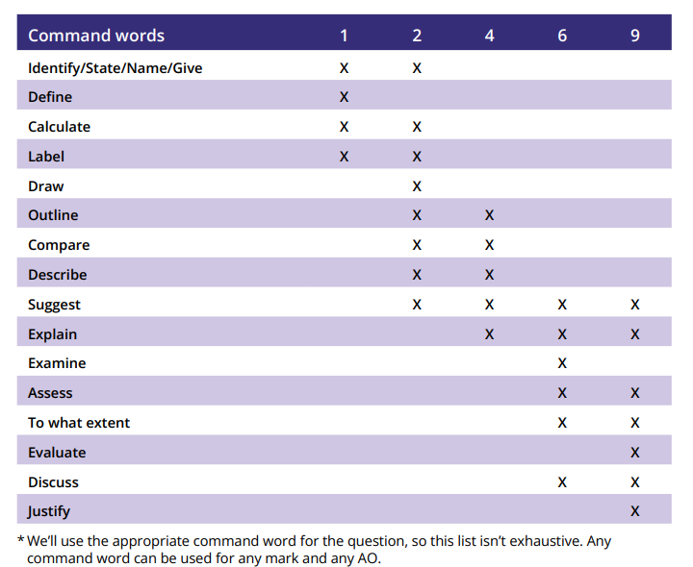
Command words: get to grips with command words

Slide 39
Further support

Slide 40
Free upcoming support available to you
GCSE Geography: Stretching grade 3 to 4
This AQA training course will focus on improving your student's confidence in attempting all question types. We will look at how students can successfully move through the levels by examining example responses at level 1 and level 2.
GCSE Geography: Working towards outstanding grades
This AQA training course will focus on how your students can maximise marks across a range of question types. We will explore example responses at the highest level and highlight key skills for success when working with more able students.

Slide 41
Reminder of recently published and upcoming resources to support you
Supporting Grades 1-3
This resource was created by a teacher of our specification with tangible ideas that can be used in the classroom to support engagement of students aiming for grades 1-3.
LIC/NEE student and teacher booklets
This resources exemplifies through Nigeria how to engage students in this area of the specification. There is a student workbook that is accompanied by a teacher workbook to explain the rationale behind the decisions for each activity and context.
Teacher booklet
Student booklet
Climate Change Student booklet and Teacher guide
The workbooks are a teaching and learning tool to engage students in the study of climate change as part of the GCSE Geography content and has been created in partnership with the Royal Meteorological Society.
The guide features suggestions for how to incorporate climate change into other areas of the specification with reading that will support you.
Teacher booklet
Student booklet
Teacher Guide

Slide 42
Exampro
We've worked with Exampro to devise a series of assessments that focus on specific areas for improvement
If you are an Exampro user, take a look at these new resources to support your teaching.

