Slide 1
Geog CPD Hampshire - Jan 25.
Ant Fleming
anthony.fleming@wjec.co.uk
David Jones
Davidr.jones@wjec.co.uk

Slide 2
Contents
How important it is to use case studies in the longer answers?
Use the mark scheme – 8 markers
Use the mark scheme – 12 markers.
Command Words
Support with Component 3, part A and B
Use of resources
Geog Shots – AO3
Geog shots – assess, to what extent, etc
Exemplar answers

Slide 3
Case Studies in 8 and 12 mark questions
For questions, where relevant, most good responses of 6 marks or more will have some “wider geographical knowledge” included.
This could be in the form of:
This is like __________ where they did this, this and this
A similar scheme is _________________________
In class we learn about _________________________
It doesn’t have to be a massive amount. It has to be relevant, named, referred to and not implied.
For example – next slide please..

Slide 4
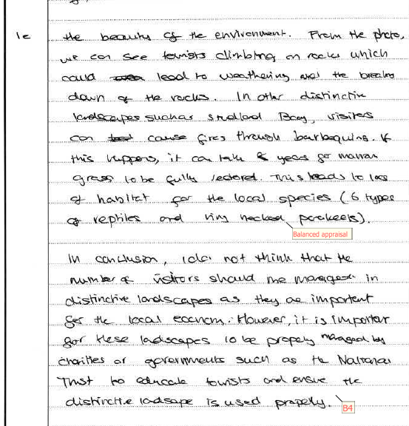
Case Studies in 8 and 12 mark questions
Spec A Comp 1
Q1e
8/8

Slide 5
Use the mark scheme
Understanding of the mark scheme is vital if students are to be clear about what is expected in a good answer. A method could be to simplify it like the example below.
Band | Mark | Band descriptor | Student mark scheme
4 | 7-8 | Exceptional application of knowledge and understanding. Comprehensive chain(s) of reasoning provide sophisticated response. Balanced and coherent appraisal draws together wider understanding of both advantages and disadvantages. Clear evidence of analysis. Clear indication of a detailed level of agreement/disagreement with the statement. | A clear decision is made and fully justified Balance is throughout the answer Own knowledge is clear and well used Chains of reasoning are detailed and fully expanded.
3 | 5-6 | Thorough application of knowledge and understanding. Relevant chain(s) of reasoning provide detailed/elaborated analysis Wider geographical understanding of both advantages and disadvantages but may not be balanced. Evidence of analysis There is a discussion of a level of agreement/disagreement with the statement. | Balanced is obvious A reasoned decision has been made Links to your own knowledge is clear Chains of reasoning start to appear Analysis of the issue
2 | 3-4 | Sound application of knowledge and understanding. Some connections provide valid but limited analysis Limited appraisal from wider geographical understanding to support points May refer to just advantages or disadvantages May be little evidence of agreement/disagreement. with statement | Some valid links made between the resource and the content Both sides of the issue briefly mentioned or inferred No real decision made
1 | 1-2 | Some basic application of knowledge and understanding. Limited and weak appraisal of the arguments May be generic with little evidence of analysis | A few comments linked to the content A basic understanding of the question Copies from the resource box
 | 0 | Award zero marks if answer is incorrect or wholly irrelevant.

Slide 6
Use the mark scheme
Understanding of the mark scheme is vital if students are to be clear about what is expected in a good answer. A method could be to simplify it like the example below.
Band | Mark | Descriptor | Student mark scheme
4 | 10-12 | The candidate writes a comprehensive response that: provides comprehensive analysis (argument/counterargument, differing reasons/viewpoints) addressing sustainability concepts. may use a range of evidence in the Resource Folder and/or exam paper. reaches a conclusion / decision that fully justifies why the agreement or disagreement has been reached. addresses positive(s) and negative(s)/alternatives(s) in a balanced way. applies wider geographical knowledge and understanding to effectively substantiate chain(s) of reasoning. | All reasons are explained and backed up by opinions, resources or wider geographical understanding Resources are used from the resource folder to back up the decision made / conclusion Wider geographical understanding is obvious Detailed chains of reasoning are obvious Specific positives and negatives are balanced.
3 | 7-9 | The candidate writes a detailed response that: provides detailed analysis (reasons with elaboration and linkages/connections between reasons, breadth & depth) which addresses sustainability concept. may be supported by some evidence in the Resource Folder and/or exam paper. reaches a decision that justifies in detail why the agreement or disagreement has been reached. addresses specific positive(s) and negative(s)/alternative(s). Does not have to be balanced. includes relevant chains of reasoning. applies wider geographical knowledge and understanding to support reasoning. | All reasons are explained and link ed to resources or wider geographical understanding Resources are used from the resources folder to back up views Decision is made which is backed up Chains of reasoning are clear Specific positives and negatives are developed

Slide 7
Use the mark scheme
Understanding of the mark scheme is vital if students are to be clear about what is expected in a good answer. A method could be to simplify it like the example below.
Band | Mark | Descriptor | Student mark scheme
2 | 4-6 | The candidate writes a response that: provides basic analysis (elaborated reasons) with some link to the concept of sustainability. may be supported by occasional evidence in the Resource Folder and/or exam paper. reaches a decision about why the agreement or disagreement has been reached addresses general positive(s) or negative(s)/alternative(s) states some limited geographical knowledge/understanding. | Some reasons are explained Links are made to the issue Resources are used to back up an opinion Some outside knowledge may be used Basic decision made
1 | 1-3 | The candidate writes a basic response that: provides a simple but unsubstantiated decision. uses / quotes mostly accurate information from the resource folder. Simple statements. | Simple conclusion mentioned but not developed Copies from the resource booklet Few statements made with no explanation or evidence
 | 0 | Award 0 marks if the answer is incorrect or wholly irrelevant.

Slide 8
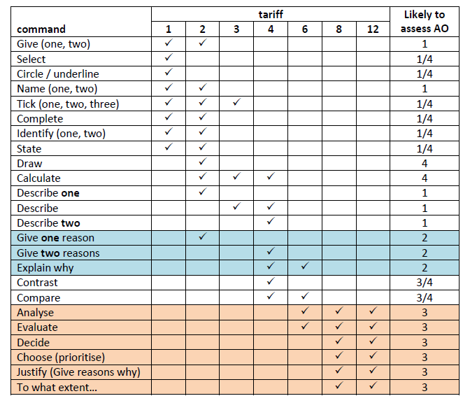
Command words and what they mean
Understanding what command words are likely to be used and what they mean.

Slide 9
Structures – lots of different ways to approach the answer
https://www.eduqas.co.uk/media/cjhnn0jy/geogshots-ao3.pptx

Slide 10
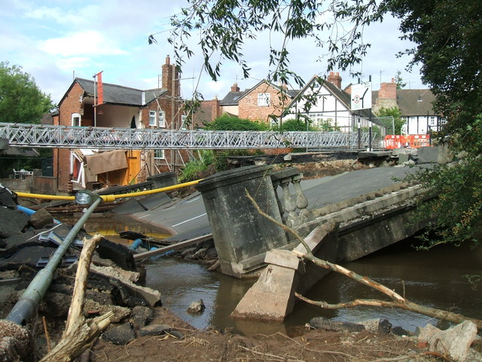
Using the resources

Slide 11
Using the resources

Slide 12
Exemplar responses

Slide 13
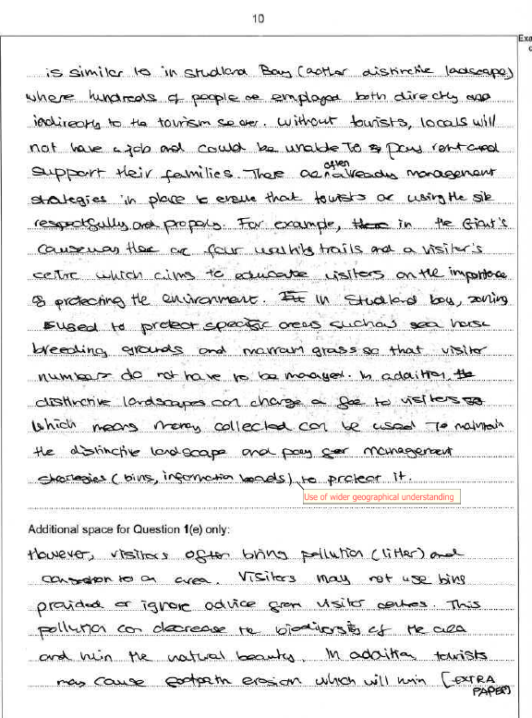
Spec A Comp 1
Q1e
8/8

Slide 15
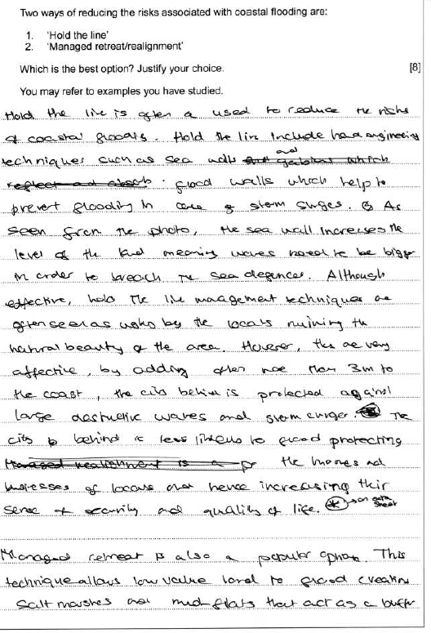
Spec A Comp 1
Q4c
8/8

Slide 16
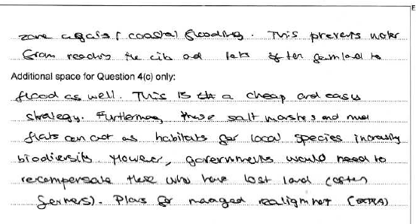
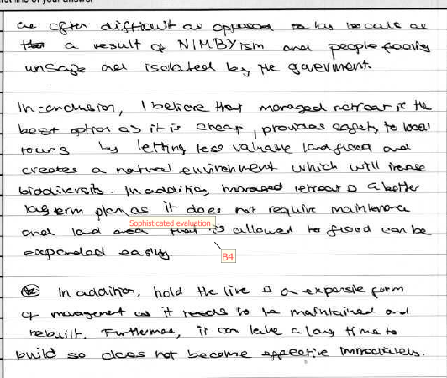

Slide 17
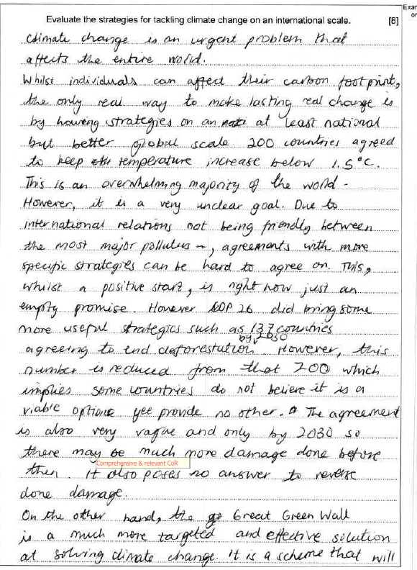
Spec A Comp 2
Q4b
8/8

Slide 18
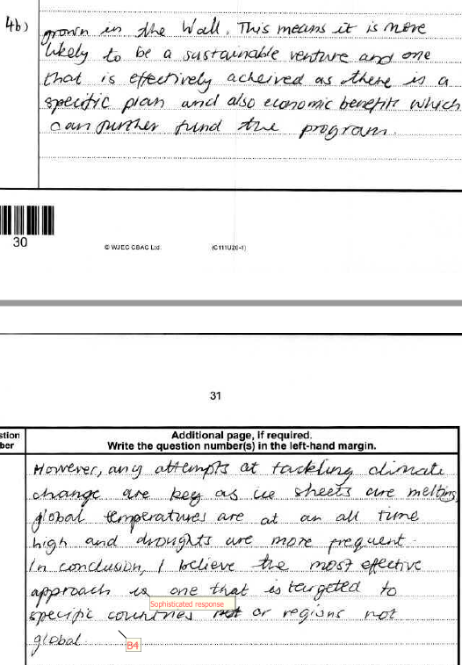
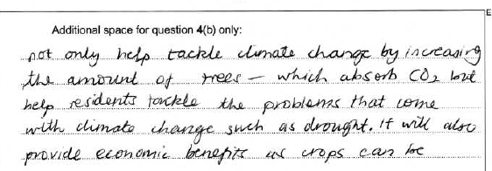

Slide 19
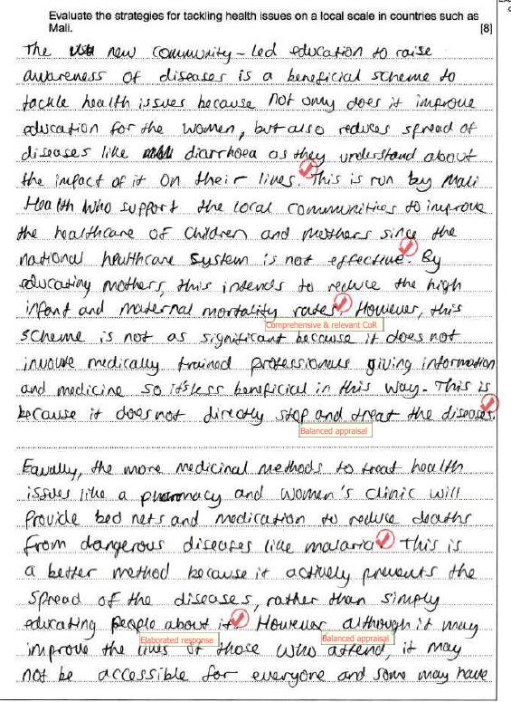
Spec A Comp 2
Q3b
8/8

Slide 20
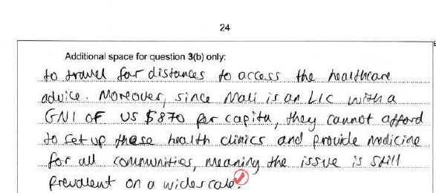
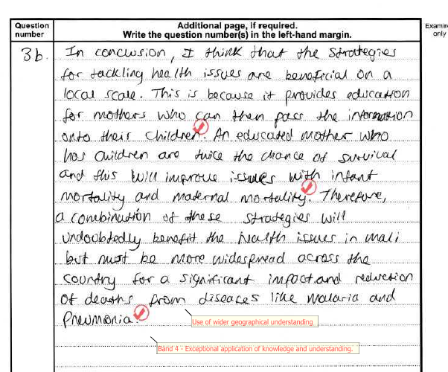

Slide 21
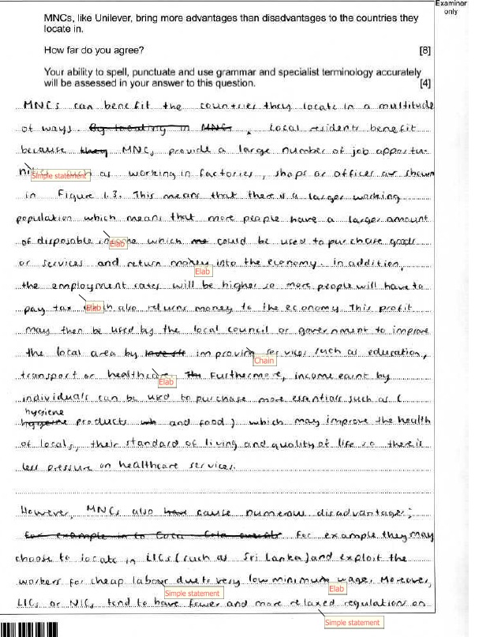
Spec B Comp 1
Q1d
8/8

Slide 22
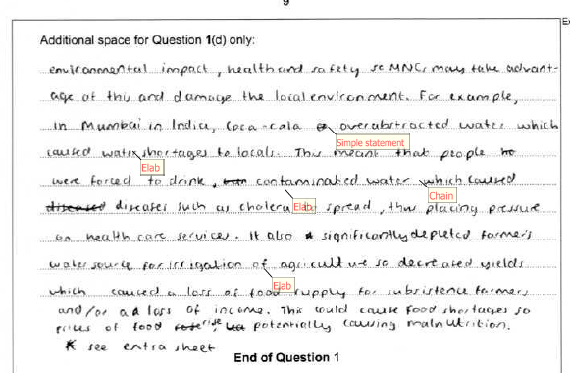
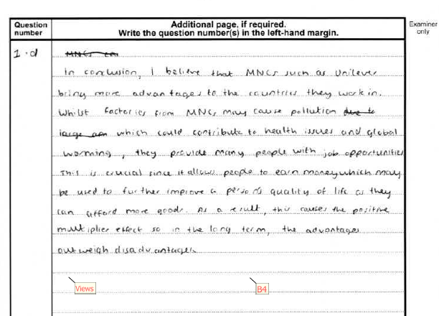

Slide 23
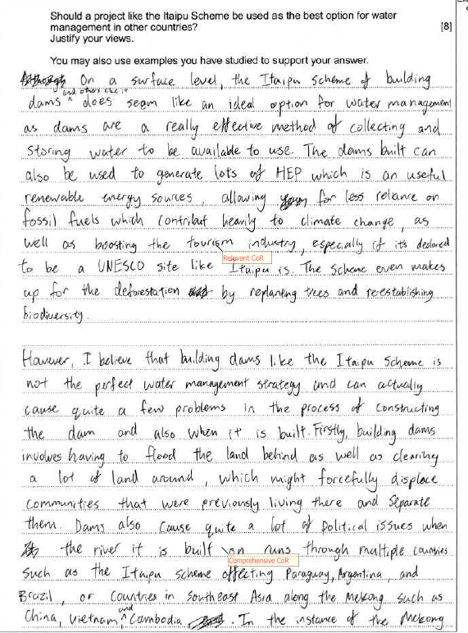
Spec B Comp 1
Q3d
8/8

Slide 24
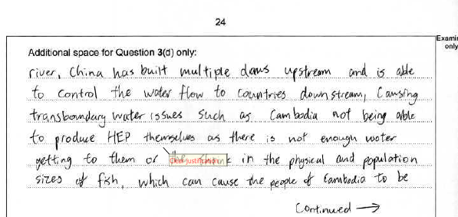

Slide 25
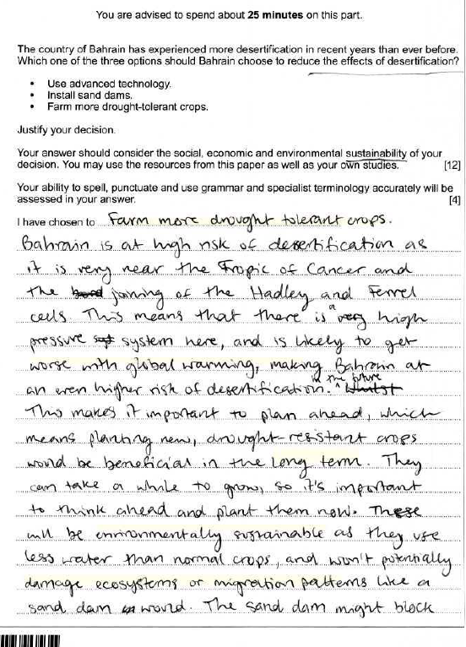
Spec B - Comp 2
Part C (12 marks)
12/12, 4 SPAG

Slide 26
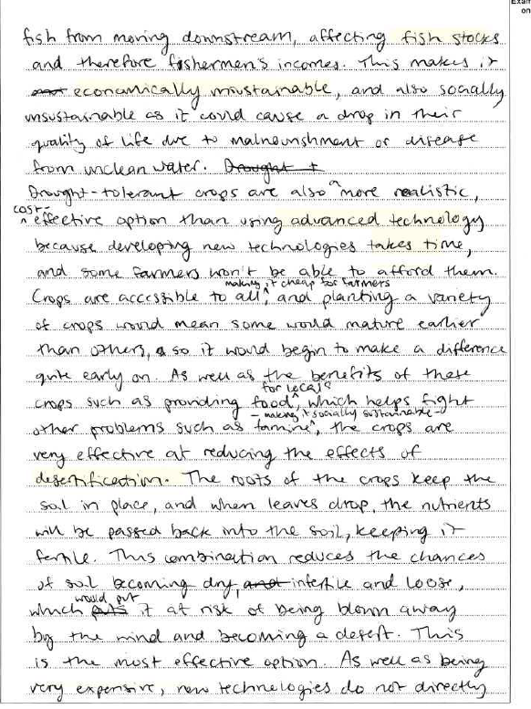
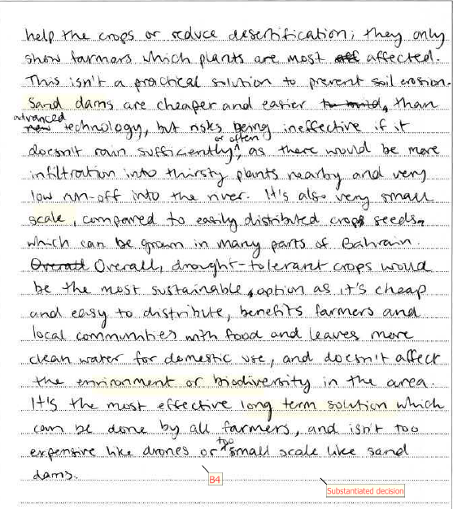

Slide 27
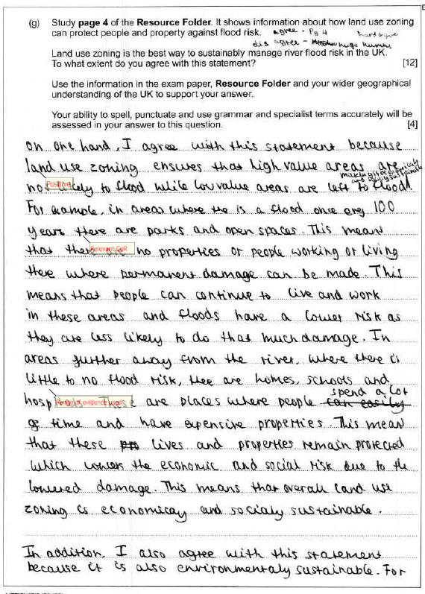
Comp 3
Part C (12 marks)
12/12, 4 SPAG

Slide 28
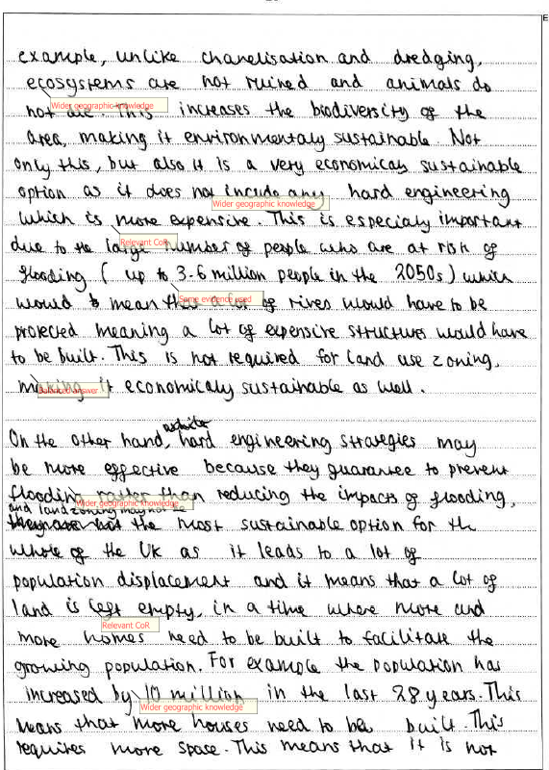
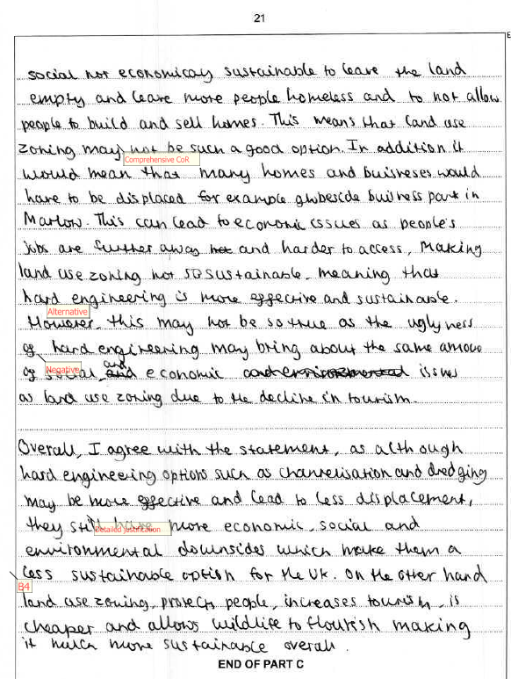

Slide 29
Any questions?

